Slide 1
ELMS-Canvas use at UMD
Accessibility implications of personal technology bans in the classroom
Megan Masters, PhD, Alia Lancaster, PhD, Ana Palla-Kane, PhD
November 5, 2019

Slide 2
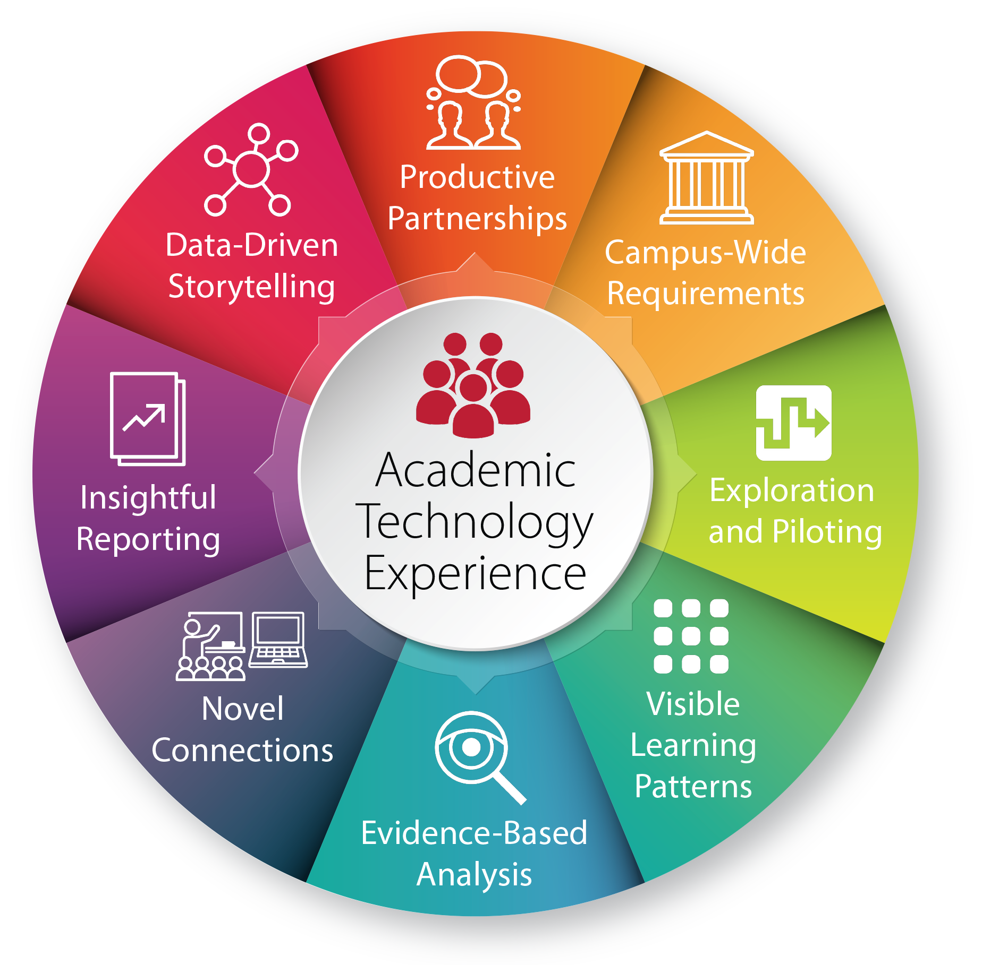
Notes:
Today’s talk is in the area of novel connections and data-driven storytelling and insightful reporting.
Who has ever started a project to do X and end up doing Y? Tableau story. We’ve often found that in our reporting, triangulating multiple data sources can help us uncover the experience of different campus populations.

Slide 3
Three Main Take-Aways
Triangulating multiple data sources can help uncover the experience of different campus populations.
Personal technology bans, which appear to be pervasive in classrooms, often have disproportional implications for students with disabilities.
There are strategies to make this issue less black and white but instead the beginning of a conversation about responsible technology use and classroom climate.

Slide 4
Focus of today’s conversation
Show how triangulating multiple data sources can help uncover the experience of different campus populations
Share data related to personal technology bans
Point to accessibility implications of personal technology bans in the classroom
Explore strategies to make this issue less black and white and the beginning of a conversation about responsible technology use and classroom climate

Slide 5
Main Data Sources
ELMS-Canvas System Data
Surveys
UMD-Specific Student and Instructor Surveys (Summer 2018)
Demographic Information
Academic Technology: ELMS-Canvas
WiFi for Teaching
Classroom Technology
Classroom Spaces (including TERP classrooms)
Nationally-administered survey results
EDUCAUSE Center for Analysis and Research (ECAR)
Anecdotes and/or Qualitative Feedback
Peer-Reviewed Research Studies
ELMS = Enterprise Learning Management System
Notes:
Interested in student and faculty perceptions of technology (including classroom technology)
Part of a longer story on teaching and learning experiences at UMD
Presenting 2/5 sections (other sections: academic technology and wifi for teaching
Sneak peak before final report, just finished analyzing. If you have follow-up analyses ideas or questions, love to hear about it/get in touch
Future plans: survey instructors like this every other year. Students via ECAR every year

Slide 6
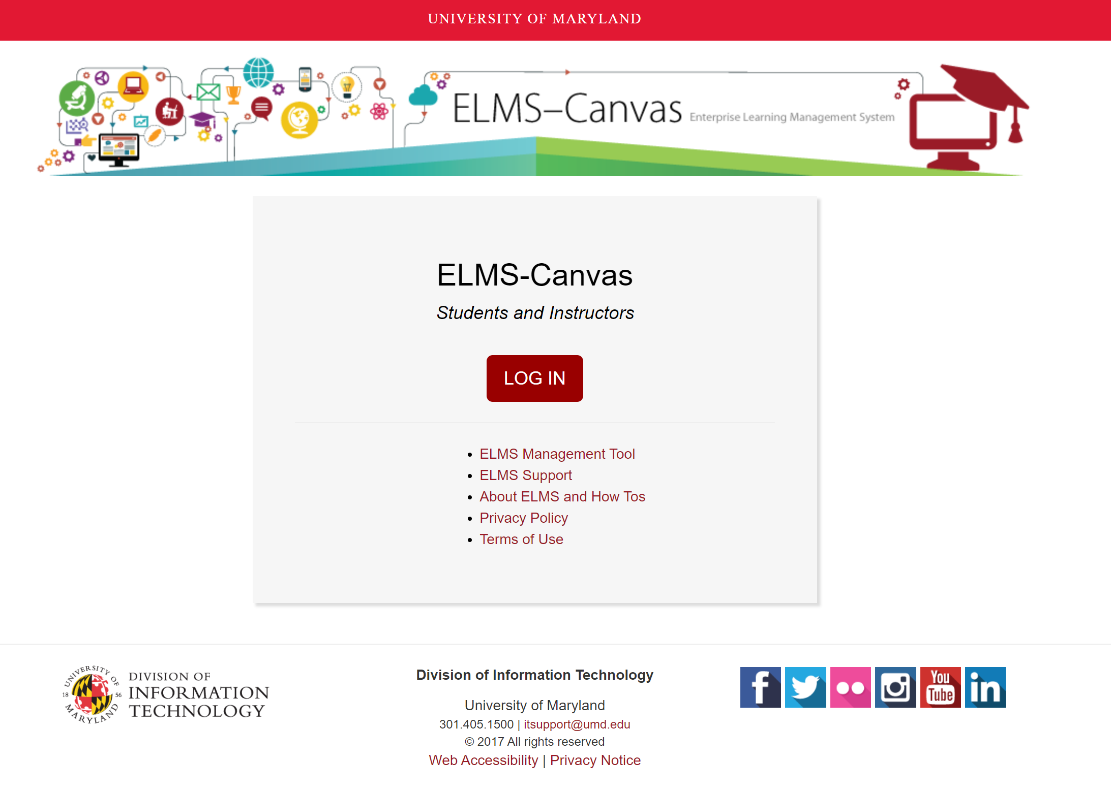
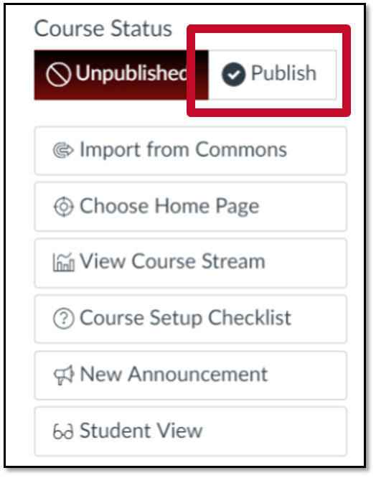
ELMS-Canvas usage
Notes:
Who uses Canvas as their Enterprise Learning Management system (ELMS)?
Can be a common course space online for instructors and students
Each semester a space automatically generated within our ELMS-Canvas instance (with exception of some types of sections, like independent study)
Instructor can publish a space = ACCESS available to students
Available since Fall 2012. Many teams within DIT piloted, implemented, and maintain

Slide 7
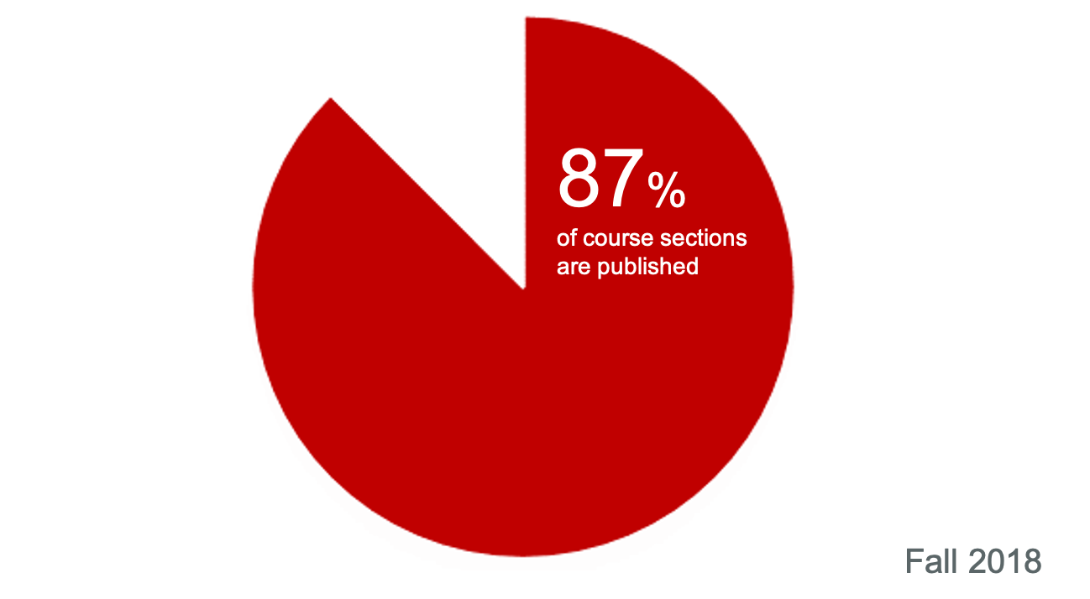
ELMS-Canvas usage
Notes:
This 87% represents 7,249 published course sections
The remaining 13 % represents 1,034 unpublished course sections
We don’t know what instructors are doing within those ELMS-Canvas spaces? Are they posting the syllabus, are all assignments submitted online?
Here is where we can pull in another dataset to triangulate information or provide some context

Slide 8
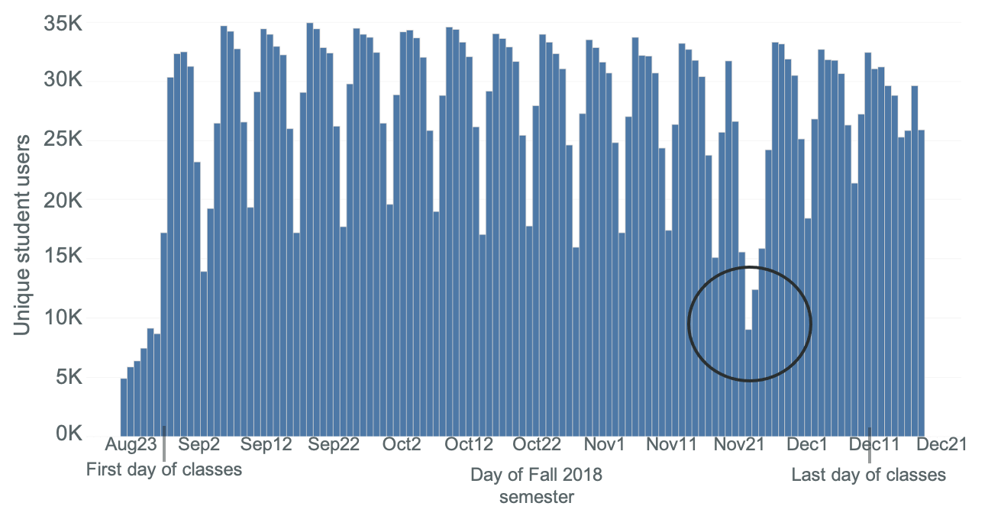
ELMS-Canvas usage
28,129 unique students used ELMS-Canvas on average every day during Fall 2018
Notes:
Average is for period Aug 27 – December 10
This number is JUST students and JUST activity related to a Fall 2018 course
28,129 / 41,200 = 68% of all students
Peak use was 34,924 on September 17, 2018. (85% of all students)
Thanksgiving is a good check – we would expect there to be fewer users
Averages per day
Sunday 26,444
Monday 31,245
Tuesday 30,942
Wednesday 30,036
Thursday 28,640
Friday 23,834
Saturday 17,474
Pervasive learning technology that DIT supports that touches 65% of on a daily basis. And that’s just 1 tool that DIT provides, not to mention the other services.
First day of classes: Jan 25, last day: May 11

Slide 9
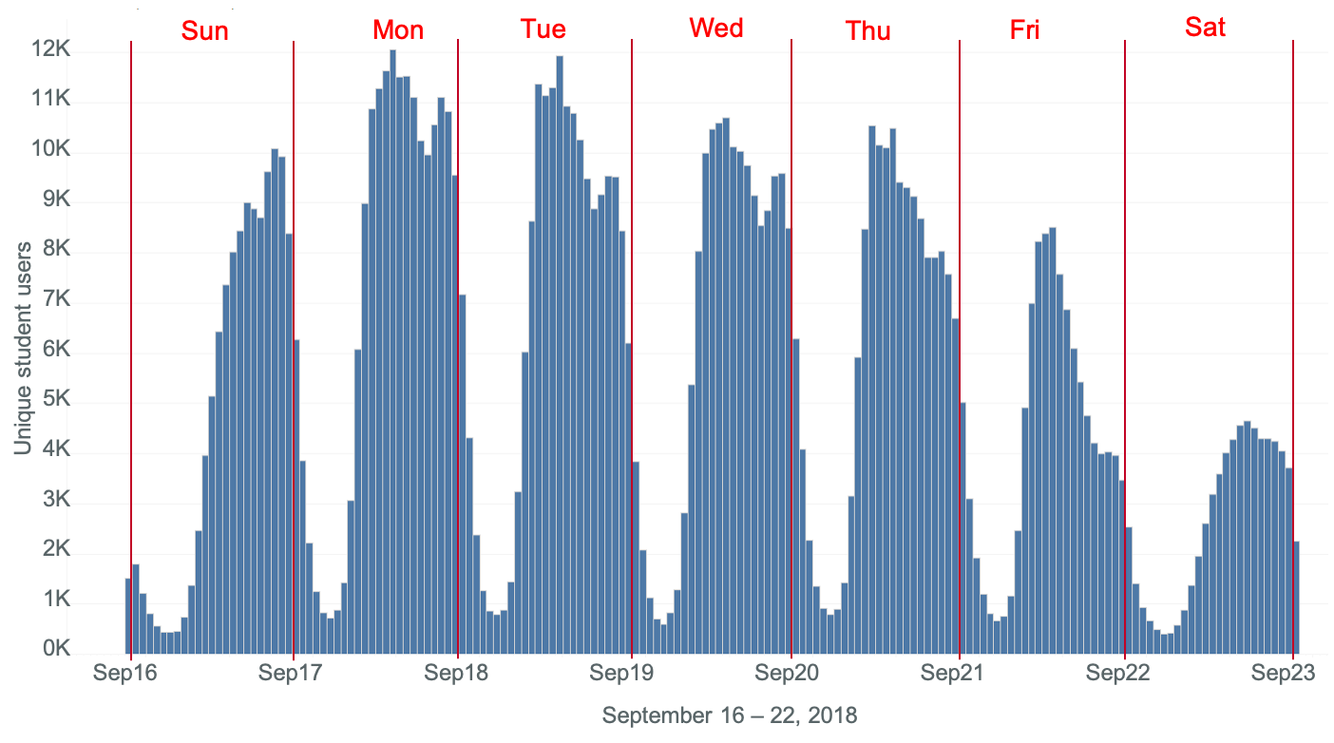
ELMS-Canvas usage
Notes:
This chart is the number of unique student users per hour for a week in Fall 2018
September 16 (Sunday) midnight – 1:00 AM through September 22 (Saturday) 11:00 PM – midnight
Most days, usage tends to peak at 2:00 PM, with a secondary uptick around 9:00 PM
Lowest usage is around 5:00 AM in the morning
The largest number of hourly users here was around 2:00 PM on Monday, September 17 (12,050 users)
Because of the difficulty in unambiguously disambiguating human activity from system activity in the log table, this chart is best for understanding general trends rather than obsessing on exact numbers

Slide 10
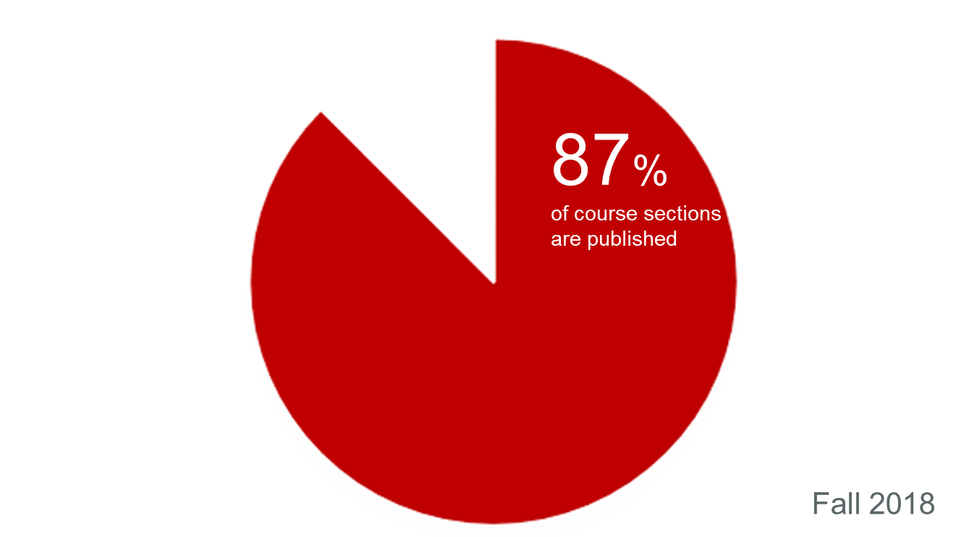
Combining Data Sources
60% of UMD students wish their instructor used ELMS-Canvas more.¹
¹UMD Student EDUCAUSE Survey, 2017
Notes:
In Spring 2017, 70% of course sections published, meaning available to students, on ELMS-Canvas (that’s 6,882 course sections). For 4,000 course sections, students have to go elsewhere
Harder to navigate for others (where is my syllabus)
From the 2017 Educause survey of studentsNeither datasets are perfect. Canvas data have to pull data from multiple tables, not transparent. Survey data is self-report.
Can start to develop inferences – sections are being published but students still want more, which could mean more sections published or more use with those already published
One way to contextualize is by triangulating data sources. Another is to examine trends over time.

Slide 11
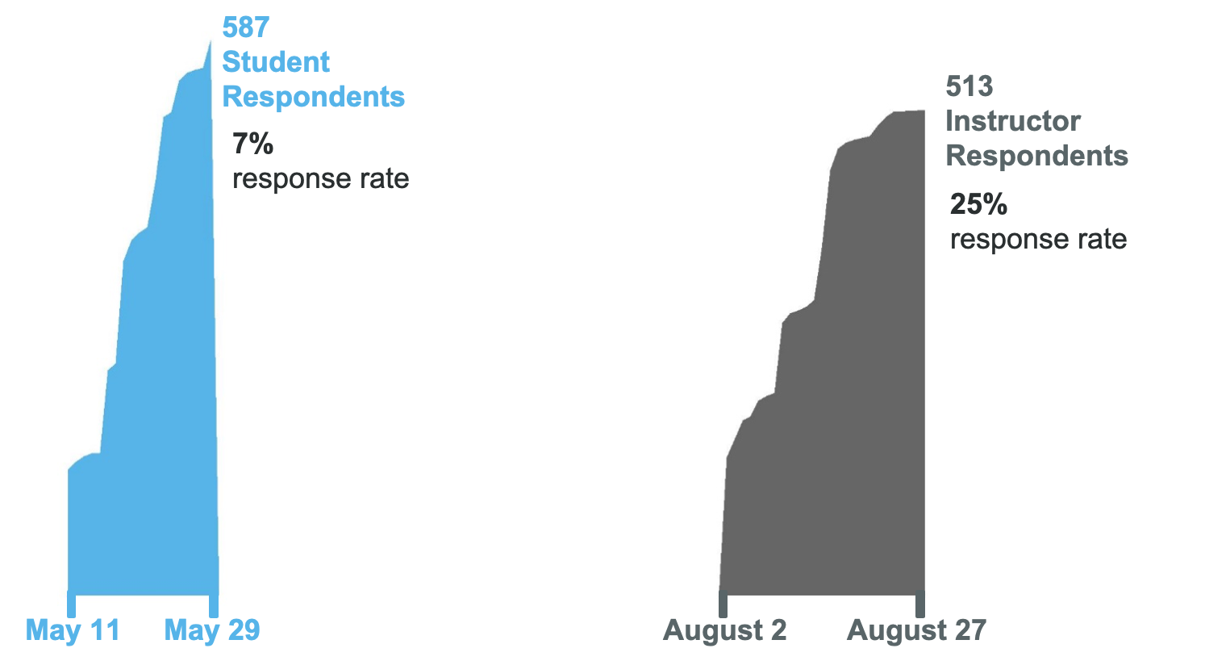
2018 UMD Surveys
Notes:
Instructor response rate = 25%, student = 7%
Students survey was shorter, but we were able to ask some of the same questions to both groups, which I’ll present today. (also some questions not as relevant for students, e.g., ease of use of classroom technology features which they don’t use as much as instructors)
Instructor info:
Population: Instructors of record during 2017-2018 academic year, meaning respondents could be faculty, staff, or graduate students. 2041 email addresses obtained from UMD Registrar’s office. Two bounce backs on initial email invitation, for a total of 2039 possible respondents.
Respondents: 513 instructors responded, resulting in a 25% response rate.
Completion rate: Of the respondents, 457 (89%) fully completed the survey. In the subsequent analysis, all responses are included, thus the n-size per question may vary but is displayed in the lower, left corner of each figure.
Duration: The median response time was 18 minutes.
Student info:
8,000 students were randomly selected to represent approximately one quarter (26.7%) of the undergraduate student enrollments during the 2017-2018 academic year.
Each class designation (e.g., freshmen, sophomore) was equally represented.
resulting in a 7% response rate.
Three-hundred and ninety-eight students (68%) fully completed the survey, and
the median response time was 7 minutes.

Slide 12
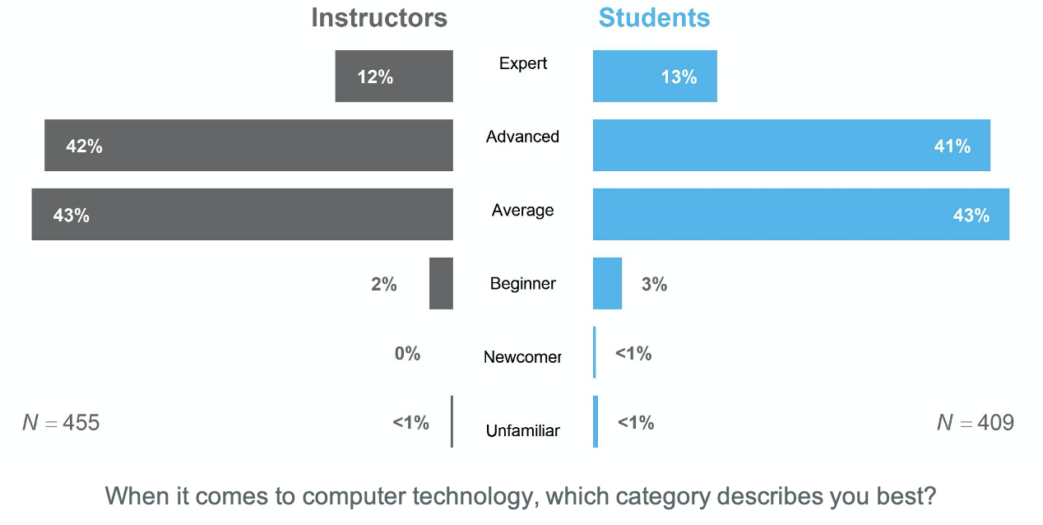
Digital literacy
Instructors and students reported similar rates of digital literacy.
Notes:
When it comes to digital literacy, instructors and students rated themselves similarly. Granted this is self-report, so categories may be something slightly different to different groups, but I think both groups have assumptions about the other on this topic.
Digital natives can easily pick up on technology – not necessarily the case
Entire Scale:
Unfamiliar – I have little to no experience with computer technologies
Newcomer – I have attempted to use computer technologies, but I still require help on a regular basis
Beginner – I am able to perform basic functions in a limited number of computer applications
average (i.e, “I demonstrate a general competency in a number of computer applications”)
advanced (i.e., “I have acquired the ability to completely use a broad spectrum of computer technologies”)
Expert – I am extremely proficient in using a wide variety of computer technologies

Slide 13
ELMS-Canvas
Over 90% of students
Prefer all their courses to be available in ELMS-Canvas
Find it easier to learn when all their courses are published in ELMS-Canvas
Notes:
Agreed or strongly agreed to these statements

Slide 14
Comments
“I've read research that shows students learn more without laptops or smartphones - but I occasionally assign group work or activities that require laptops/phones/tablets so it would be quite hypocritical for me to prohibit them only sometimes.” (Instructor)
“Laptops are prohibited during lecture (but allowed for discussions). Research backs up this choice. [. . . ]” (Instructor)
“I have read the research on why hand writing is better. I get it. I agree. But now I can hand write my notes on my iPad so I can digitally store them - and that is not being allowed. I find this to be a hindrance. So maybe add a caveat that hand writing on digital devices is acceptable.” (Student)
“I occasionally allow them to use devices for certain activities, but otherwise the no-device policy can make sure no one is distracted…I learned from a TLTC workshop that there is research proving this.” (Instructor)

Slide 15
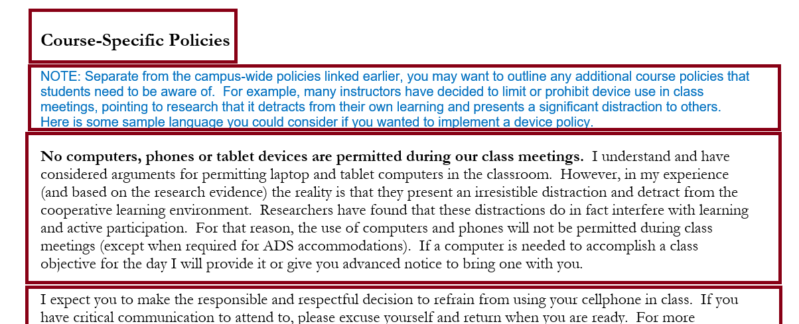
To Teach or Not To Teach…With Technology

Slide 16
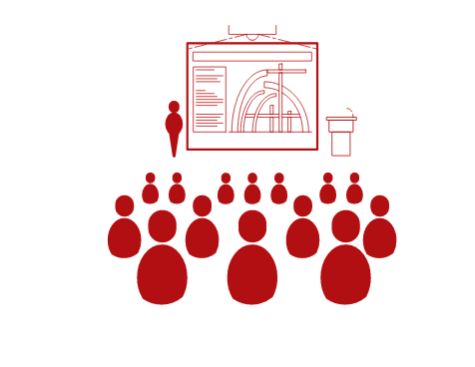
Research
* denote controlled, classroom-based studies
Notes:
Mueller and Oppenheimer, 2014: taking hand-written notes led to better recall on content-application of ted talks than taking notes on a laptop. No difference in factual recall, so benefits in higher-order thinking in Bloom’s taxonomy
Hembrooke & Gay, 2003: multitasking via internet browsing recalled less lecture content

Slide 17
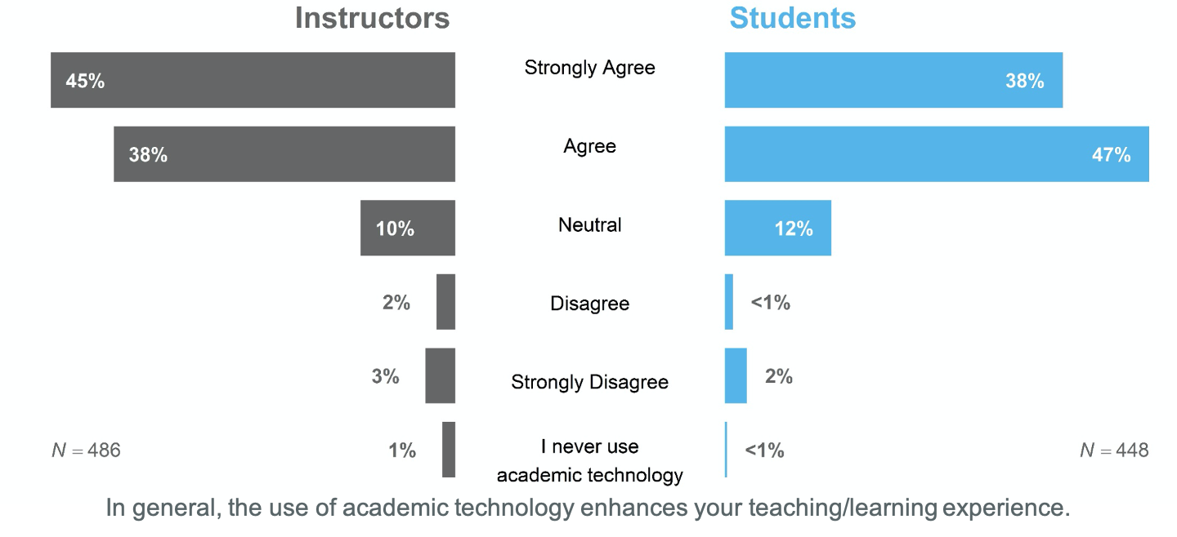
Academic Technology
A majority of instructors and students agree that academic technology enhances their teaching or learning experience

Slide 18
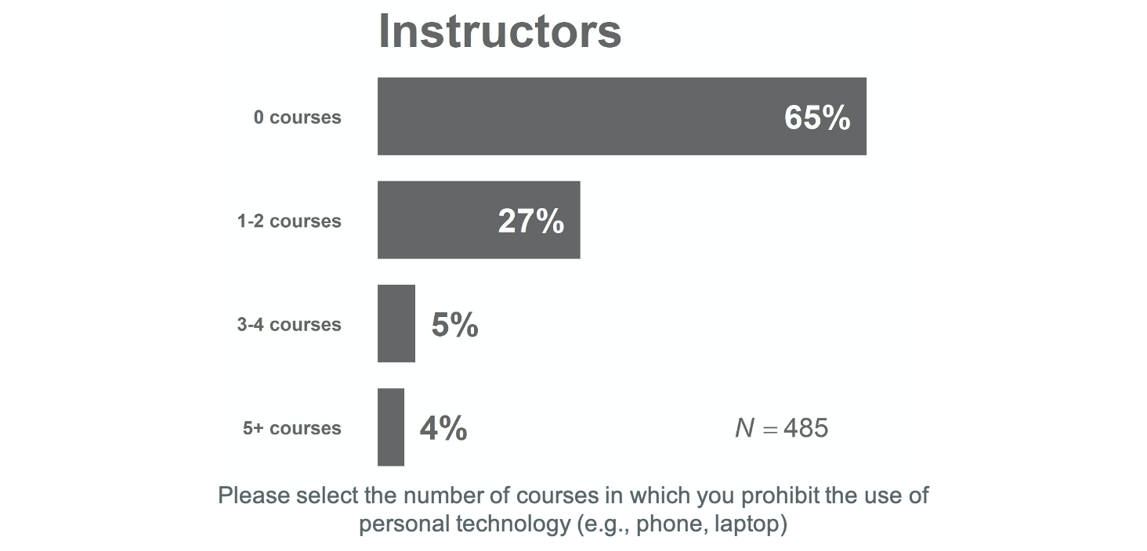
Personal Technology Ban
Approximately a quarter of instructors report banning personal technology in 1-2 courses

Slide 19
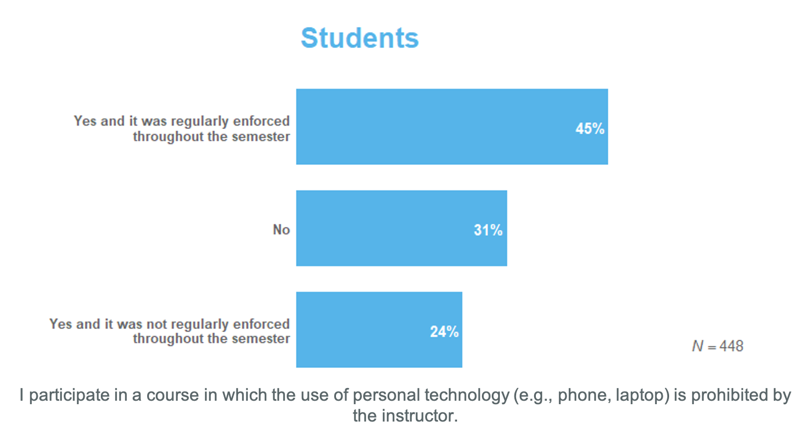
Personal Technology Ban
Almost 70% of students reported that personal technology, such as a phone or laptop, was prohibited in one of their courses in the past academic year

Slide 20
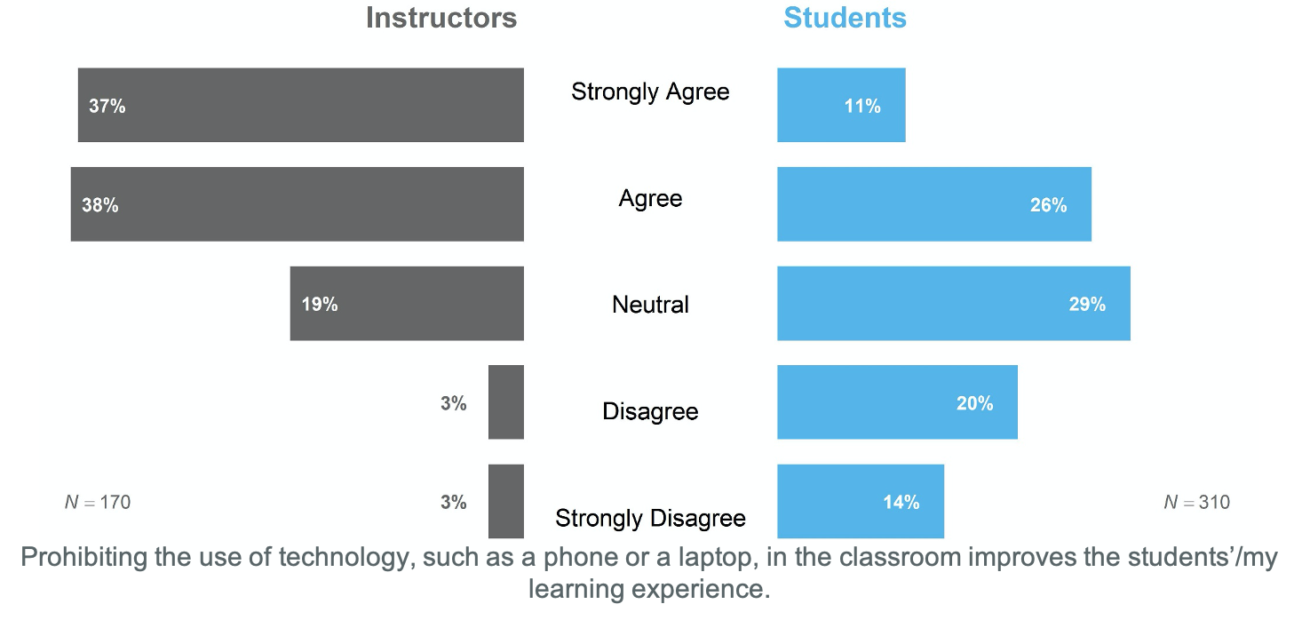
Personal Technology Ban
Among instructors and student who HAD imposed/experienced a personal technology ban in the classroom, instructors reported that it enhanced student learning to a larger degree than students.
Notes:
75% SA or A instructors
37% SA or A students, 35% D or SD

Slide 21
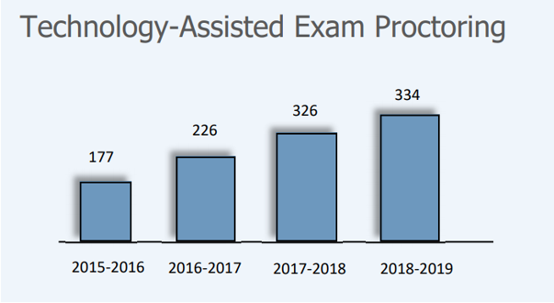
Accessibility implications of personal technology bans in the classroom
1. Growing number of students with disabilities
At UMD 7.07% (N=2177) of 30,762 of UMD UG students reported having a disability²
Large growth of students with disabilities using assistive technology during exams
²UMD Counseling Center Annual Report 2018-2019
Type of Disability | 2018-2019²
Psychological | 661
ADHD | 673
Learning Disability | 304
Medical | 207
Neurological | 89
Physical | 32
Deaf/Hard‐of‐Hearing | 29
Brain Injury | 29
Vision | 26
Other/Not indicated | 127
TOTAL | 2177
²U.S. Department of Education, National Center for Education Statistics, 2019
Notes:
19% of undergraduates in 2015-16 reported having a disability²
²Source: U.S. Department of Education, National Center for Education Statistics. (2019). Digest of Education Statistics, 2017

Slide 22
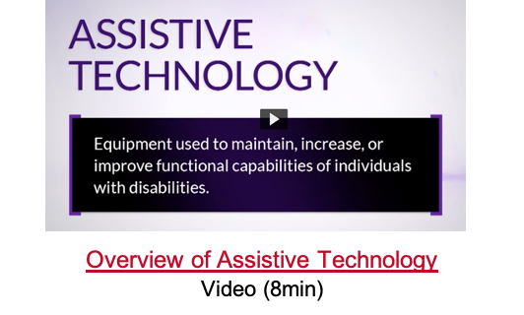
Accessibility implications of personal technology bans in the classroom
2. May violate students’ rights to use their accommodation
Course policy banning technology conflicts with students with disabilities’ rights to use their academic accommodation
Students who don’t want to disclose their disability may not use their accommodation
Brings additional barrier to the accommodation process
Faculty lacks understanding of:
How to implement academic accommodations
How students with disabilities use technology to support learning and success
Use of laptop, iPad, smartphones to support learning
Use of adaptive/assistive technology
Screen readers, text to speech software, dictation software, note taking devices/Apps
Notes:
Course policy banning technology (use of laptop, recording device, other) conflicts with students with disabilities’ rights to their academic accommodation.
Faculty lacks of understanding of Academic Accommodations
Faculty lacks of understanding of how students with disabilities use technology
Taking notes
Adaptive/Assistive technology use during classroom
Show Video if we have time: https://kaltura.umd.edu/media/Assistive+Technology+at+Montgomery+College+2014/1_3o09mnbu

Slide 23
Comments about Technology Ban
“I have taught courses by both allowing and prohibiting personal technology. I find that students are more engaged when technology is prohibited. I do allow exceptions for DSS registered students and those who just feel they need to have technology. Surprisingly, I only get a handful of students who opt in to use technology.”
“I ban all electronics, except for students with special needs.”
“I do permit students whose first language is not English to use devices during class when they need to look up words or phrases that they may not understand or know how to say.”
“I have stopped short of banning technology, but I do share with them the research on technology in the classroom and strongly urge them all to take notes by hand instead of on their laptops or tablets. About 90% of them take notes by hand after that lecture, and the remaining 10% no doubt includes kids with disabilities who must use a laptop, so I don't feel like I need to take the extra step and ban them (for now).” (Instructor)
Notes:
When to use them, how to use them, and when to just put them away and take out a pencil
Independent of research and feelings associated with technology use, there is likely a disproportional impact of these types of bans on students with differing abilities
Well-intended idea with unintended consequences
Spring 2019 report released by the Health Center showed that the top three accessibility and disability services are:
Psychological
ADHD
Learning Disabilities
And, the existance of these types of needs are historically under-reported; the burden of working with a professor to disclose a disability is on the students’ shoulders…and it’s often the first time they’ve had to navigate this on their own…
Now, we’re potentially putting them in a position where their disability, either internal or external, will be made clearly visible to their peers?
While these conversations will likely be ongoing between adminstrators, students, faculty, and staff, I leave you with these words, which you’ll find on our wall in ESJ…
The idea being that our students start and end in all different places…and my opinion is that technology, through a wide-modality of different forms, from system data, to online surveys, to allowing them to connect to their instructional technology across campus…helps meet our campus community where they are at, with the promise of helping them get to where they want to go…whereever that may be.

Slide 24
Accessibility implications of personal technology bans in the classroom
3. Violation of Students’ Privacy
Faculty violates students’ privacy when they make exceptions ONLY for students with disabilities
Students with disabilities, specially those with hidden disabilities are exposed
Protect students’ with disabilities privacy by making exceptions available to everyone
"If you are a student who wishes to use a laptop, iPad, smartphone or any technology for note-taking or other reason, please come see me during office hours to discuss your rationale for this request.”
Impact on students’ experience of belonging and safety in the classroom

Slide 25
Final Comment about Technology Ban
"I don't disagree with the research that says "banning devices improves learning." They are probably right within the parameters of the the experiment.
If I want to get rid of devices, I need to re-format my classes to make them not worthy of use during class.
Otherwise, I am putting students who have the right to devices for class (note taking purposes, for example) at a disadvantage.
If I blanket ban devices...except for those that need them, then I am "outing" my students with disabilities. That is very bad.”
(Instructor)

Slide 26
Take-Aways
Reflect on your reason(s) for banning technology
Provide training to faculty on the purposeful integration of student technology for more inclusive, active, and engaged learning
Involve students in the development of their class's technology policy and designated seating for device users
Educate faculty and all students on the available adaptive technology services and how to request them
Work with teaching and learning centers and instructional designers to train faculty on the Universal Design for Learning framework to promote inclusive strategies that benefit all learners
Ensure that disability and accessibility are part of faculty and students orientations and training
Accessibility is part of everyone responsibility
Notes:
Students with disabilities already face barriers:
Stigma
Consider using Universal Design for Learning
Present content and information in multiple media and provide varied support
Give students plenty of options for expressing what they know and provide different models, feedback and supports for their different levels of proficiency.
and different modalities to for students to engage with course content and to express what they know and are learning
Reflect on the reason(s) for banning technology
What is my goal? What do I want my students to do, know and care about?
Faculty may choose to restrict the use of technology for an specific class activity.
Discuss course policies and procedures with fellow faculty and students
Ask yourself “what about accessibility?”
Does this policy violates the rights of my students with disabilities?
UDL resources http://www.cast.org

Slide 27
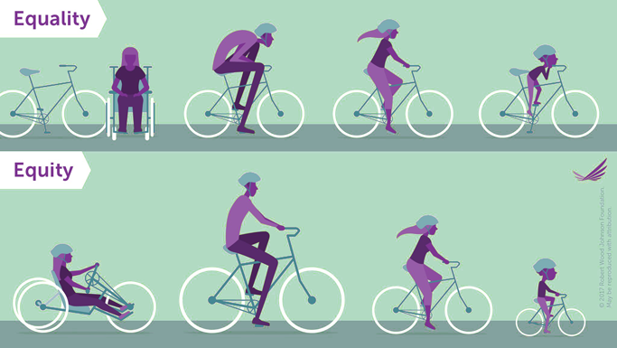
Ending thought
“Teachers are frequently unaware of the fact that they are providing more favorable conditions for learning for some students than they are for other students. Generally, they are under the impression that all students in their classes are given equality of opportunity for learning.”
- Benjamin S. Bloom (1984)
Notes:
Top image shows the concept of equity, when we give everyone the same equipment. Wheelchair user, tall man, reg woman and child using the same size of bike. It is not effective for most of them. Wheelchair user cannot participate and tall man and child ride the bike with difficulty.
Bottom image shows each individual using a bike customized to their size or ability. All are able to participate and ride the bike at their level of skill.

Slide 28
Discussion
How is personal technology in the classroom being considered at your home institution?
How can universal design principles create a more inclusive classroom climate with regard to personal technology use?

Slide 29
Megan Masters, PhD | Alia Lancaster, PhD | Ana Palla-Kane, PhD
acadtechfeedback@umd.edu

