Slide 1
Lessons Worth Keeping
Harnessing Lessons Learned Throughout the COVID-19 Pandemic
Innovations in Teaching & Learning Conference | May 11, 2022

Slide 2
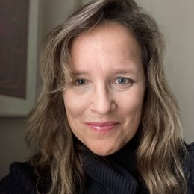
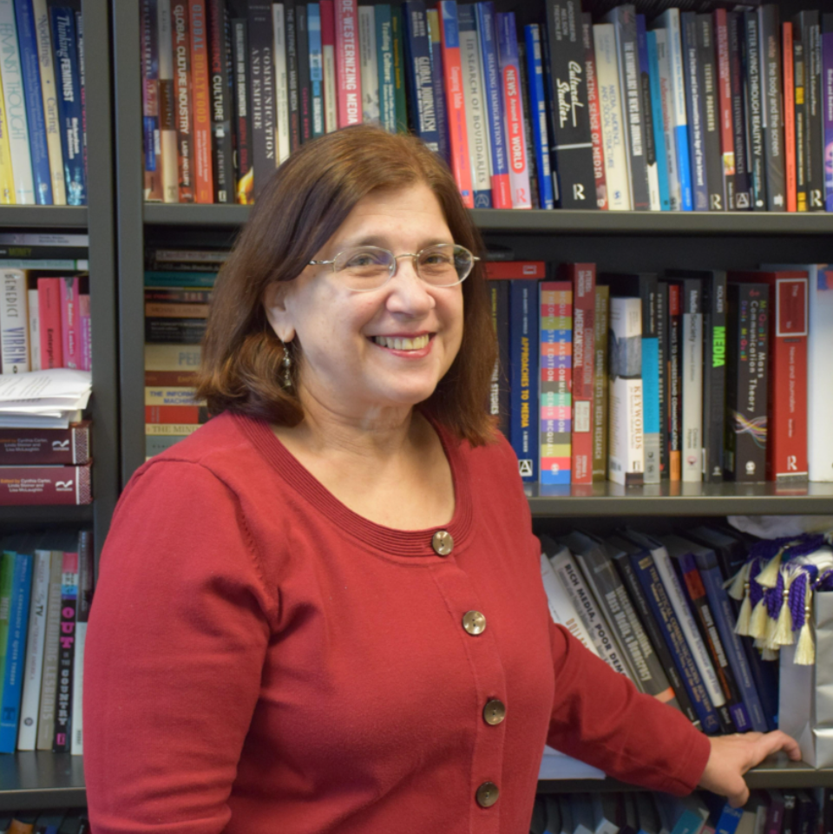
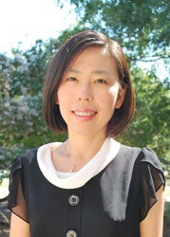
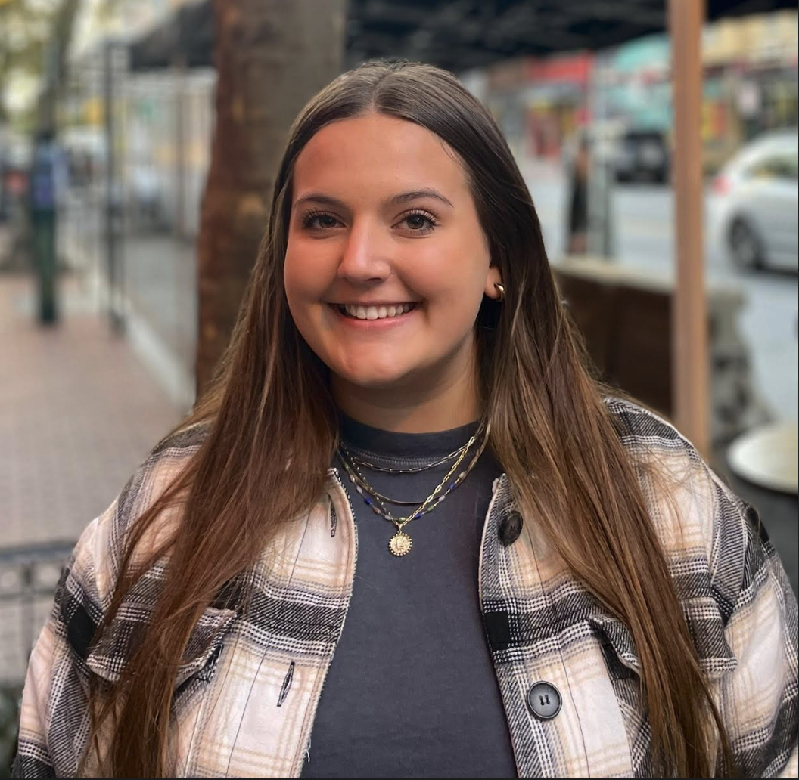
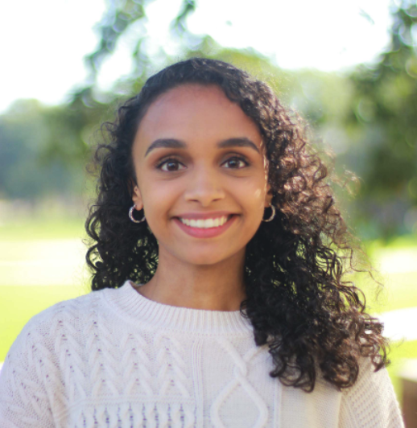
Welcome to our panelists!
Laura Stapleton, PhD
Professor and Acting Dean,
College of Education
Linda Steiner, PhD
Professor, Philip Merrill College of Journalism
Director, University of Maryland ADVANCE
Yu-Wei Wang, PhD
Director, Clinical Associate Professor, Research Director, and Assistant Director of the
Counseling Center
Lucy Hess
Sophomore, Kinesiology Major
Madhulika Nallani
Senior, Cell Biology and Genetics

Slide 3
Divisional Partnerships
Division of Information Technology
Academic Technology Experience
Marcio Oliveira, Megan Masters, Alia Lancaster, Bekzod Akramov, Martyn Clark
Division of Student Affairs
Patty Perillo, Sophie Tullier, Joann Prosser, Serena Freund
Division of Academic Affairs
Institutional Research, Planning & Assessment
Sharon La Voy, Alan Socha, Danielle Glazer, Jamie Edwards, Ezra Cho
Teaching and Learning Transformation Center
Marcio Oliveira, Mary Warneka, Alice Donlan
Student Government Association
Madhulika C. Nallani, Steven Berit, Matthew Weiss, Umailla Fatima

Slide 4
Review of Campus-Wide Experience Surveys
March 2020
May & June 2020
November 2020
November 2021
Technological Readiness for Learning & Teaching Online Surveys
Target populations: students & faculty
Transition to Remote Learning, Teaching, and Working Surveys
Target populations: students, faculty, & staff
Fall 2020 Student & Faculty Experience Surveys
Target populations: students & faculty
Fall 2021 Student & Instructor Experience Surveys
Target populations: students & instructors

Slide 5
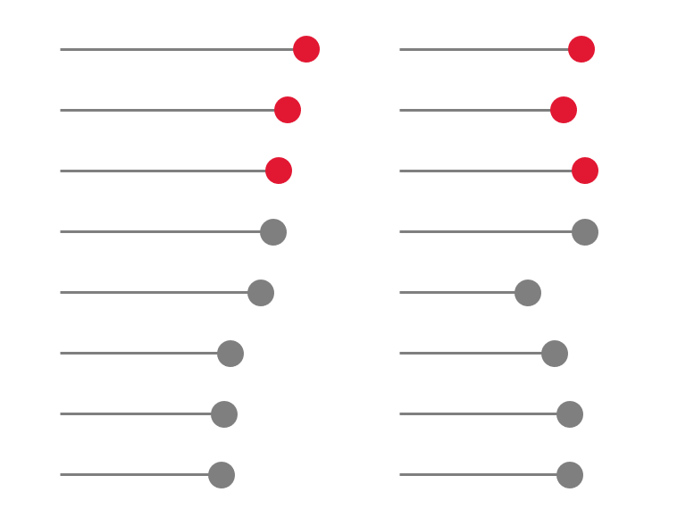
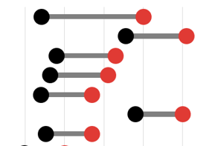
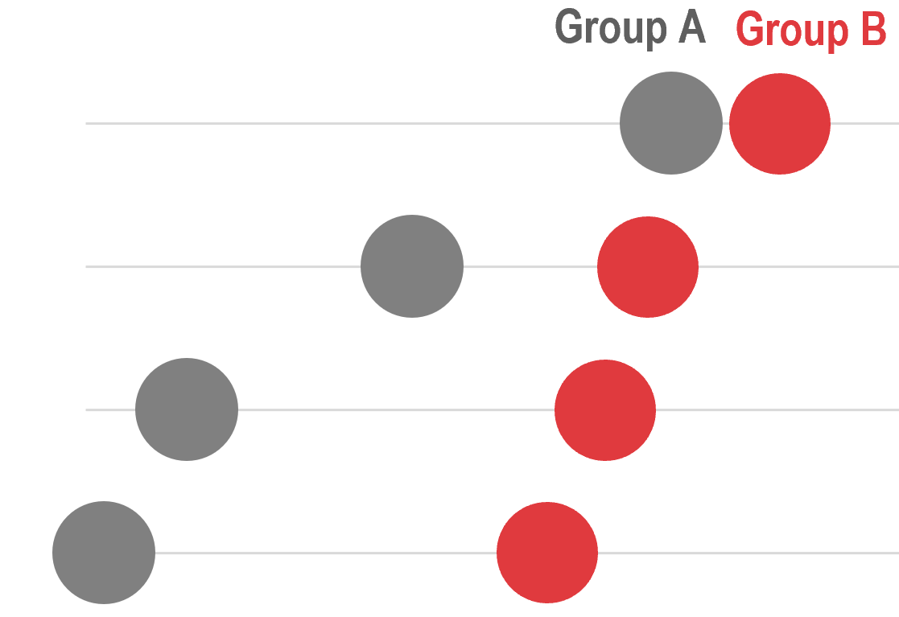
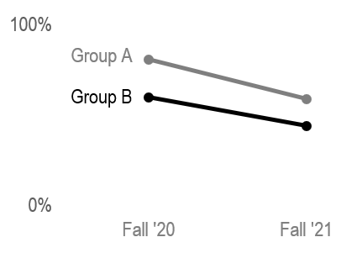
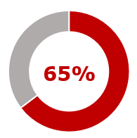
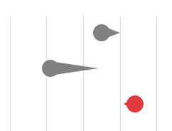
Getting Situated | Data Visualizations
Dot plot
Dumbbell dot plot
Lollipop graph
100%
0%
Pie/Donut graph
Comet plot
Slopegraph

Slide 6
What have we learned?

Slide 7
Four Main Take-Aways
Instructors and students had a more positive experience in Fall 2021 compared to Fall 2020.
1
More students felt engaged in class during the Fall 2021 semester compared to Fall 2020.
2
3
The demand for different teaching and learning experiences has increased.
4
Instructors and students are navigating similar challenges within their own unique contexts.

Slide 8
Instructors and students had a more positive experience in Fall 2021 compared to Fall 2020.
1

Slide 9
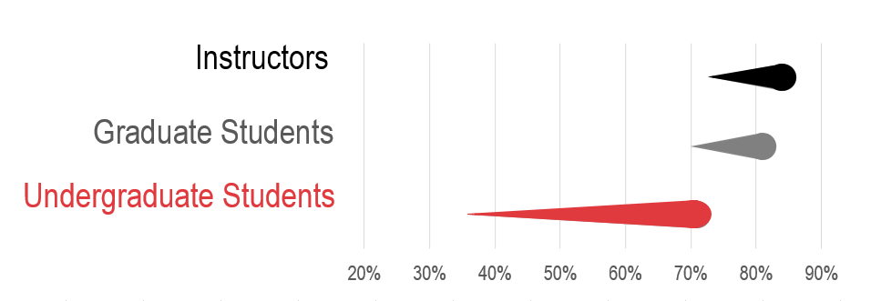
Coursework Experience
Student survey question: Overall, my experience in my courses this semester has been:
Instructor survey question: Overall, my experience teaching my course(s) this semester has been: (% Positive & Somewhat Positive)
n_{undergraduate} = 1,731 – 3,527; n_{graduate} = 862 - 899 ; n_{instructor} = 1,064 – 1,207
Source: Fall 2020 & Fall 2021 UMD Student & Instructor Experience Surveys
Across the board, instructors and students had a more positive coursework experience in Fall 2021.

Slide 10
Graduate-level instructors had a slightly more positive experience than undergraduate course instructors. % Positive & Somewhat Positive
Coursework Experience
Survey question: Overall, my experience teaching courses this semester has been: (% Positive & Somewhat Positive)
n = 113 - 505
Source: Fall 2021 UMD Instructor Experience Survey

Slide 11
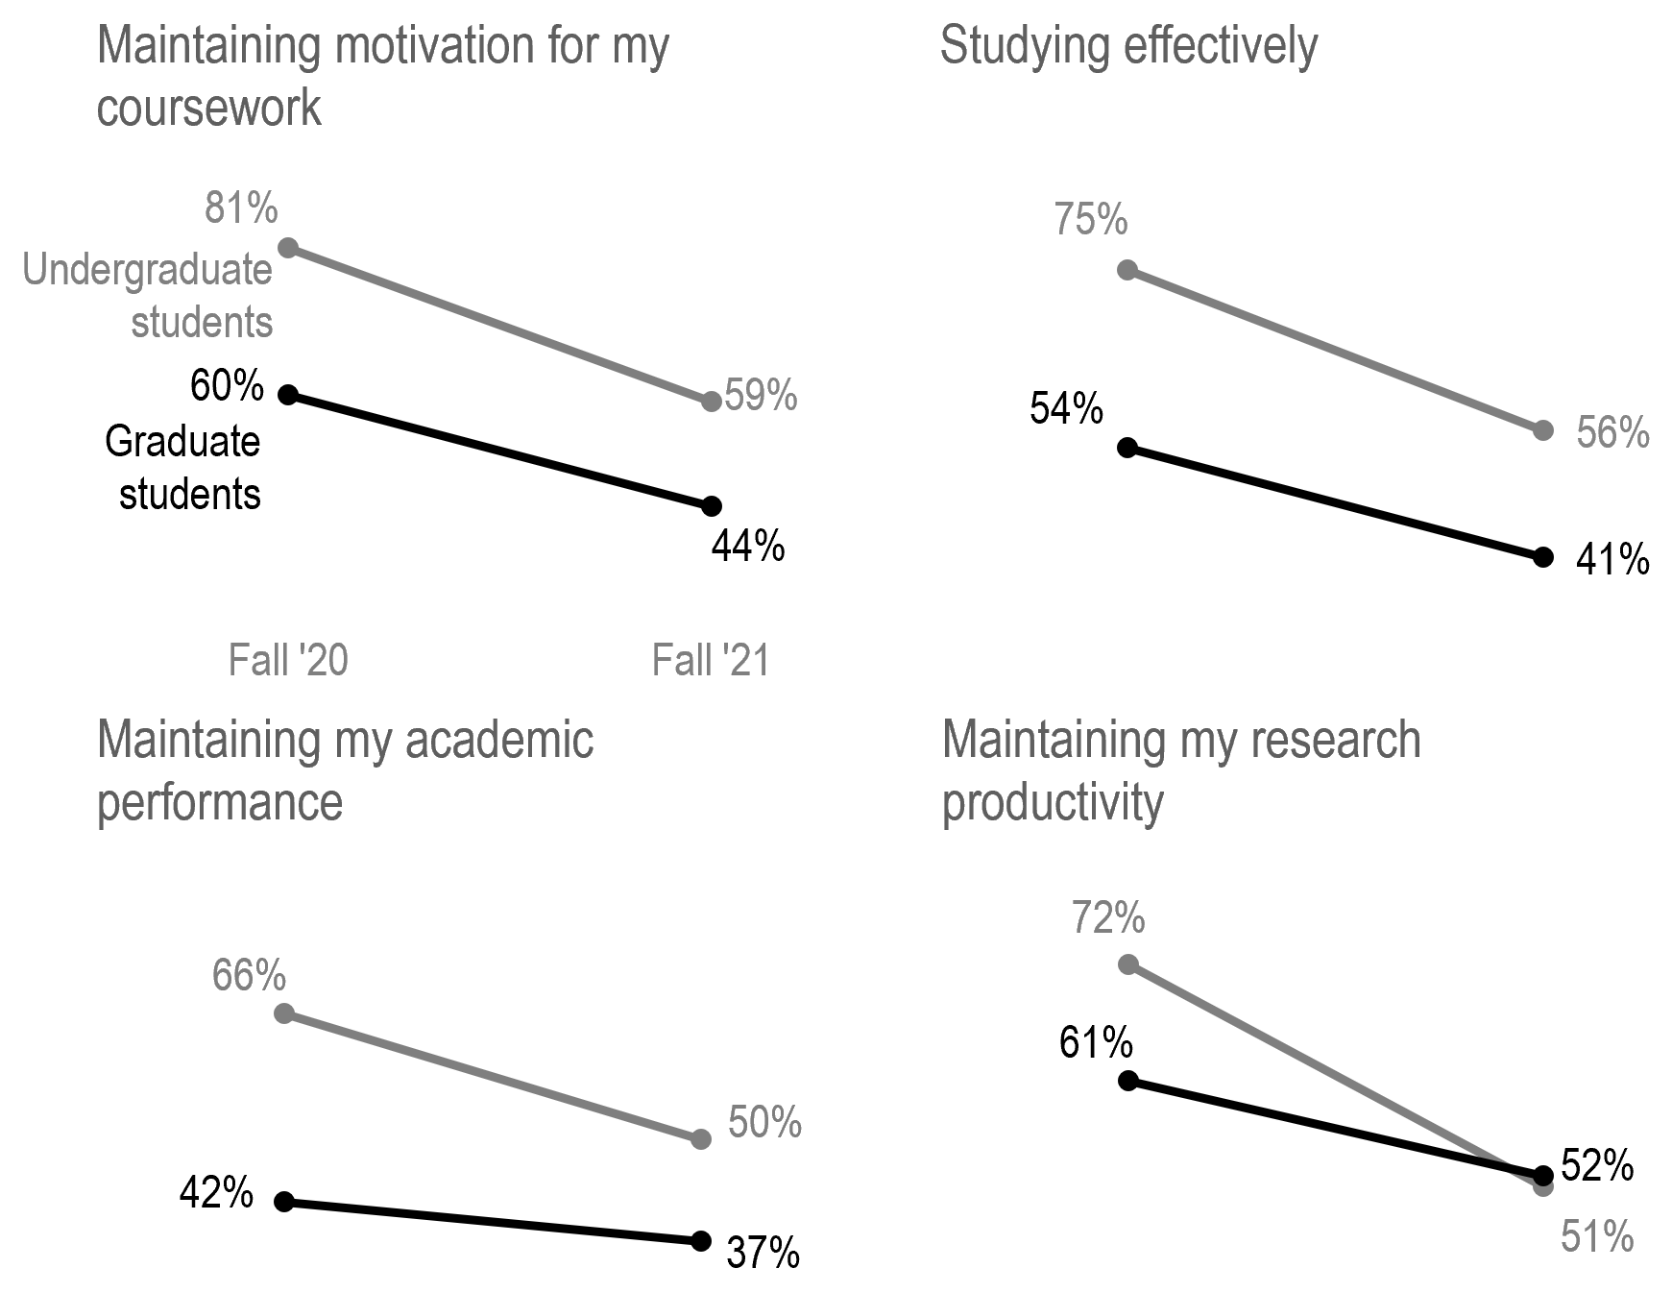
Academic Activities
Survey question: How easy or difficult have you found each of the following to manage this semester? (% Somewhat Difficult & Very Difficult)
n_{undergraduates} = 180 – 4,314| n_{graduates} = 125 – 1,197
Source: Fall 2020 & Fall 2021 UMD Student Experience Surveys
Academic activities were difficult for fewer students in Fall 2021 compared to Fall 2020.

Slide 12
More students felt engaged in class during the Fall 2021 semester compared to Fall 2020.
2

Slide 13
UMD Connection
Survey question: Please rate the extent to which you agree or disagree with the following statements. This semester: (% Somewhat Agree & Strongly Agree)
n_{undergraduates} = 1,594 – 1,731| n_{graduates} = 812 – 1,038
Source: Fall 2020 & Fall 2021 UMD Student Experience Surveys
More students felt engaged with campus and in their classrooms in Fall 2021 than in Fall 2020.

Slide 14
Engagement, Academic Experience, and Course Engagement
Academic experience items by response to “I feel a strong sense to the UMD community” (Strongly Disagree & Somewhat Disagree are “Not connected to UMD” and Strongly Agree & Somewhat Agree are “Connected to UMD”)
n_{undergraduates} = 1,261 – 1,288 | n_{graduates} = 842 – 862
Source: Fall 2021 UMD Student Experience Survey
More students who felt connected to campus felt engaged or had a positive academic experience.

Slide 15
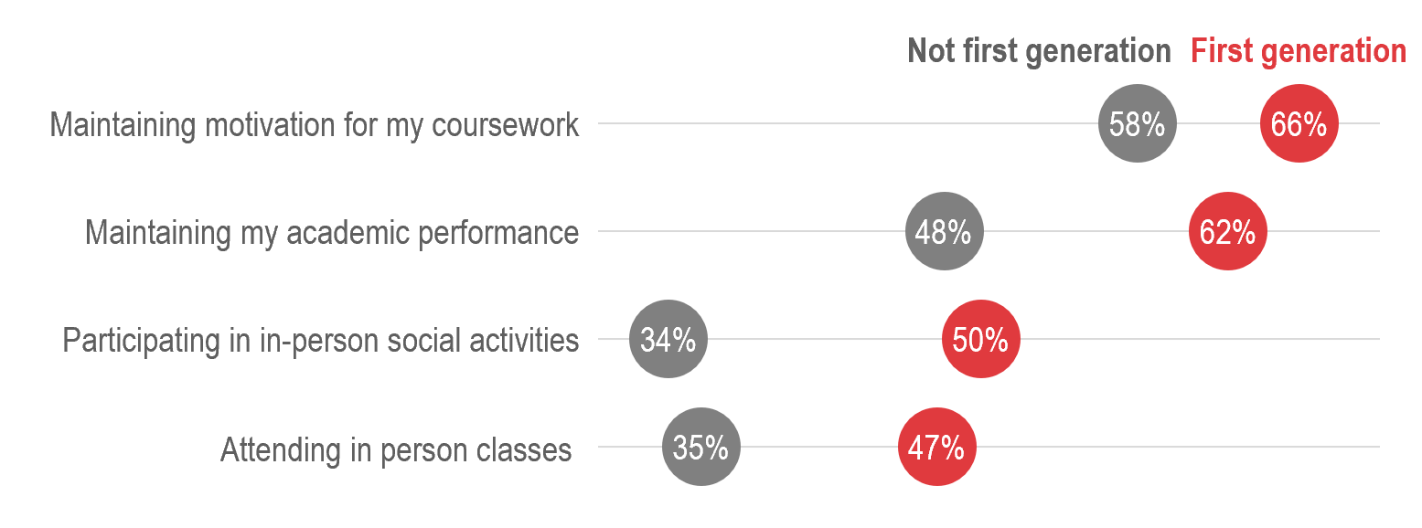
Academic Engagement, First Generation Status
Survey question: How easy or difficult have you found the following to manage this semester? (% Somewhat Difficult & Very Difficult)
Note that first-generation status is recorded for undergraduate students only.
n_{undergraduates} = 180 – 1,837
Source: Fall 2021 UMD Student Experience Survey
Not all students felt equally engaged. First generation undergraduate students reported struggling more with in-person engagement.

Slide 16
UMD Connection and Race/Ethnicity
Survey question: I feel like I belong at UMD (% Somewhat Agree & Strongly Agree)
This includes domestic students only. Indigenous students are not shown below due to small n sizes.
n_{undergraduates} = 155 – 895
Source: Fall 2021 UMD Student Experience Survey
Not all students felt equally engaged. Black/African American and Hispanic students reported feeling less like they belong at UMD than their peers.
Black/African American

Slide 17
The demand for different teaching and learning experiences has increased.
3

Slide 18
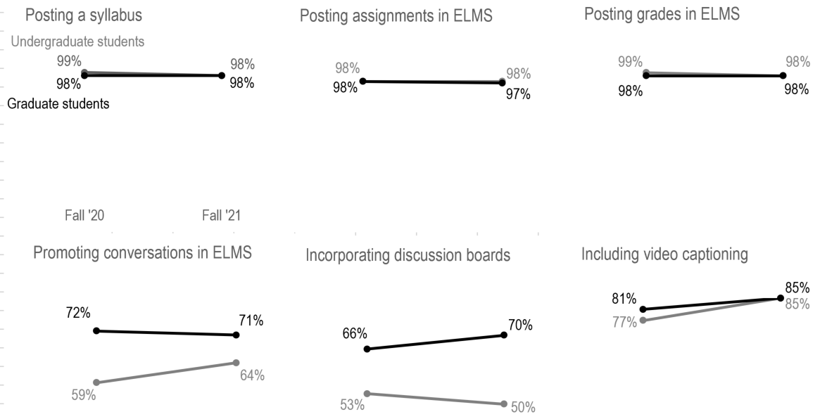
Instructional Practices
Survey question: Of the instructional practices your instructors have used this semester, are there any that you hope to continue to encounter in future courses?
n_{undergraduates} = 314 – 3,271 | n_{graduates} = 187 - 797
Source: Fall 2020 & Fall 2021 Student Experience Surveys
Both undergraduate and graduate students continue to want course-management and engaging instructional practices incorporated into their classes.

Slide 19
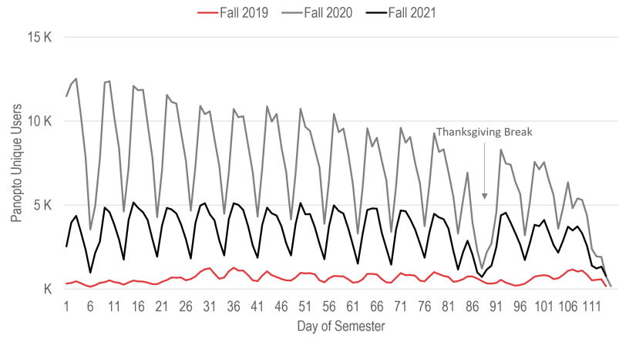
There were typically 5 times more unique Panopto viewers in Fall 2021 compared to Fall 2019.
Panopto Unique Viewers
Source: Fall 2021 Academic Technology Systems and Services Report

Slide 20
Recorded lectures were popular among most students, while instructors had mixed reviews.
Instructor & Student Qualitative Comments
Source: Fall 2021 Instructor Experience Survey. Representative of 156 instructor and 104 student comments.
Provided accessibility, flexibility & convenience
Allowed students to re-watch material
Requests for more instructors to offer recordings
Contributed to lower attendance, especially in larger undergraduate courses
Added to students’ workload
Created technology & teaching challenges

Slide 21
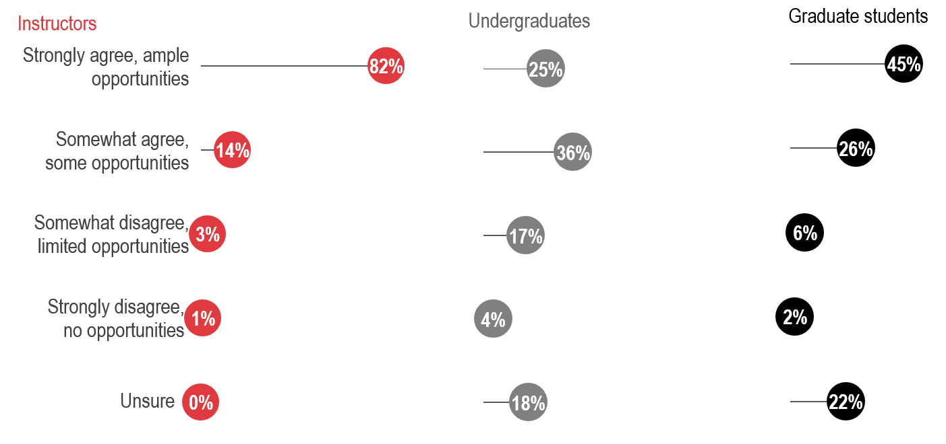
Make Up Coursework
Instructor survey question: Overall, I provide my students with opportunities to make up coursework should they have required an excused absence.
Student survey question: Overall, my instructors provide me with opportunities to make up coursework should I require an excused absence.
n_{undergraduates} = 1,587 | n_{graduates} = 800 | n_{instructors} = 1,031
Source: Fall 2021 UMD Student & Instructor Experience Surveys
Most instructors said they provided students with ample opportunities to make up coursework if they required it, but fewer students agreed.

Slide 22
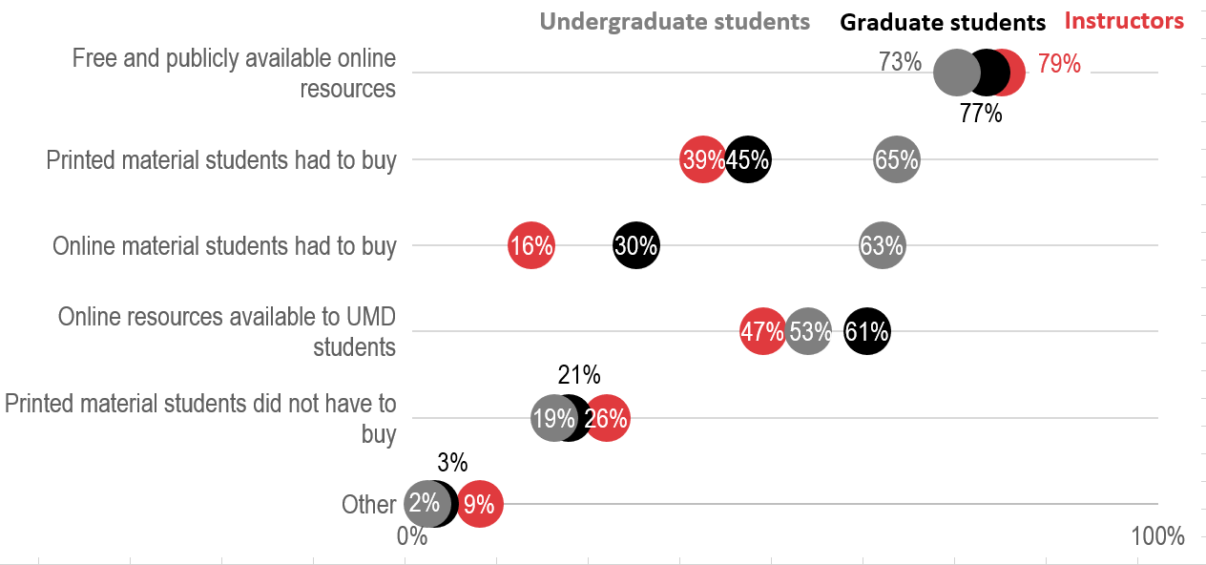
Course Materials
Instructor survey question: Which types of course materials did you require for your students within your course(s) this semester? Please select all that apply.
Student survey question: Which types of course materials were required for your courses this semester? Please select all that apply
n_{undergraduates} = 1,672 | n_{graduates} = 834 | n_{instructors} = 1,044
Source: Fall 2021 UMD Student & Instructor Experience Surveys
Students use a mix of online, printed, purchased, and freely available materials in their coursework.

Slide 23
Instructors and students are navigating similar challenges within their own unique contexts.
4

Slide 24
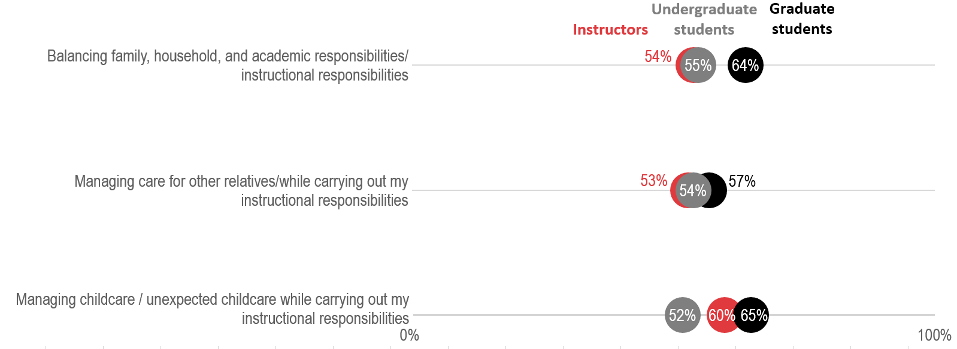
Caregiving
Survey question: How easy or difficult have you found each of the following to manage this semester? (% Very Difficult & Somewhat Difficult)
n_{undergraduates} = 180 – 1,837 | n_{graduates} = 125 – 1,039 | n_{instructors} = 46 – 1,075
Source: Fall 2021 UMD Student & Instructor Experience Surveys
Regardless of their role at UMD, respondents with caregiving responsibilities found it difficult to manage care for relatives, childcare, and balancing all their responsibilities.

Slide 25
Interactions with Peers & Instructors
Student survey question: There are adequate opportunities to interact with my instructors. (% Somewhat Agree & Strongly Agree)
Instructor survey question: There are adequate opportunities to interact with students. (% Somewhat Agree & Strongly Agree)
n = 1,032 - 2,406
Source: Fall 2021 UMD Student & Instructor Experience Surveys
Students and instructors also felt they had more opportunities to interact with each other.

Slide 26
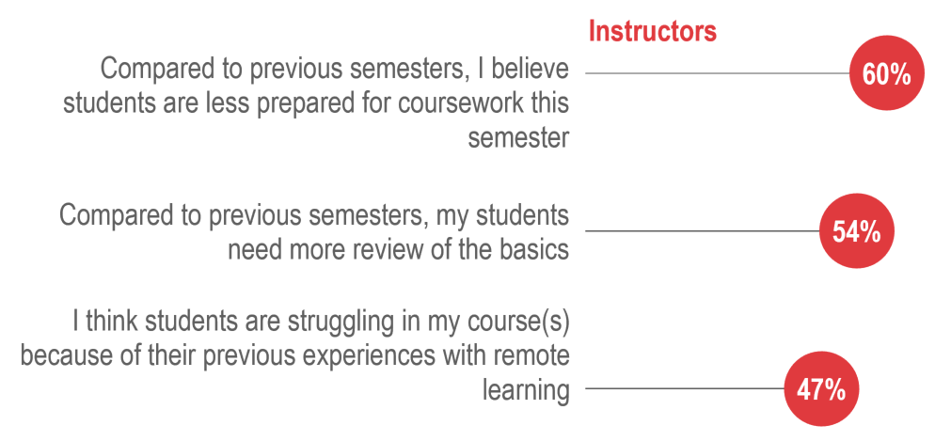
Academic Readiness
Student survey question: During the Fall 2021 semester, please indicate the level of negative impact the COVID-19 pandemic has had on each of the following aspects of your life: (% Extremely, Quite a bit, & Moderately)
Instructor survey question: Please rate the extent to which you agree or disagree with the following: (% Somewhat Agree & Strongly Agree)
n_{undergraduates} = 1,308 – 3,867 | n_{graduates} = 839 – 1,123 | n_{instructors} = 949 – 986
Source: Fall 2021 UMD Student & Instructor Experience Surveys
Although concerns have decreased, instructors and students continued to have a general sense that disruptions in learning affected perceived academic readiness for Fall 2021.
Undergraduate
students
Graduate
students

Slide 27
Academic Readiness
Instructor survey question: Overall, I have felt that my students’ previous coursework prepared them well for the course(s) that I taught this semester (% Somewhat Agree & Strongly Agree)
Student survey question: Overall, I have felt that my previous coursework has prepared me for the current coursework I am taking this semester (% Somewhat Agree & Strongly Agree)
n_{undergraduates} = 1,585 | n_{graduates} = 798 | n_{instructors} = 1,032
Source: Fall 2021 Student & Instructor Experience Surveys
However, both instructors and students felt that previous coursework had prepared them well for current coursework.
66%
72%
78%
84%

Slide 28
What have we learned?
Notes:
While we currently have more questions than answers in terms of what to expect for our incoming student body, we have learned an incredible amount about ourselves as an institution, as leaders, as faculty, and as students
What I will be sharing with you now are data

Slide 29
Four Main Take-Aways
Instructors and students had a more positive experience in Fall 2021 compared to Fall 2020.
1
More students felt engaged in class during the Fall 2021 semester compared to Fall 2020.
2
3
The demand for different teaching and learning experiences has increased.
4
Instructors and students are navigating similar challenges within their own unique contexts.

Slide 30
Innovate for Impact | What will you do in ‘22?
Are there certain instructional innovations implemented this academic year that you hope are here to stay?
Do you think instructors’ expected roles in students’ lives have shifted since March 2020?
Despite general perceptions of academic unpreparedness, when asked about academic preparedness for a specific course, both students and instructors reported feeling academically ready for learning. Can you think of examples that may be contributing to the disconnect?
The Fall 2021 cohort of UMD students all had different experiences with learning (including both high school and college experiences). Can you think of an example of how these varied experiences with previous learning contexts may have shaped their holistic UMD experience?

Slide 31
Megan Masters, PhD | Director, Academic Technology Experience (DIT)

