Slide 1
Generating Show-stopping insights from LMS (CANVAS) Data
PRESENTATION BY:
Martyn Clark, Alia Lancaster, Megan Masters
Notes:
v

Slide 2
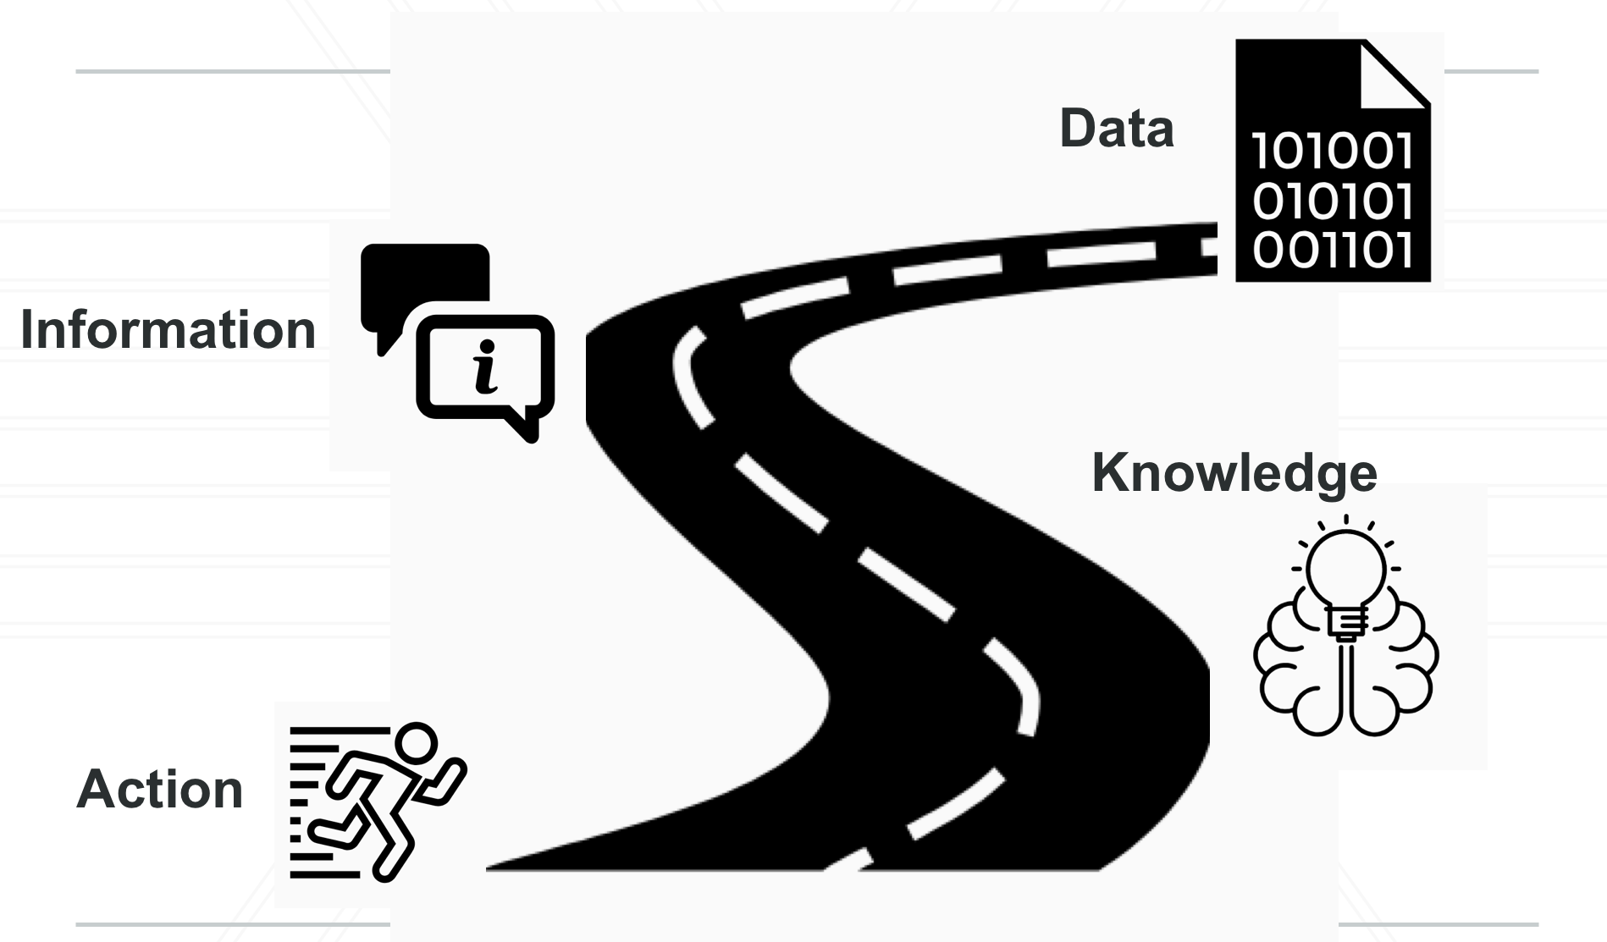
ABOUT US
Academic Technology Experience
Focus on student, faculty, and staff experiences with technology
Provide evidence-based insights about university-wide initiatives and IT systems and services
Notes:
COMMENT: Trying to fit on one slide, but we can expand as needed. The primary goal is to get across the idea that we are coming from a social science rather than computer science or other “traditional” IT background. Folks at Instructurecon tend to be instructors, instructional designers, or John Burke types, so we might be a little bit of an anomaly. Also need to get the UMD brand on the slides, but it looks better here than on the title slide.

Slide 3
GUIDING PRINCIPLES
Notes:
Talking about how a huge part of our portfolio has to do with the use of ELMS-Canvas as an academic technology tool; as such, we began exploring quantitative metrics about what enterprise-wide use looked like across campus

Slide 4
DATA DOWNLOADING ACROBATICS
Where we are going
What we do now
Notes:
COMMENT: Our abstract talked about 1) data downloading acrobatics, 2) balancing act between effort and insight, and 3) inviting people into our tent. I’ve kept those ideas as the structure for the talk.

Slide 5
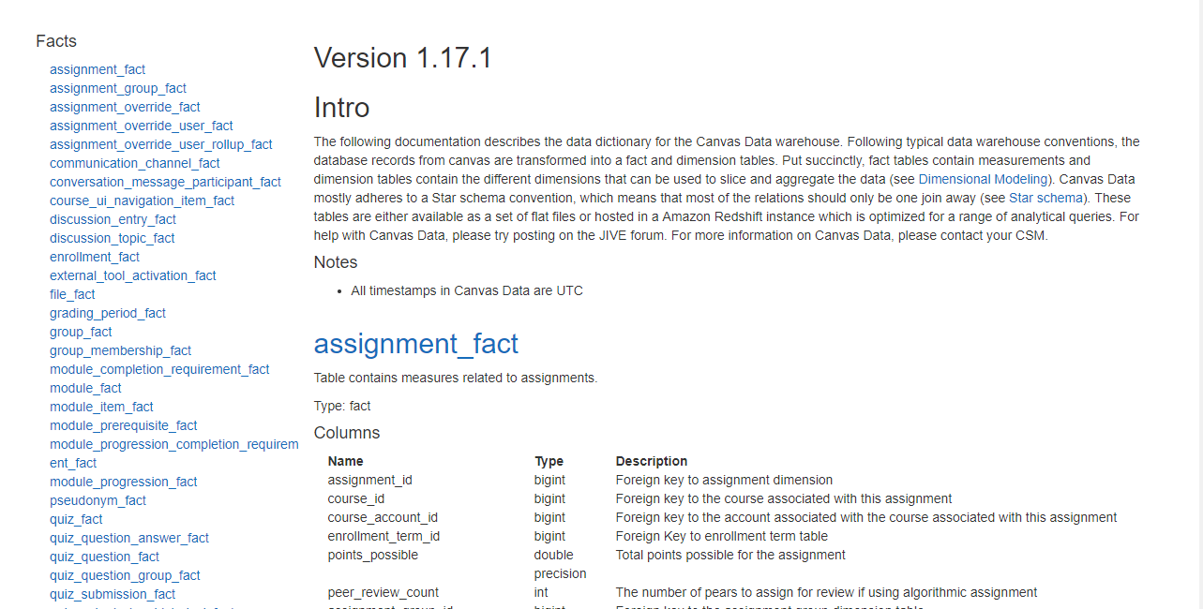
Notes:
COMMENT: This section is primarily a retread of the LARG presentation to let folks see what we’ve done (“We feel your pain” for folks just getting started with Canvas data). Many folks in the audience will know what Canvas Data means, but for those who are just getting started, it helps to contextualize things. No analysis in this section, just “how we do it.”

Slide 6
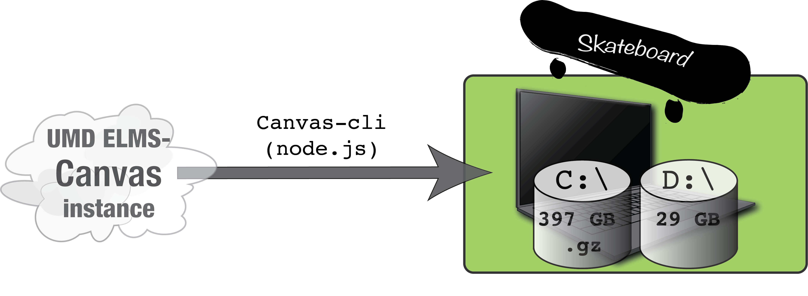
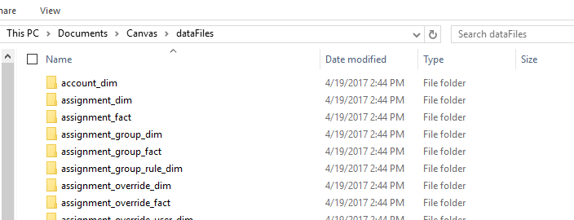
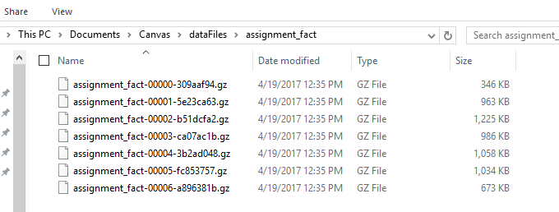
Data are downloaded from “the cloud” using a command line tool and stored on the team laptop.
Each download folder contains multiple compressed files
Notes:
It might be interesting to note that although UMD has a supercomputer, that doesn’t necessarily mean that we had access to it for Canvas data….

Slide 7
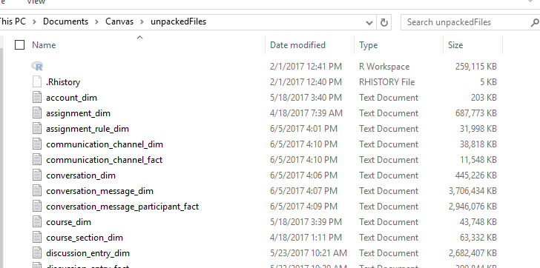
Downloaded data are uncompressed to a second drive.
unpack
The command line tool unpacks the files and re-assembles them to a single file per table.

Slide 8
Unpacking the request table has been challenging

Slide 9
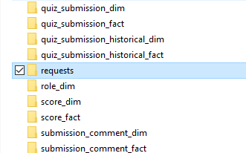
When trying to unpack the “request table” folder…..
unpack

Slide 10
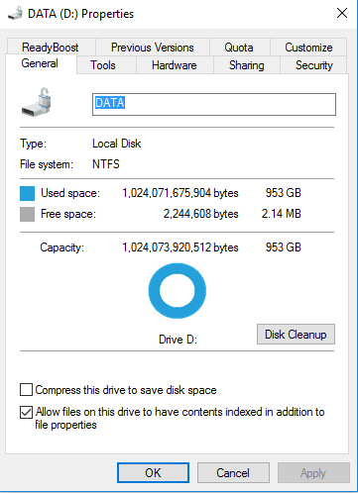
When trying to unpack the “request table” folder…..
unpack
….we blew up a 1 TB drive.

Slide 11
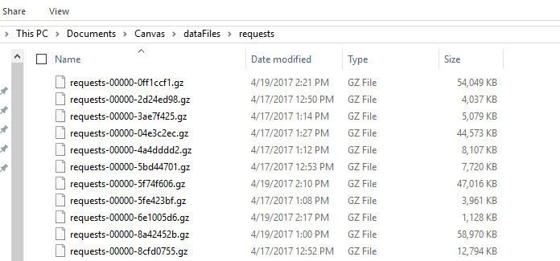
“Manually” extract single term by iterating through zipped files and writing relevant portions to disk.
We had to develop a work-around for request data
“Unpacked” Spring 2017 requests:
346 GB
800M rows
Thousands more

Slide 12
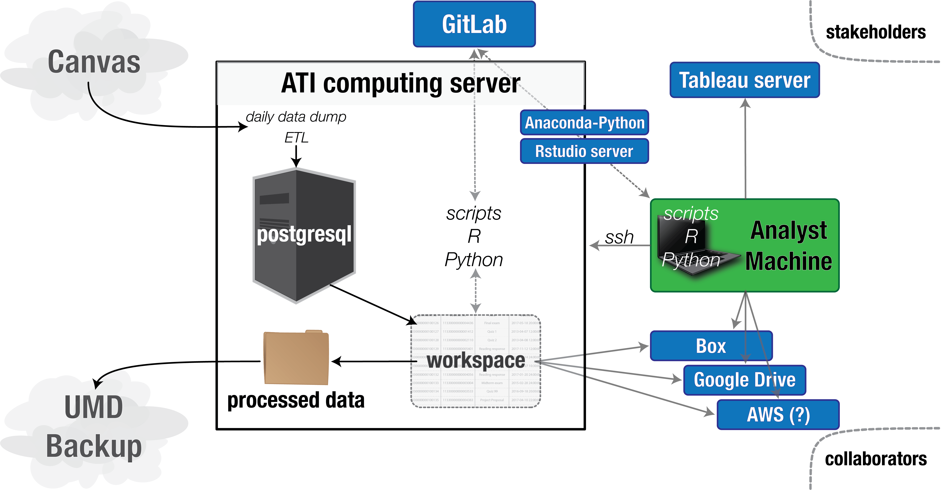
Notes:
COMMENT: This is a good chance to set up the idea that the ultimate goal is to get info to users, which is what the next section is about. It also highlights the fact that we are beginning to move to Tableau as a campus.

Slide 13
BALANCING EFFORT AND INSIGHT
Enterprise wide usage patterns
Notes:
Comment: This section is mainly “pretty pictures” that we have created about Canvas data. I grabbed somewhat randomly from other presentations to highlight usage (I think most are Tableau visualizations, right?) as well as “insights” (e.g., folks use Canvas on study day). The goal for this section is to show how we have started characterizing ELMS-Canvas usage at the enterprise level to understand the “general” or “typical” student experience, but need partners (the next section) to really dive in deep to the student experience.

Slide 14
Notes:
We had an average of 25,185 (57% of potential student and instructor users) unique students using Canvas during Spring 2017. Not surprisingly, usage drops during spring break. During the week, students activity starts in the late morning.

Slide 15
WHAT DO STUDENTS DO ON READING DAY?
There are more ELMS-Canvas logins on Reading Day than on average Fridays throughout the semester.
Reading Day
24%
Average Friday
0
5,000
10,000
15,000
20,000
25,000
30,000
Notes:
This started as an offhand comment from Marcio, the head of our unit, with the assumption that students aren’t using Reading day to study, so why even have it? Anecdotal assumption, we all have them.
24% increase from average 21,074 students on previous Fridays
While likely not everyone studying, some where using ELMS-Canvas to access course content
So what, who cares? For refreshes and updates that we control, we know that Reading day is one to avoid.

Slide 16
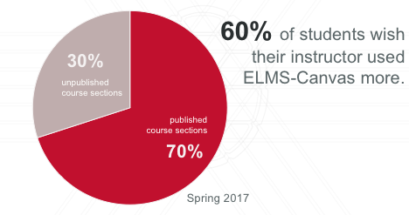
WHAT PERCENTAGE OF UMD FACULTY ARE PUBLISHING COURSES ON CANVAS?
Notes:
In Spring 2017, 70% of course sections published, meaning available to students, on ELMS-Canvas (that’s 6,882 course sections)
Using our no adjectives principle, we know that use of ELMS-Canvas is growing, but there are still some sections that do not use it (30%).
We don’t know what instructors are doing within those ELMS-Canvas spaces? Are they posting the syllabus, are all assignments submitted online?

Slide 18
Notes:
15 week semester –4 assignments/week, a quiz about every week, and a discussion entry every other week.
In Tableau, we can filter by college. This allows us to see that, for example, educ has more discussion entries, agnr (college of agriculture & natural resources) has many more quizzes

Slide 19
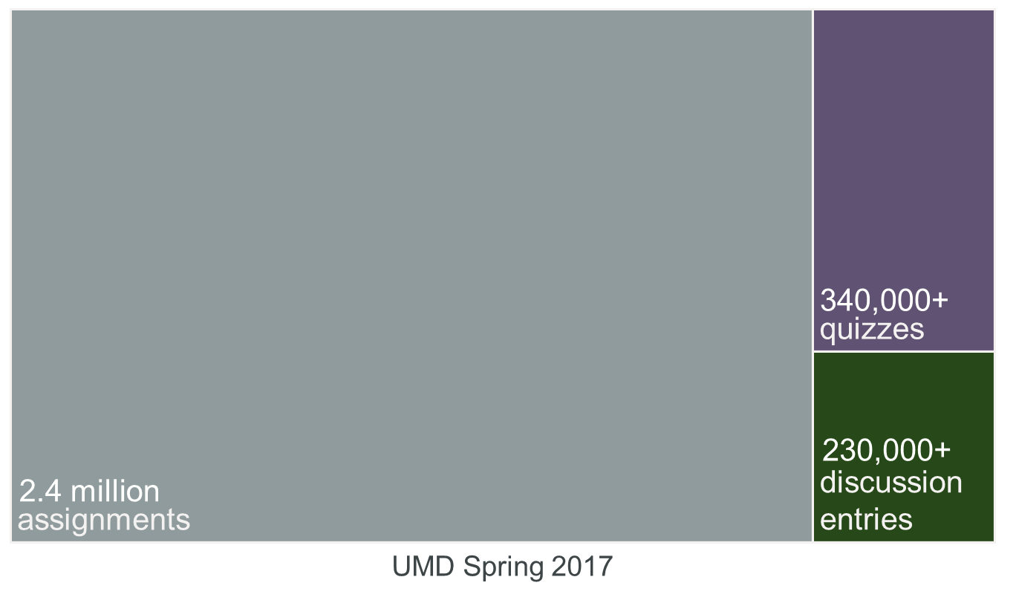
Notes:
In those more than 6,000 course sections, students submitted over 2 million assignments!
This was by far the most frequent type of submission by students.
Per student that’s about 6 discussion entries, 3 quizzes, and 14 assignments over the semester

Slide 20
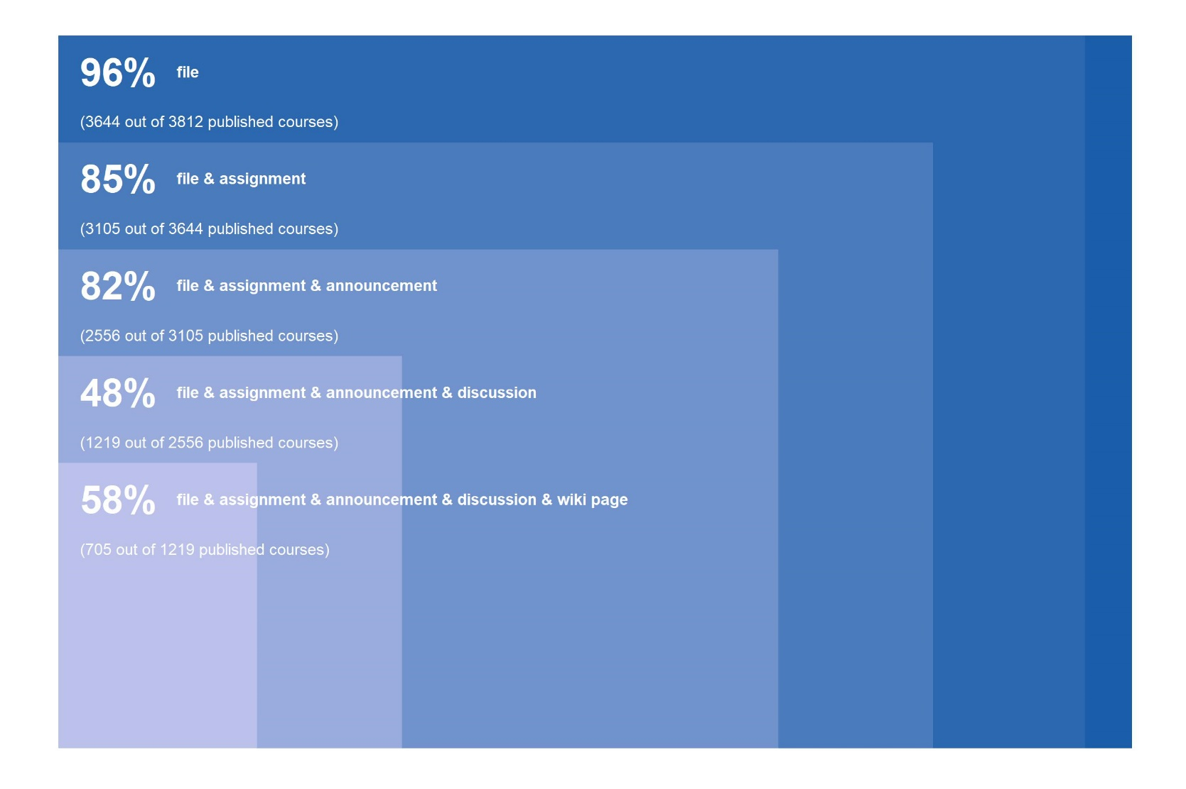
Notes:
Graph explanation: Top 5 features from previous graph. 96% of all course sections have at least 1 file uploaded. Of those 96%, 85% also have an assignment posted.
All UMD. Start to understand more what instructors are doing with this tool, which could inform work of others in DIT (e.g., learning technology stratigists).

Slide 21
Notes:
ENG professional writing face-to-face sections version.
We can only get so far by taking the 30-mile high view, thus we developed small-scale partnerships that are mutually beneficial. We learn more about the Canvas Data – what is meaningful, what is not, what instructors, administrators, students want to see – and our collaborators learn more about the use of this academic technology by their instructors and/or students, which they can then tie to outcomes they care about (e.g., grades, how many courses to offer)

Slide 22
LURING OTHERS TO THE TENT
Collaborations with colleagues
Collaborations with researchers
Collaborations with instructors
Notes:
COMMENT:

Slide 23
CONTACT US
MARTYN CLARK – mclark19@umd.edu
ALIA LANCASTER – abiller@umd.edu
MEGAN MASTERS – mkrol@umd.edu
IT ANALYTICS -- https://dit.umd.edu/analytics

