Slide 1
ELMS-Canvas use at UMD
Learning by Design: The integration of learning analytics and instructional design
Megan Masters, PhD, Alia Lancaster, PhD, Martyn Clark, PhD, & Scott Moses

Slide 2
Three Main Take-Aways
ELMS-Canvas:
A critical component of the teaching and learning experience
Patterns in usage provide insights into the overall student learning experience
Data housed within ELMS-Canvas serves robust resource for learning analytic research that can inform instructional design practices
ELMS = Enterprise Learning Management System
Notes:
Interested in student and faculty perceptions of technology (including classroom technology)
Part of a longer story on teaching and learning experiences at UMD
Presenting 2/5 sections (other sections: academic technology and wifi for teaching
Sneak peak before final report, just finished analyzing. If you have follow-up analyses ideas or questions, love to hear about it/get in touch
Future plans: survey instructors like this every other year. Students via ECAR every year

Slide 3
Three Main Data Sources
ELMS-Canvas System Data
Surveys
UMD-Specific Student and Instructor Surveys (Summer 2018)
Demographic Information
Academic Technology: ELMS-Canvas
WiFi for Teaching
Classroom Technology
Classroom Spaces (including TERP classrooms)
Nationally-administered survey results
EDUCAUSE Center for Analysis and Research (ECAR)
Administered annually to students and bi-annually to instructional faculty
Anecdotes
Notes:
Interested in student and faculty perceptions of technology (including classroom technology)
Part of a longer story on teaching and learning experiences at UMD
Presenting 2/5 sections (other sections: academic technology and wifi for teaching
Sneak peak before final report, just finished analyzing. If you have follow-up analyses ideas or questions, love to hear about it/get in touch
Future plans: survey instructors like this every other year. Students via ECAR every year

Slide 4
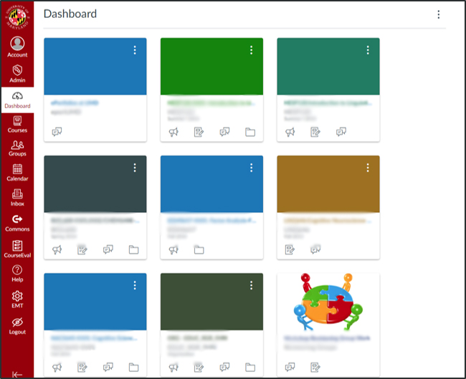
ELMS-Canvas usage
Notes:
Who uses Canvas as their Enterprise Learning Management system (ELMS)?
Can be a common course space online for instructors and students
Each semester a space automatically generated within our ELMS-Canvas instance (with exception of some types of sections, like independent study)
Instructor can publish a space = ACCESS available to students
Available since Fall 2012. Many teams within DIT piloted, implemented, and maintain

Slide 5
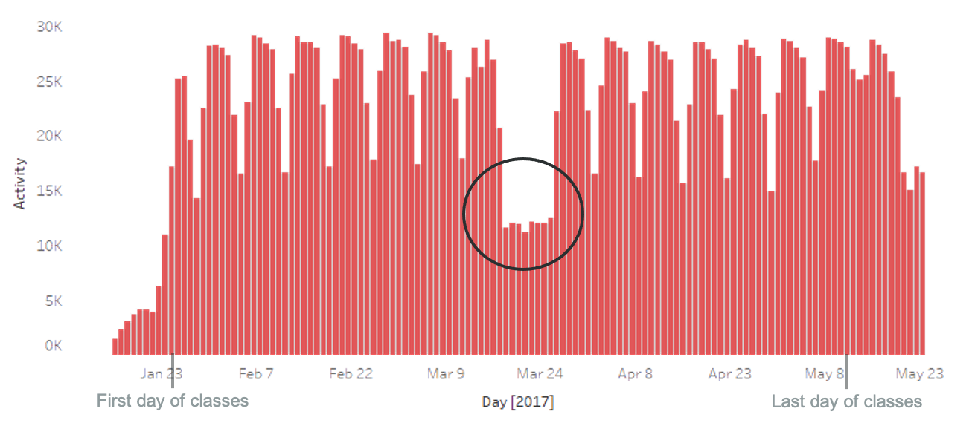
ELMS-Canvas usage
25,185 students used ELMS-Canvas on average every day during Spring 2017
Notes:
Spring break is a good check – we would expect there to be fewer users
25185/39,000 = 65%
Pervasive learning technology that DIT supports that touches 65% of on a daily basis. And that’s just 1 tool that DIT provides, not to mention the other services.
Spring break = gut check. Out expectations about the patterns were met. Situation with the opposite.
First day of classes: Jan 25, last day: May 11

Slide 6
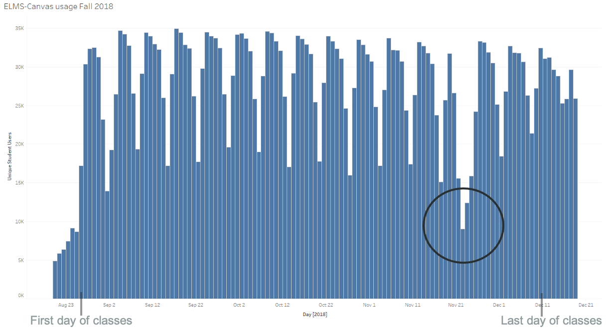
ELMS-Canvas usage
28,129 students used ELMS-Canvas on average every day during Fall 2018
Notes:
Average is for period Aug 27 – December 10
This number is JUST students and JUST activity related to a Fall 2018 course
28,129 / 41,200 = 68% of all students
Peak use was 34,924 on September 17, 2018. (85% of all students)
Thanksgiving is a good check – we would expect there to be fewer users
Averages per day
Sunday 26,444
Monday 31,245
Tuesday 30,942
Wednesday 30,036
Thursday 28,640
Friday 23,834
Saturday 17,474
Pervasive learning technology that DIT supports that touches 65% of on a daily basis. And that’s just 1 tool that DIT provides, not to mention the other services.
First day of classes: Jan 25, last day: May 11

Slide 7
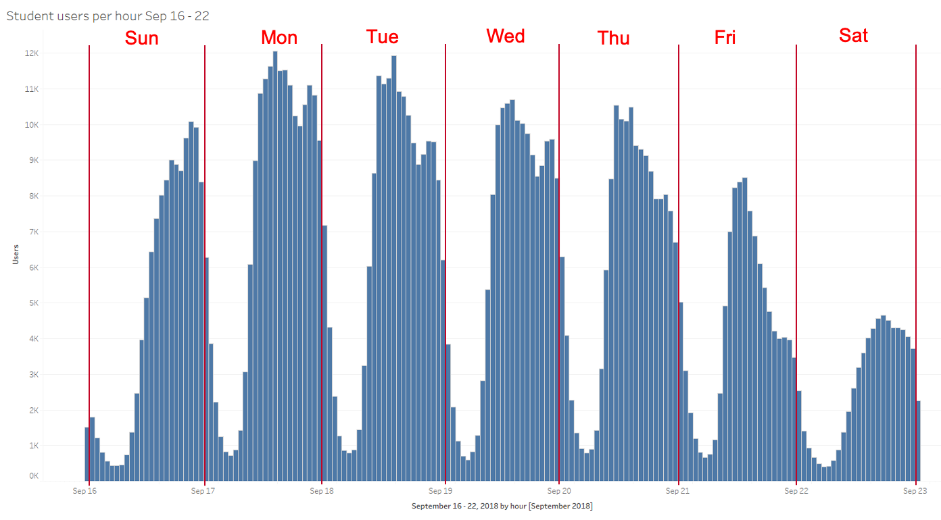
ELMS-Canvas usage
Notes:
This chart is the number of unique student users per hour for a week in Fall 2018
September 16 (Sunday) midnight – 1:00 AM through September 22 (Saturday) 11:00 PM – midnight
Most days, usage tends to peak at 2:00 PM, with a secondary uptick around 9:00 PM
Lowest usage is around 5:00 AM in the morning
The largest number of hourly users here was around 2:00 PM on Monday, September 17 (12,050 users)
Because of the difficulty in unambiguously disambiguating human activity from system activity in the log table, this chart is best for understanding general trends rather than obsessing on exact numbers

Slide 8
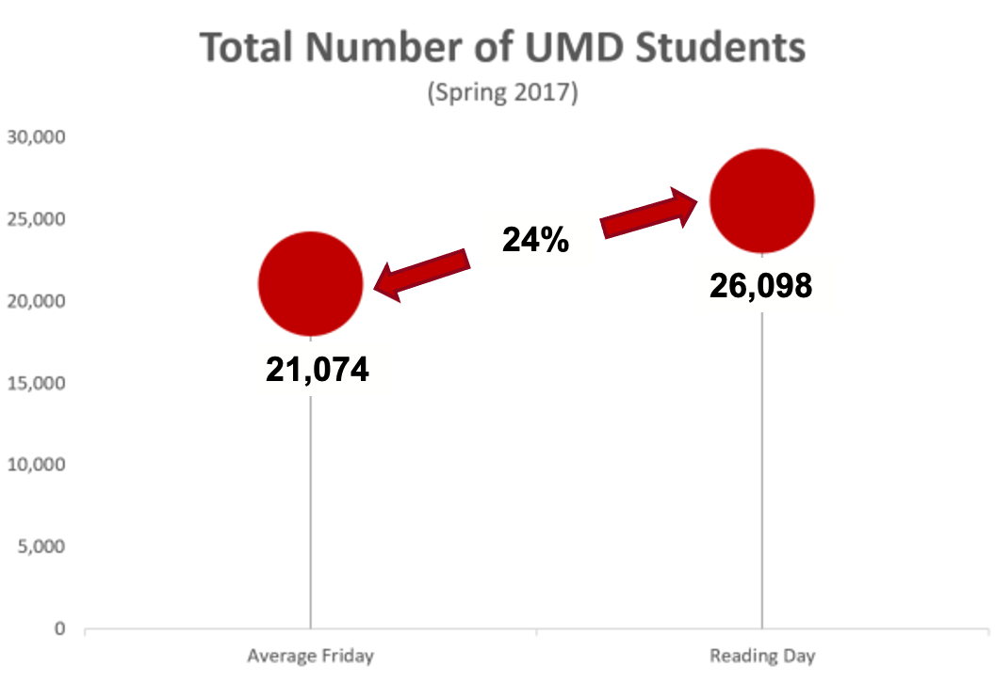
ELMS-Canvas usage

Slide 9
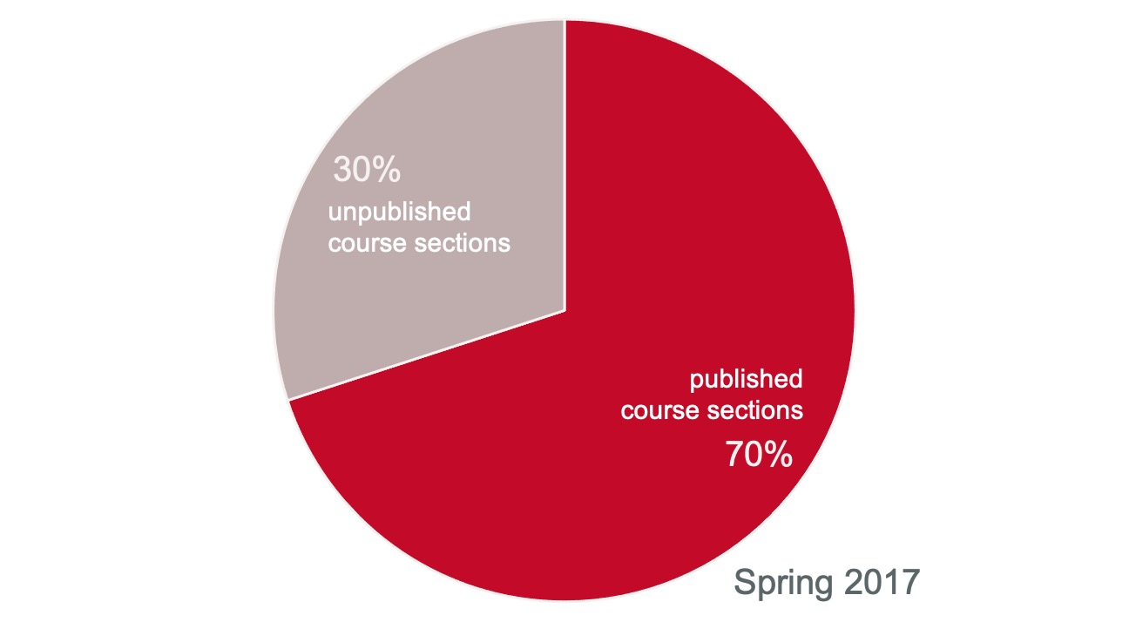
ELMS-Canvas usage
Notes:
In Spring 2017, 70% of course sections published, meaning available to students, on ELMS-Canvas (that’s 6,882 course sections)
Using our no adjectives principle, we know that an average of 70% of a students course sections were published in EC
We don’t know what instructors are doing within those ELMS-Canvas spaces? Are they posting the syllabus, are all assignments submitted online?
Here is where we can pull in another dataset to triangulate information or provide some context

Slide 10
Student thoughts on ELMS-Canvas
60% of students wish their instructor used ELMS-Canvas more.¹
¹UMD Student EDUCAUSE Survey, 2017
Notes:
From the 2017 Educause survey of studentsNeither datasets are perfect. Canvas data have to pull data from multiple tables, not transparent. Survey data is self-report.
Can start to develop inferences – sections are being published but students still want more, which could mean more sections published or more use with those already published
One way to contextualize is by triangulating data sources. Another is to examine trends over time.

Slide 11
Context
Academic Technology Experience
Interested in instructor and student perceptions of technology
These slides:
University-wide ELMS-Canvas usage statistics
Five total survey sections
Demographic Information
Academic Technology: ELMS-Canvas
WiFi for Teaching
Classroom Technology
Classroom Spaces (including TERP classrooms)
ELMS = Enterprise Learning Management System
Notes:
Interested in student and faculty perceptions of technology (including classroom technology)
Part of a longer story on teaching and learning experiences at UMD
Presenting 2/5 sections (other sections: academic technology and wifi for teaching
Sneak peak before final report, just finished analyzing. If you have follow-up analyses ideas or questions, love to hear about it/get in touch
Future plans: survey instructors like this every other year. Students via ECAR every year

Slide 12
Digital Literacy
Instructors and students reported similar rates of digital literacy.
When it comes to computer technology, which category describes you best?
Notes:
When it comes to digital literacy, instructors and students rated themselves similarly. Granted this is self-report, so categories may be something slightly different to different groups, but I think both groups have assumptions about the other on this topic.
First series of questions were about accessing ELMS-Canvas, frequency and with which device
Entire Scale:
Unfamiliar – I have little to no experience with computer technologies
Newcomer – I have attempted to use computer technologies, but I still require help on a regular basis
Beginner – I am able to perform basic functions in a limited number of computer applications
average (i.e, “I demonstrate a general competency in a number of computer applications”)
advanced (i.e., “I have acquired the ability to completely use a broad spectrum of computer technologies”)
Expert – I am extremely proficient in using a wide variety of computer technologies

Slide 13
ELMS-Canvas
Over 90% of students
Prefer all their courses to be available in ELMS-Canvas
Find it easier to learn when all their courses are published in ELMS-Canvas
Notes:
Agreed or strongly agreed to these statements

Slide 14
ELMS-Canvas
Instructor and student respondents agree to a similar extent that ELMS-Canvas is critical to and facilities their teaching and learning.
% of respondents who selected Strongly Agree or Agree

Slide 15
ELMS-Canvas
50% of students interacted with a course website other than ELMS-Canvas.
Notes:
Agreed or strongly agreed to these statements

Slide 16
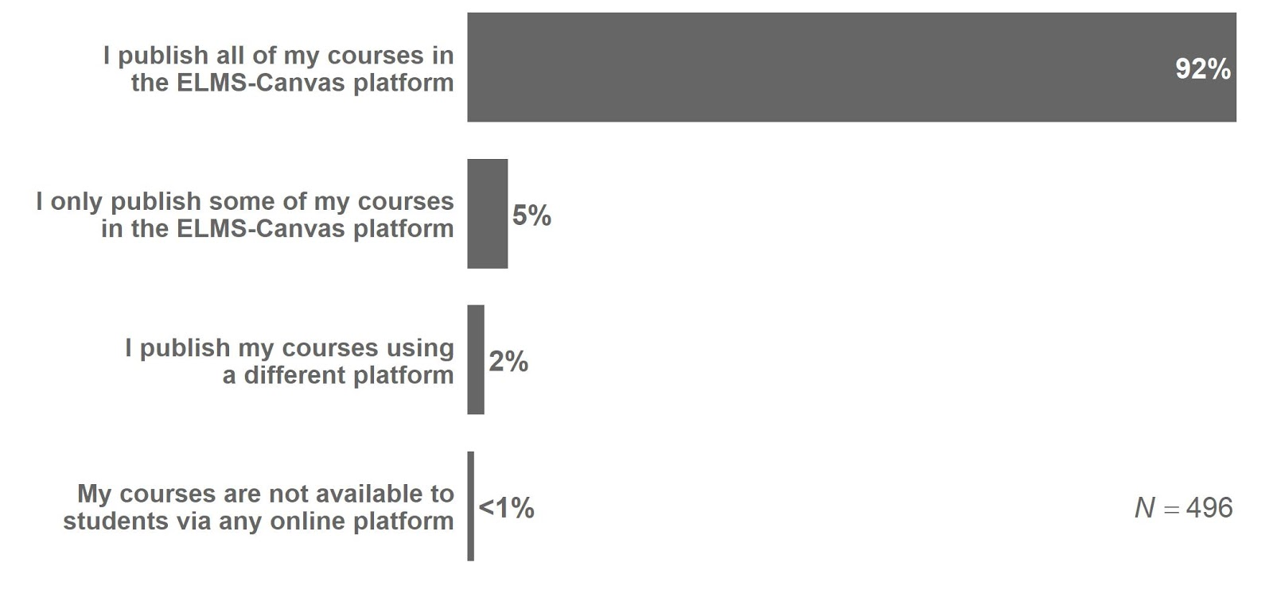
ELMS-Canvas
Nine in 10 instructors report using Canvas exclusively as their ELMS.
Notes:
To the extent that you have stuff well laid out in canvas, we can pull data and out and tell you stuff about it
Utility of due dates, modules, organization
Lastly, asked a few questions about which native features (list generated by our Director of Learning Design, Deb Matik) are used

Slide 17
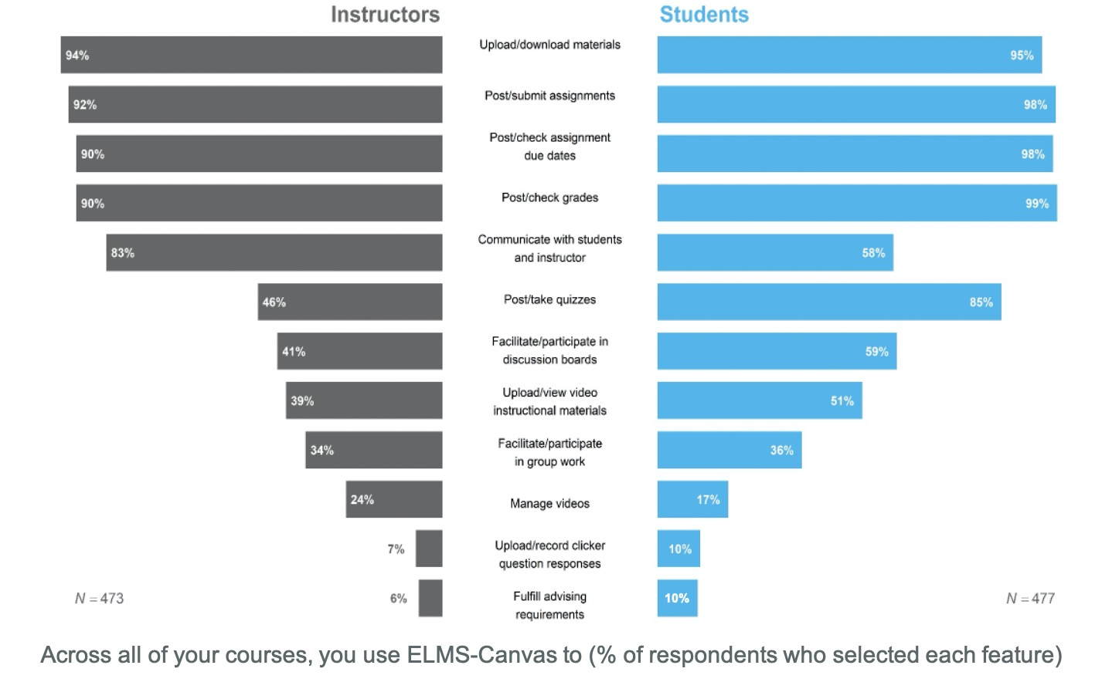
Both instructors and students report using ELMS-Canvas for course management purposes most often, such as posting/checking grades and uploading/downloading materials.

Slide 18
ELMS-Canvas usage
Notes:
Individual course analytics

Slide 19
ELMS-Canvas usage
Understanding learning patterns within ELMS-Canvas
Relatively emerging, interdisciplinary field
Data mining, machine learning, natural language processing, visualization, human computer interaction, linguistics, education
How do we move from “clicks” to “constructs”?
How might insights inform teaching and learning practices?
Notes:
Often situated under the umbrella terms of “data science”, “educational data mining”, “big data”, and “big science”
How do we employ data mining, machine learning, natural language processing, visualization, and human-computer interaction to provide educators and learners with insights that might improve learning processes and teaching practices?
Enables both instructors and learners to visually inspect their own process and progress
Potential intersection between learning analytics integration and useMakes previously invisible processes and progress visible
The following slides display some of the insights that we've learned in patterns of course-specific student activity.
Makes previously invisible processes and progress visible

Slide 20
PWP
Professional Writing Program (PWP)
14 courses fulfilling Fundamental Studies GenEd requirements
85 instructors, ~ 7,000 students/year
Largest courses offered in both face-to-face and asynchronous online formats
20+ online instructors
Notes:
Interested in student and faculty perceptions of technology (including classroom technology)
Part of a longer story on teaching and learning experiences at UMD
Presenting 2/5 sections (other sections: academic technology and wifi for teaching
Sneak peak before final report, just finished analyzing. If you have follow-up analyses ideas or questions, love to hear about it/get in touch
Future plans: survey instructors like this every other year. Students via ECAR every year

Slide 21
PWP
Key Concerns
Using available scholarship and best practices for effective course design
Quality Matters
CCCC OWI Principles
Community of Inquiry and other online learning research
Training instructors and providing professional development opportunities
Ensuring quality and consistency across instructors, courses, and delivery formats
Notes:
Interested in student and faculty perceptions of technology (including classroom technology)
Part of a longer story on teaching and learning experiences at UMD
Presenting 2/5 sections (other sections: academic technology and wifi for teaching
Sneak peak before final report, just finished analyzing. If you have follow-up analyses ideas or questions, love to hear about it/get in touch
Future plans: survey instructors like this every other year. Students via ECAR every year

Slide 22
PWP
The Potential of Learning Analytics
Student evaluations are helpful, to a point.
Manual assessment of course design is time-consuming and often only infers student experience.
Many instructors using similar or identical course shells.
ELMS-Canvas analytics offers data to complement qualitative/subjective assessment.
ELMS = Enterprise Learning Management System
Notes:
Interested in student and faculty perceptions of technology (including classroom technology)
Part of a longer story on teaching and learning experiences at UMD
Presenting 2/5 sections (other sections: academic technology and wifi for teaching
Sneak peak before final report, just finished analyzing. If you have follow-up analyses ideas or questions, love to hear about it/get in touch
Future plans: survey instructors like this every other year. Students via ECAR every year

Slide 23
PWP
Limitations
Educational Data Mining (EDM) and learning analytics in higher ed often focuses on CS and other STEM disciplines.
Much LMS research comes from Blackboard, Moodle, and other systems, not Canvas.
Researchers still determining what variables to investigate and how those variables actually relate to learning.
ELMS = Enterprise Learning Management System
Notes:
Interested in student and faculty perceptions of technology (including classroom technology)
Part of a longer story on teaching and learning experiences at UMD
Presenting 2/5 sections (other sections: academic technology and wifi for teaching
Sneak peak before final report, just finished analyzing. If you have follow-up analyses ideas or questions, love to hear about it/get in touch
Future plans: survey instructors like this every other year. Students via ECAR every year

Slide 24
PWP
What we’ve investigated so far
ELMS-Canvas usage across programs within the English department
Course design differences across delivery formats.
Student performance modeling using page views and discussion board activity
Specifically considering the modular design of PWP online courses
ELMS = Enterprise Learning Management System
Notes:
Interested in student and faculty perceptions of technology (including classroom technology)
Part of a longer story on teaching and learning experiences at UMD
Presenting 2/5 sections (other sections: academic technology and wifi for teaching
Sneak peak before final report, just finished analyzing. If you have follow-up analyses ideas or questions, love to hear about it/get in touch
Future plans: survey instructors like this every other year. Students via ECAR every year

Slide 25
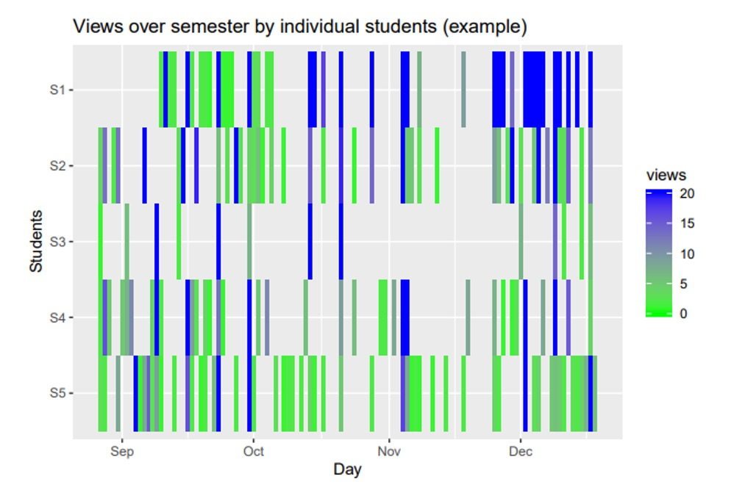
Exploring patterns in student activity within the ELMS-Canvas platform

Slide 26
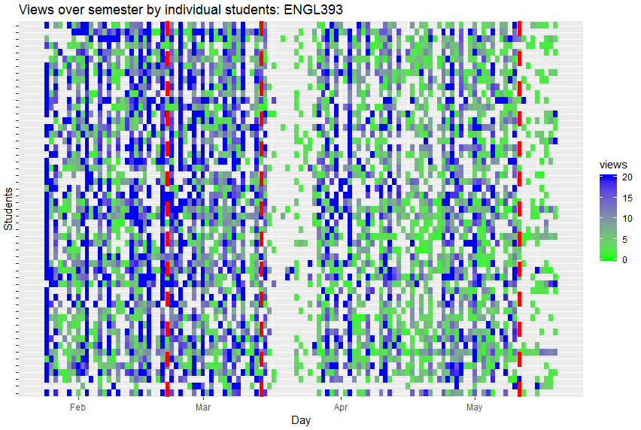
Exploring patterns in student activity within ELMS-Canvas
ENGL393 (n = 55)

Slide 27
Three Main Take-Aways
ELMS-Canvas:
A critical component of the teaching and learning experience
Patterns in usage provide insights into the overall student learning experience
Data housed within ELMS-Canvas serves robust resource for learning analytic research that can inform instructional design practices
ELMS = Enterprise Learning Management System
Notes:
Interested in student and faculty perceptions of technology (including classroom technology)
Part of a longer story on teaching and learning experiences at UMD
Presenting 2/5 sections (other sections: academic technology and wifi for teaching
Sneak peak before final report, just finished analyzing. If you have follow-up analyses ideas or questions, love to hear about it/get in touch
Future plans: survey instructors like this every other year. Students via ECAR every year

Slide 28
Megan Masters, PhD | Alia Lancaster, PhD | Martyn Clark, PhD | Phillip Scott Moses
acadtechfeedback@umd.edu

