Slide 1
ELMS-Canvas use at UMD
Perceptions of Online Privacy Survey Data Brief
Megan Masters, PhD, Alia Lancaster, PhD, Martyn Clark, PhD, & Bekzod Akramov
May 13, 2020
Special Meeting | Learning Technology Working Group, Research Technology Working Group, and IT Council
Notes:
Perceptions of Online Privacy Survey Data Brief
Megan Masters, PhD, Alia Lancaster, PhD, Martyn Clark, PhD, & Bekzod Akramov
May 13, 2020
Special Meeting| Learning Technology Working Group, Research Technology Working Group, and IT Council

Slide 3
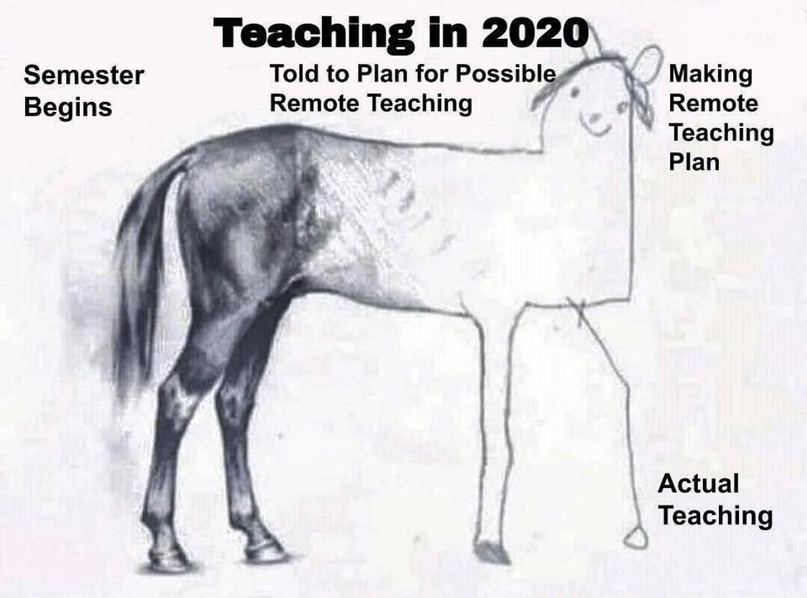
WORKING IN THE SPRING OF 2020
Semester
Begins
Thinking about planning for working/teaching remotely
Actually planning for working /teaching remotely
Actually working/ teaching remotely

Slide 4
Outline
Context of the Survey
Main findings
  Demographics
  Awareness of uses of personal data
  Being online
  Action to protect privacy
  Data at UMD
Implications

Slide 5
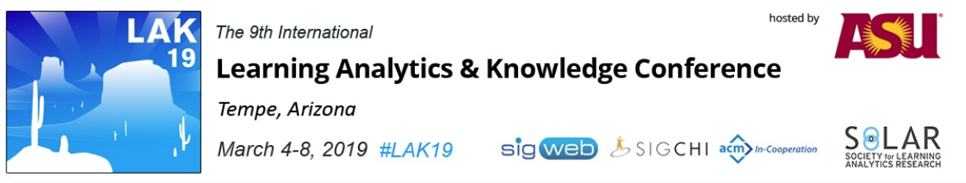
Previous Research

Slide 6
Previous Research
UK students at a fully online university:
Are not highly concerned about collection and use of personal data
Trust the higher education institution with data more than the average online provider
Do not read the Terms & Conditions (see also Obar & Oeldorf-Hirsch, 2016)

Slide 7
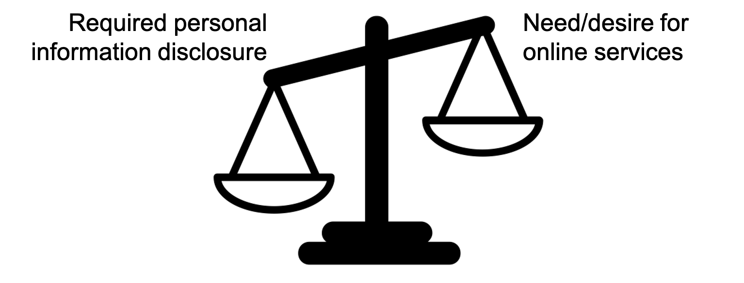
Previous Research
Privacy Calculus
Dinev, T. & Hart, P. (2006)

Slide 8

Previous Research
Privacy Paradox
Barnes, 2006; Brown, 2001; Norberg, Horne, & Horne, 2007

Slide 9
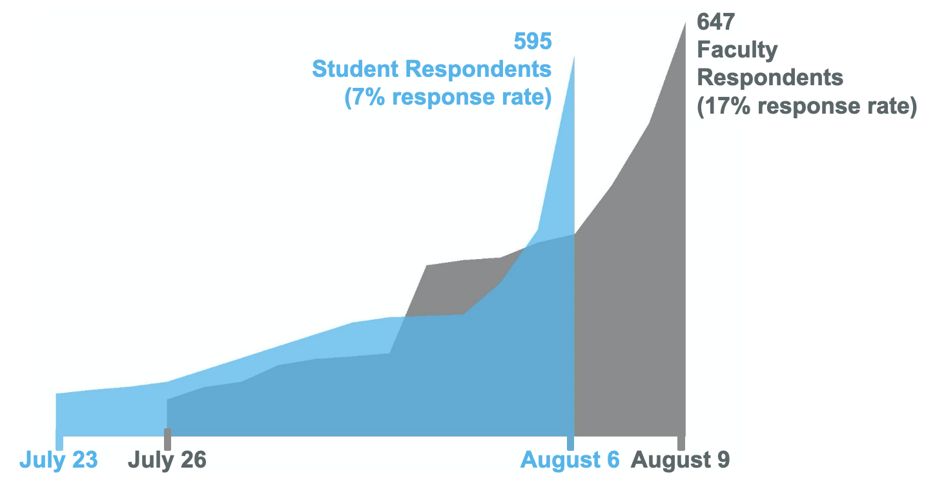
Survey Administration
Notes:
Our survey overrepresents freshmen and underrepresents seniors
Generally represents the university of Maryland population for both faculty and staff
Generally represents the University of Maryland population in terms of race/ethnicity
CMNS students were over-represented in both the faculty and student samples
Student info
Target population: All undergraduate students enrolled at the University of Maryland College Park during
the 2018-2019 academic year.
Sampling strategy: A simple random sampling technique was employed to randomly select 8,000 undergraduate
student emails from the target population with the assistance of the Registrar’s Office. The invited
sample size was selected in order to achieve approximately a 5% margin of error with the expected response
rate (i.e., we expected a 5-7% response rate based on previous survey administrations to the same group).
Response rate: 595 undergraduate students responded, resulting in a 7.44% response rate.
Completion rate: Of the student respondents, 347 (58%) fully completed the survey. In the subsequent
analysis, all responses are included on a per-question basis, thus the n-size per question may vary but is
displayed in the title of each table.
Duration: The median response time was 6 minutes.
Faculty info
Target population: All faculty members employed at the University of Maryland College Park during the
2018-2019 academic year.
Sampling strategy: A simple random sampling technique was employed to randomly select 3,700 faculty
emails from the target population with the assistance of the Registrar’s Office. The invited sample size was
selected in order to achieve approximately a 5% margin of error with the expected response rate (i.e., we
expected a 10% response rate based on previous survey administrations to the same group).
Response rate: 647 faculty members responded, resulting in a 17.49% response rate.
Completion rate: Of the faculty respondents, 498 (77%) fully completed the survey. In the subsequent
analysis, all responses are included on a per-question basis

Slide 10
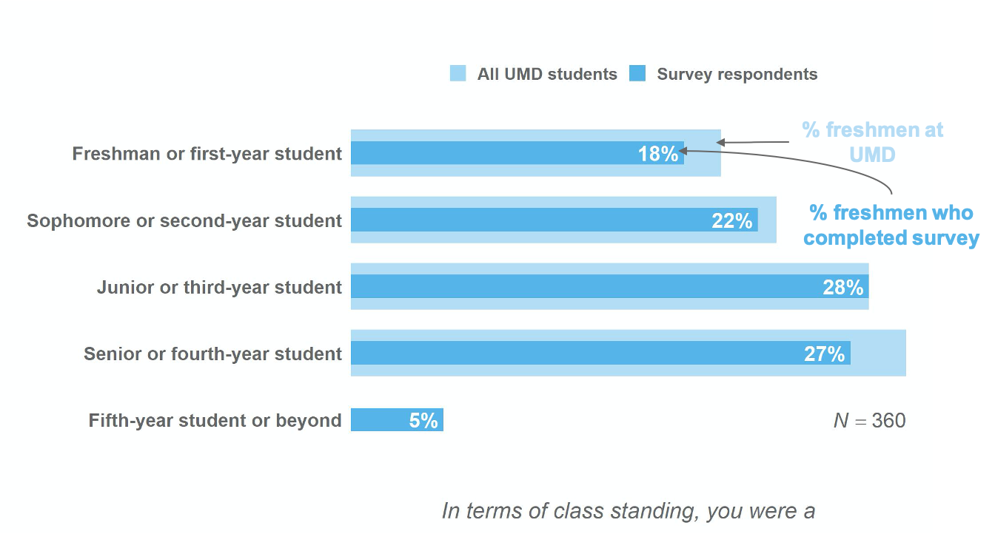
Demographics
Student respondents generally represented the student population in terms of class standing during AY 2018-2019.
Notes:
Our survey overrepresents freshmen and underrepresents seniors

Slide 11
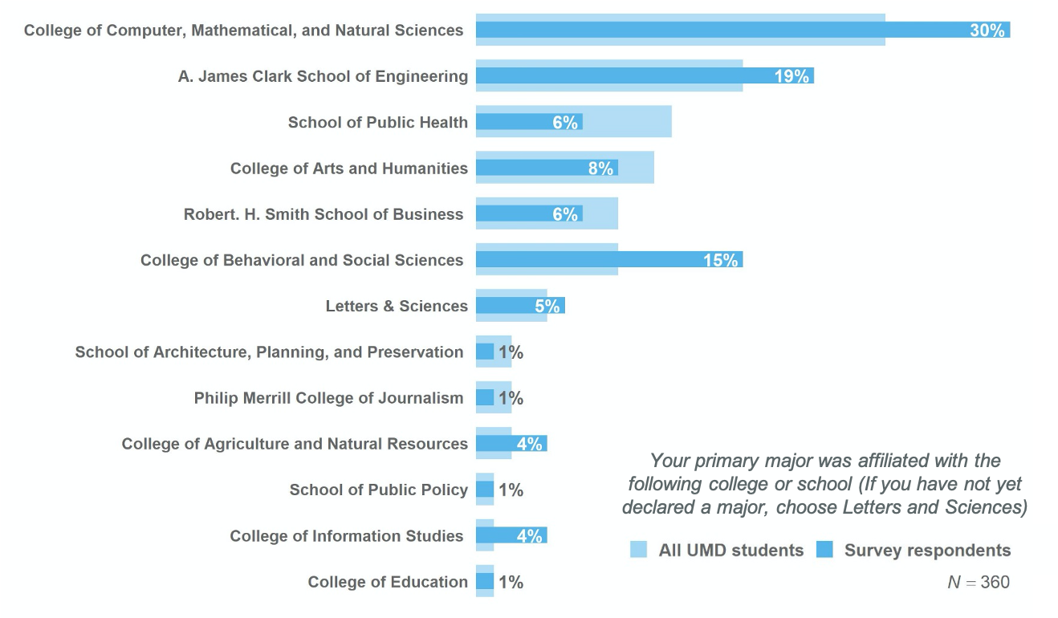
Demographics
Almost a third of student respondents’ primary major was in CMNS.
Notes:
Our survey overrepresents freshmen and underrepresents seniors

Slide 12
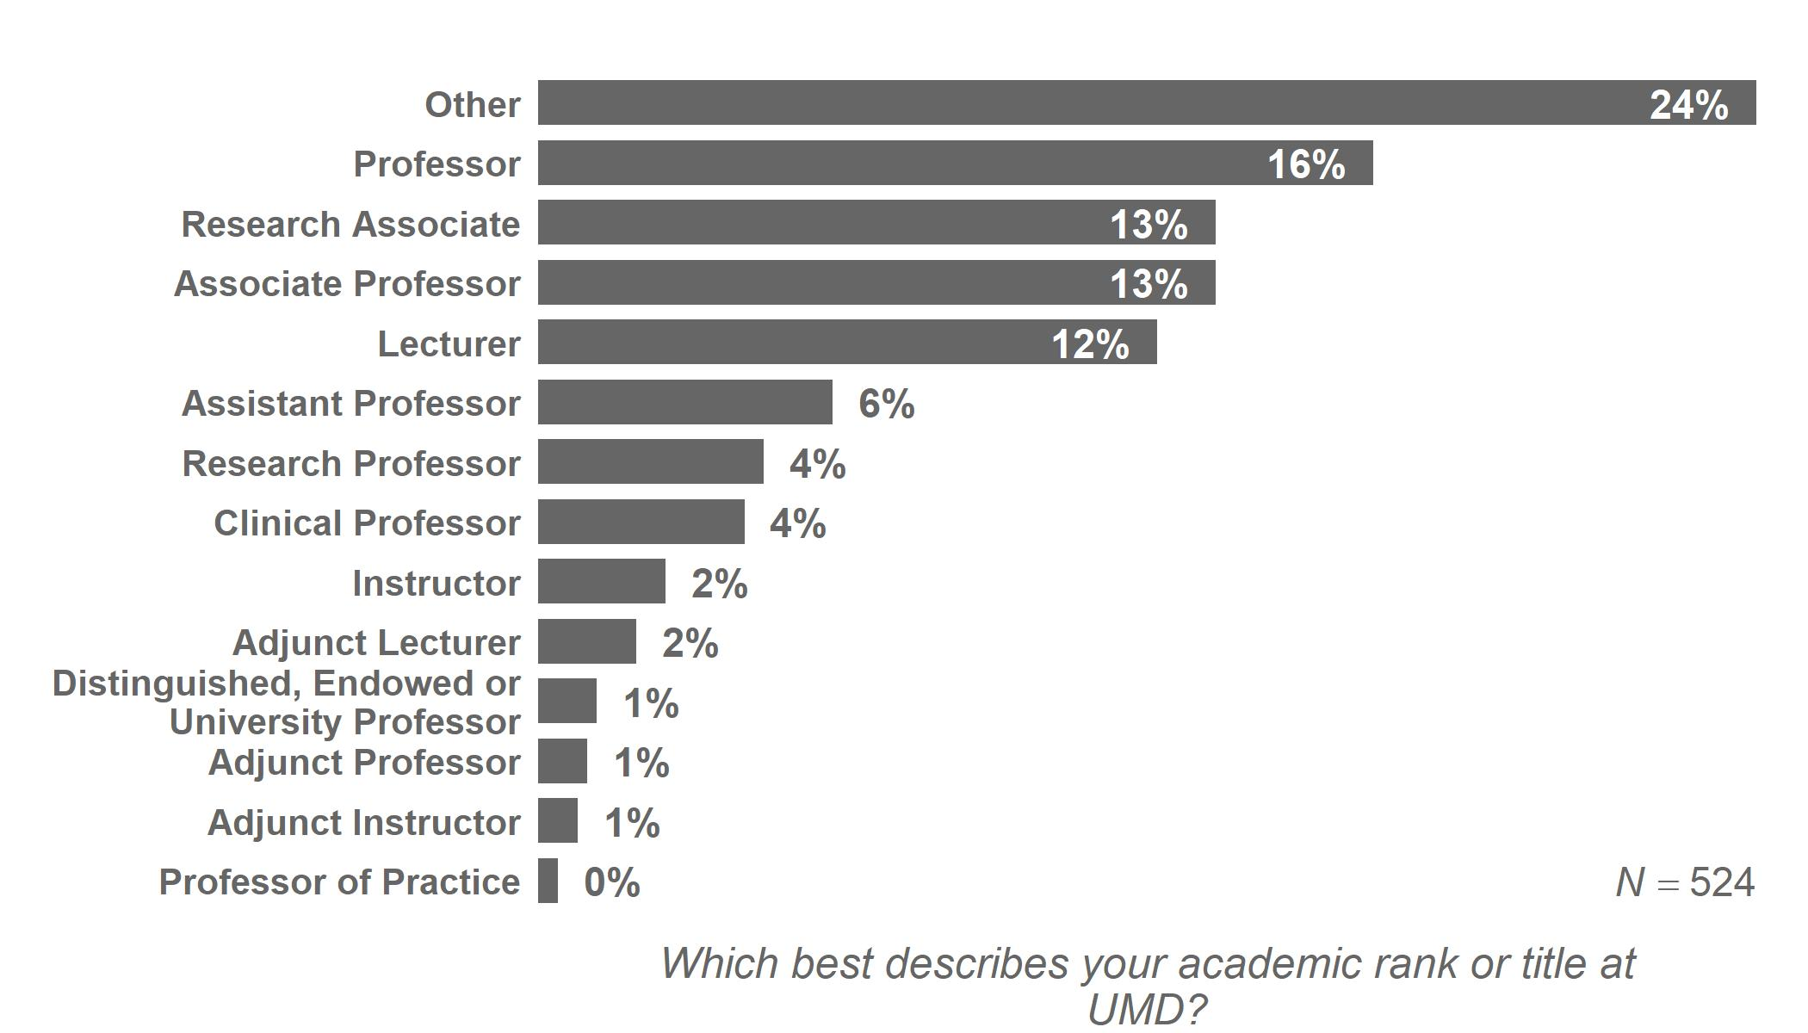
Demographics
22% of faculty respondents were lecturers or instructors.
Notes:
Units that had 0% survey respondents and 0% UMD faculty (and were removed from the bottom of the graph for readability): VP for university relations, VP for student affairs, VP for admin and finance, Shady grove center, graduate school, facilities management

Slide 13
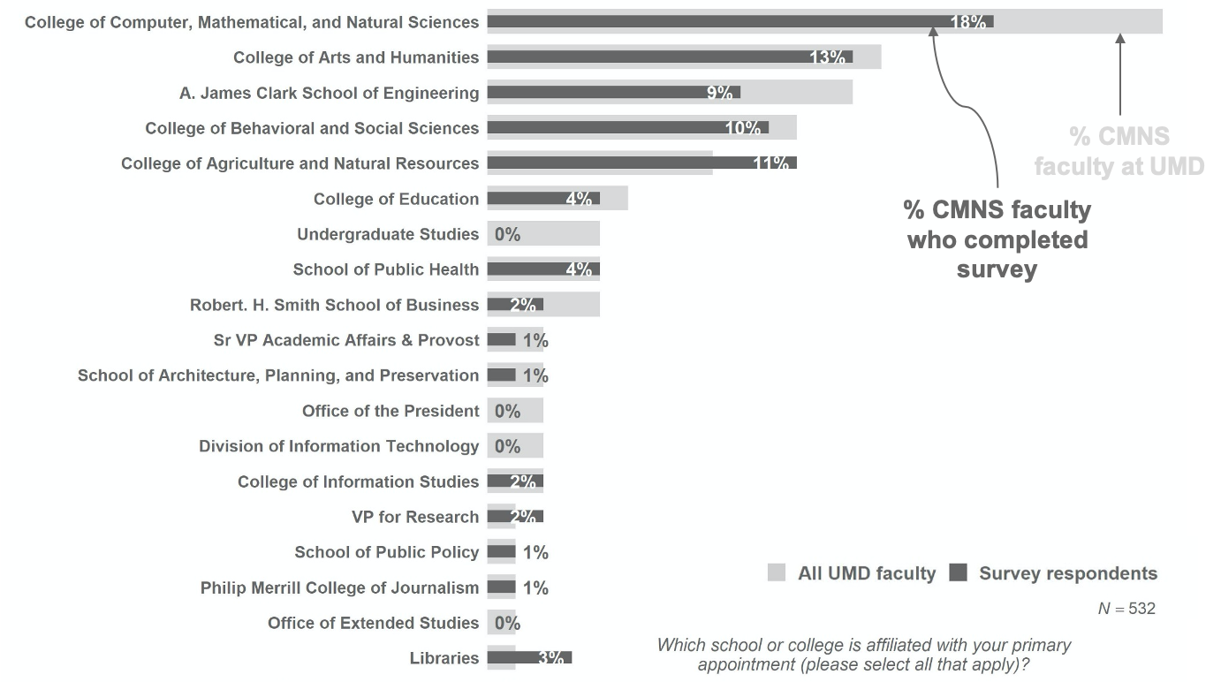
Demographics
Nearly a fifth of faculty were affiliated with CMNS during AY 2017-2018.
Notes:
Units that had 0% survey respondents and 0% UMD faculty (and were removed from the bottom of the graph for readability): VP for university relations, VP for student affairs, VP for admin and finance, Shady grove center, graduate school, facilities management

Slide 14
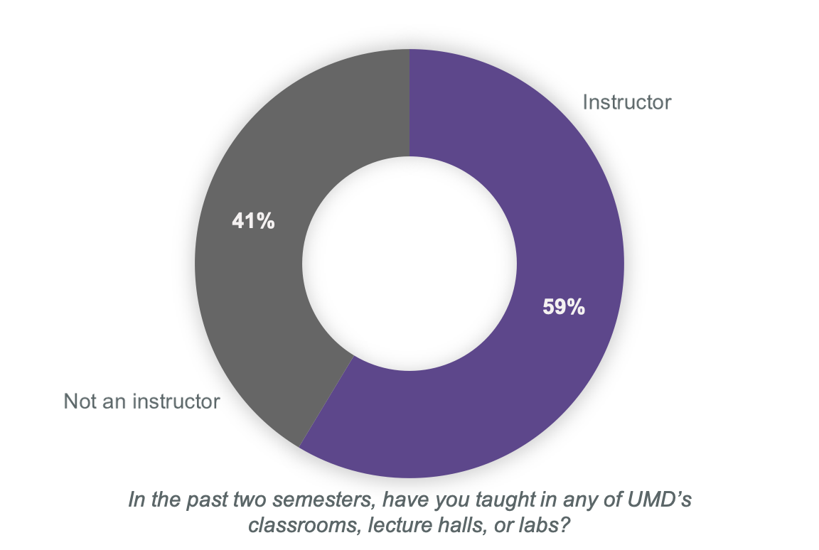
Demographics
Over half of faculty respondents had taught during AY 2018-2019
Notes:
Units that had 0% survey respondents and 0% UMD faculty (and were removed from the bottom of the graph for readability): VP for university relations, VP for student affairs, VP for admin and finance, Shady grove center, graduate school, facilities management

Slide 15
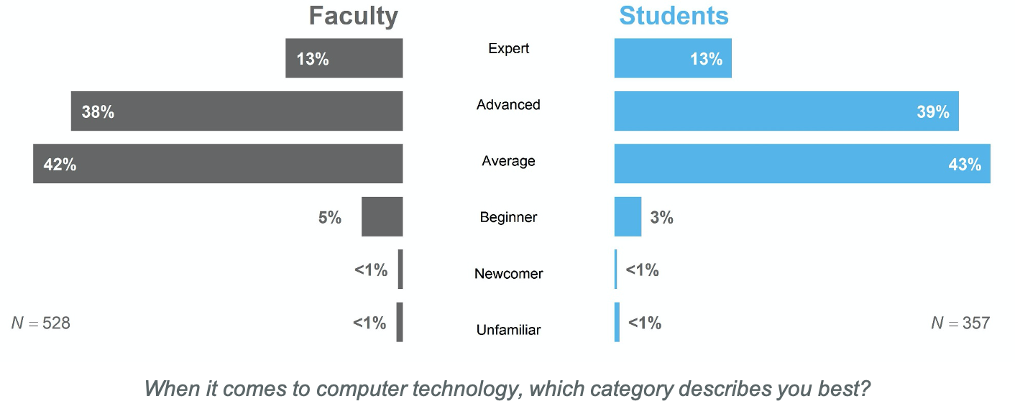
Digital literacy
The majority of faculty and students self-rated themselves as advanced or experts in terms of digital literacy.
Notes:
When it comes to digital literacy, instructors and students rated themselves similarly.
Granted this is self-report, so categories may be something slightly different to different groups, but I think both groups have assumptions about the other on this topic.
Instructors could overestimate students’ digital literacy
Entire Scale:
Unfamiliar – I have little to no experience with computer technologies
Newcomer – I have attempted to use computer technologies, but I still require help on a regular basis
Beginner – I am able to perform basic functions in a limited number of computer applications
average (i.e, “I demonstrate a general competency in a number of computer applications”)
advanced (i.e., “I have acquired the ability to completely use a broad spectrum of computer technologies”)
Expert – I am extremely proficient in using a wide variety of computer technologies

Slide 16
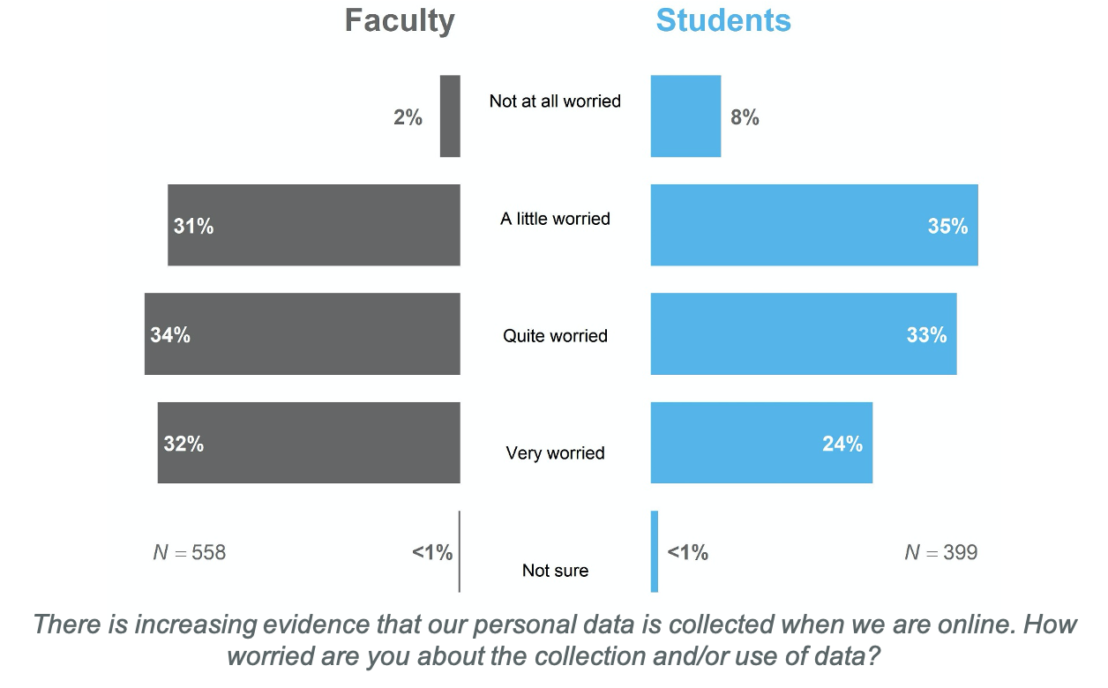
Awareness of uses of personal data
Faculty and students show similar levels of worry about collection and use of data.

Slide 17
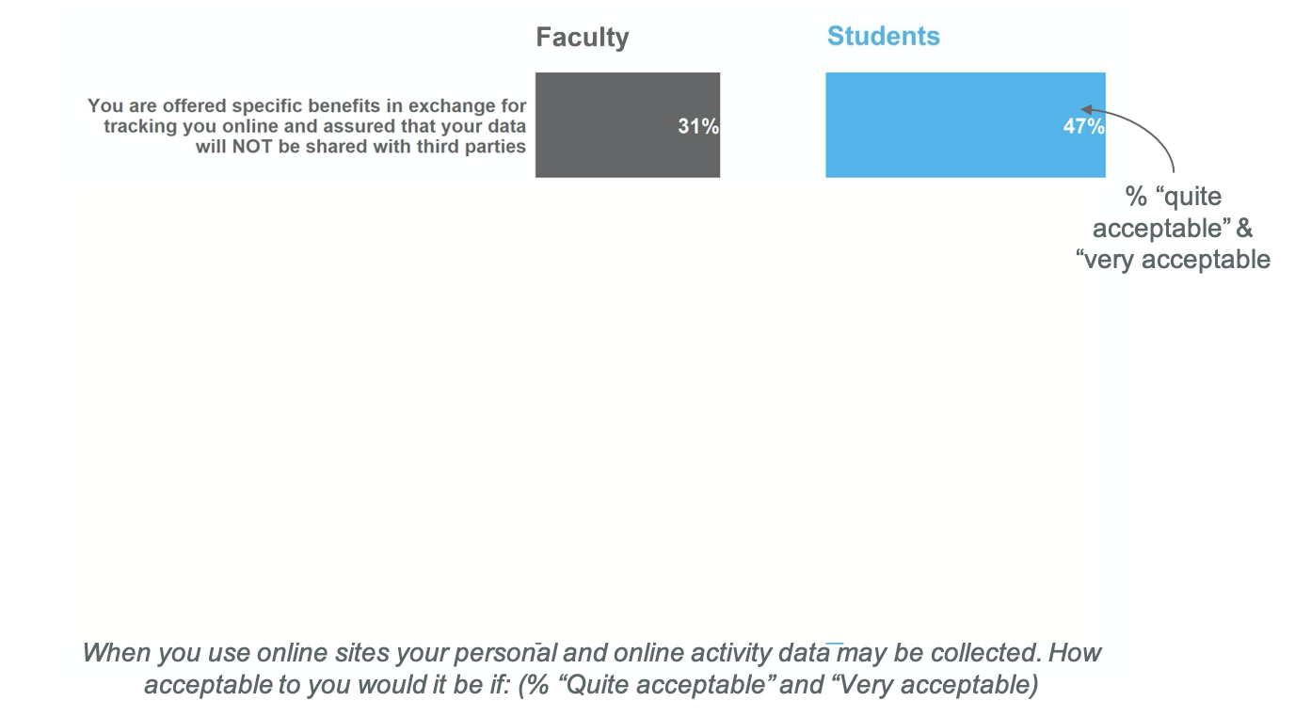
Awareness of uses of personal data
Less than half of faculty and students think it is acceptable for identifiable, online activity data to be shared with third parties.

Slide 18
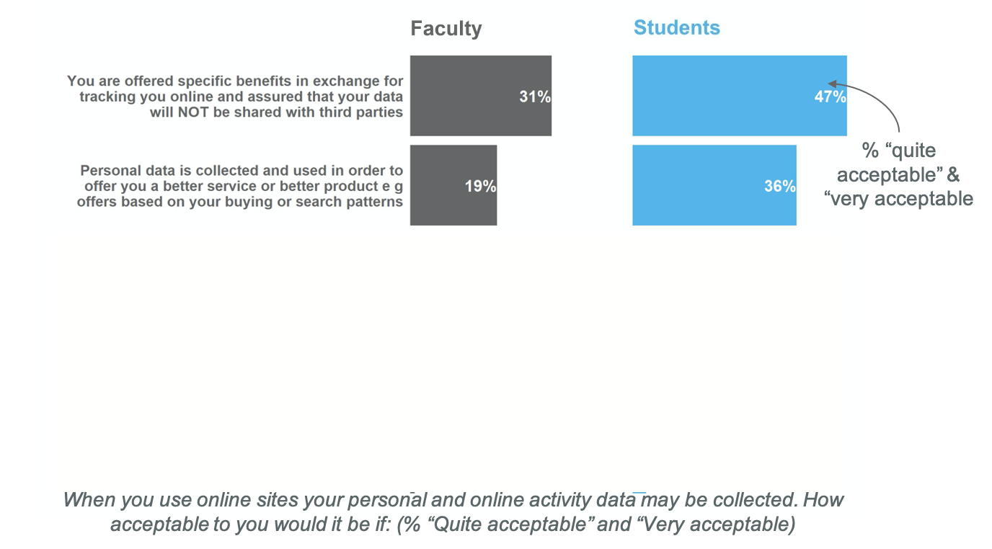
Awareness of uses of personal data
Less than half of faculty and students think it is acceptable for identifiable, online activity data to be shared with third parties.

Slide 19
Awareness of uses of personal data
Less than half of faculty and students think it is acceptable for identifiable, online activity data to be shared with third parties.

Slide 20
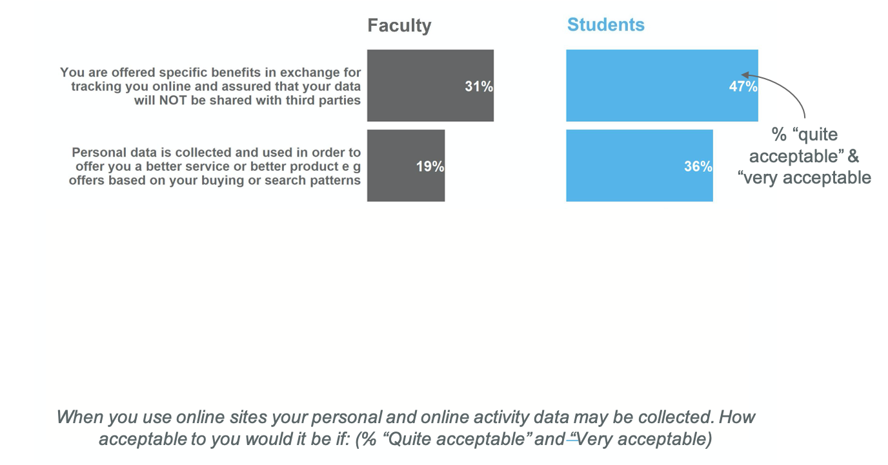
Awareness of uses of personal data
Less than half of faculty and students think it is acceptable for identifiable, online activity data to be shared with third parties.

Slide 21
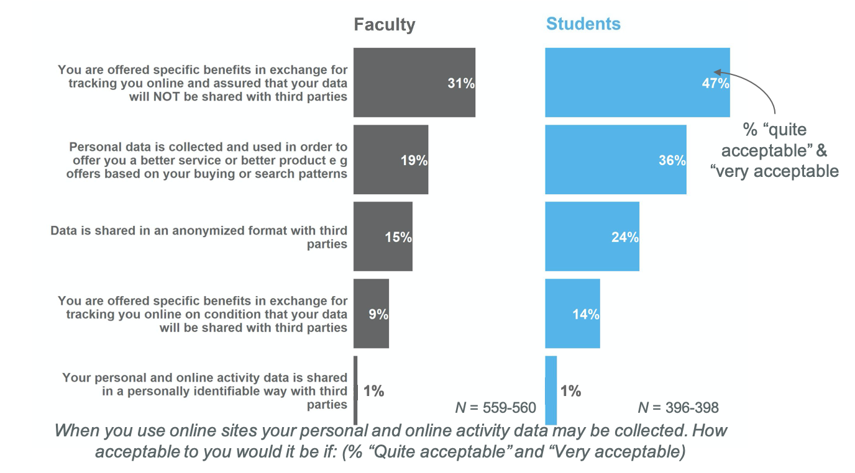
Awareness of uses of personal data
Less than half of faculty and students think it is acceptable for identifiable, online activity data to be shared with third parties.

Slide 22
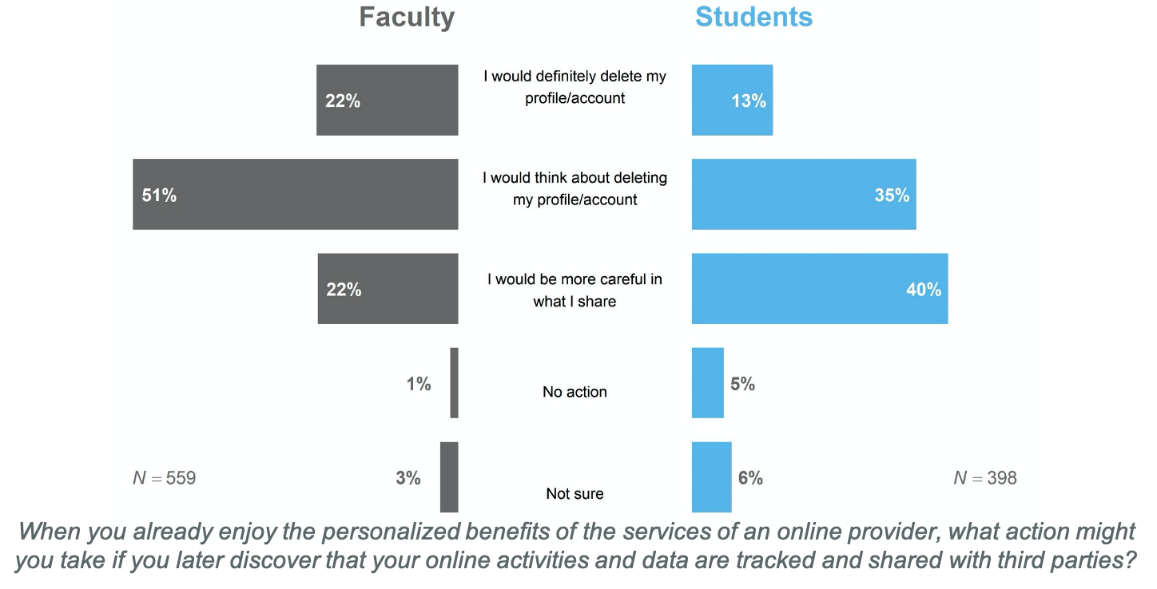
Awareness of uses of personal data
Faculty would think more seriously about deleting an account than students if they found out the data was shared with third parties.

Slide 23
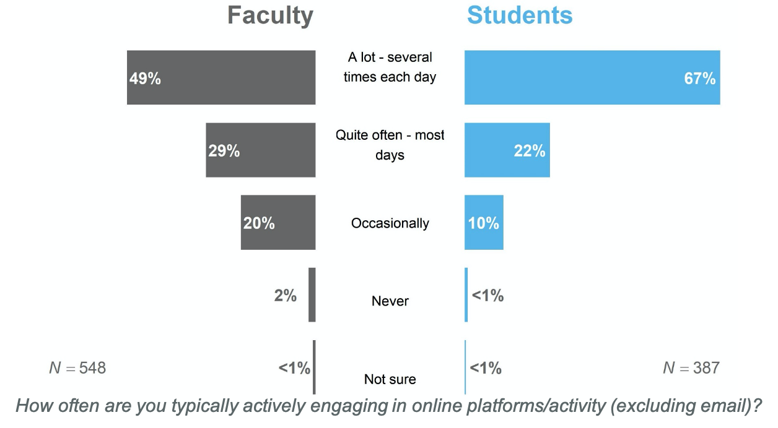
Being online
A majority of faculty and students are online most days.

Slide 24
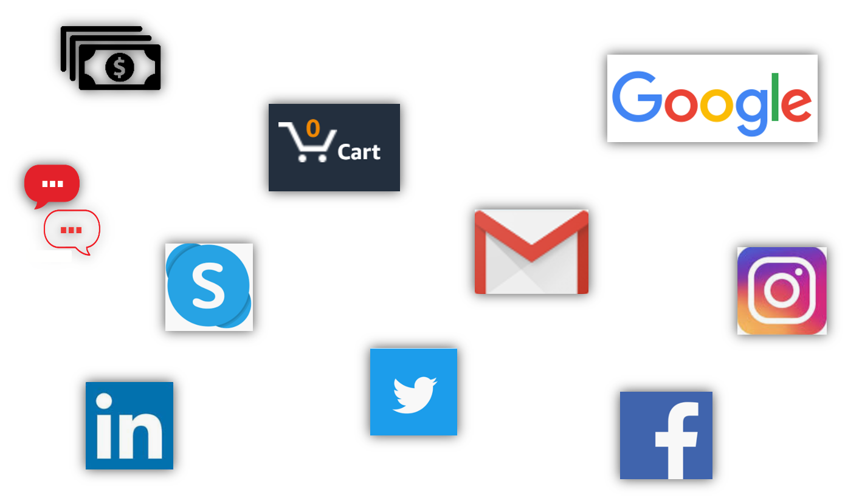
Being online
How often do you use

Slide 25
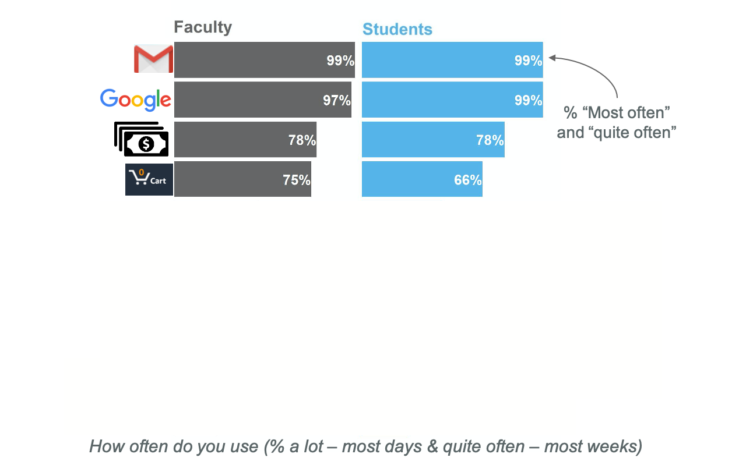
Being online
Both faculty and students regularly use email, search engines, online banking, and online shopping services.
Notes:
Faculty and students are using the top ones pretty much the same
It’s only when we get into tools not used as much that we see any differences (messaging apps and Instagram)
Response options were:
Email
Online search engines such as google or bing
Online service sites such as banking, sending or receiving money, food deliver, ride sharing, etc.
Online shopping sites like amazon or ebay
Facebook
Online texting services such as whatsapp or messenger
Skype, facetime, or an equivalent real time online calling service
Picture sharing services such as pinterest, Instagram, or google photos
Twitter
Linkedin

Slide 26
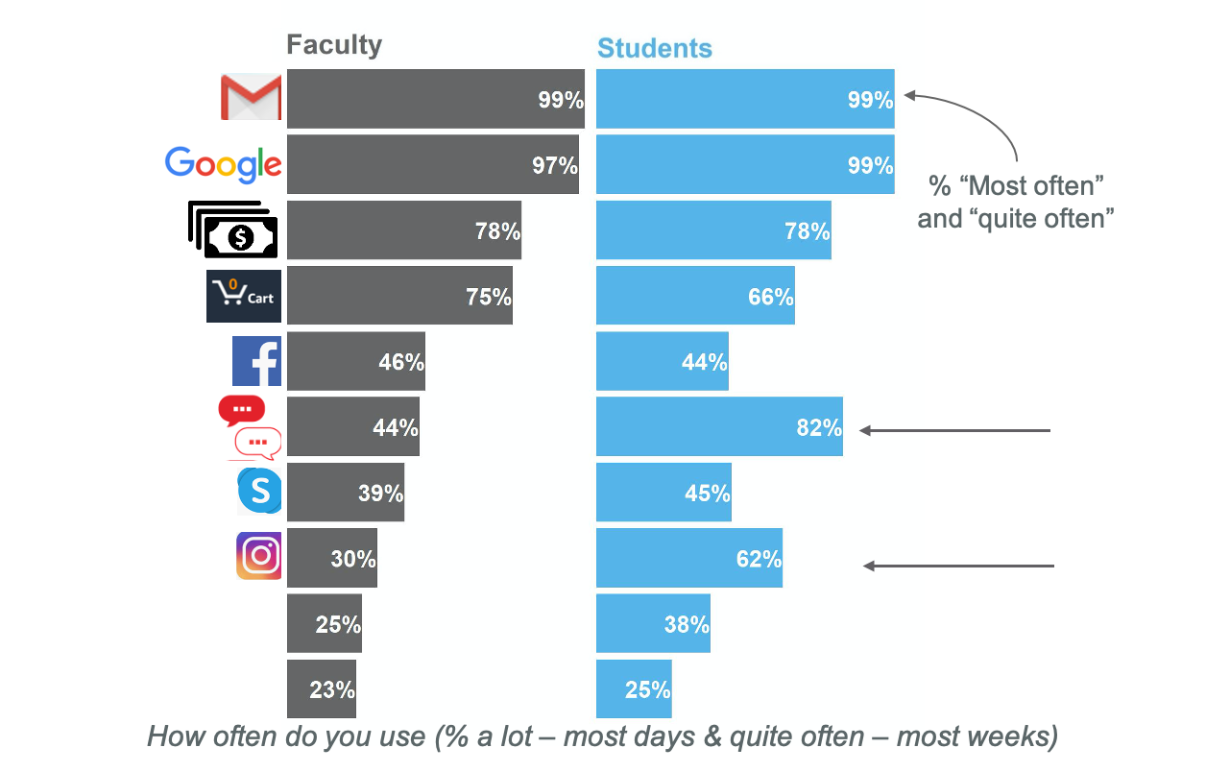
Being online
Both faculty and students regularly use email, search engines, online banking, and online shopping services.
Notes:
Faculty and students are using the top ones pretty much the same
It’s only when we get into tools not used as much that we see any differences (messaging apps and Instagram)
Response options were:
Email
Online search engines such as google or bing
Online service sites such as banking, sending or receiving money, food deliver, ride sharing, etc.
Online shopping sites like amazon or ebay
Facebook
Online texting services such as whatsapp or messenger
Skype, facetime, or an equivalent real time online calling service
Picture sharing services such as pinterest, Instagram, or google photos
Twitter
Linkedin

Slide 27
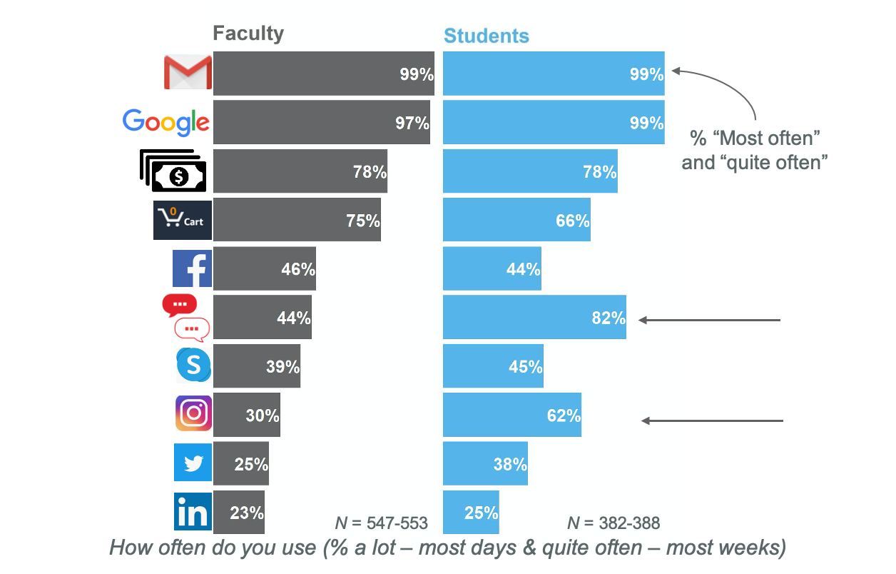
Being online
Both faculty and students regularly use email, search engines, online banking, and online shopping services.
Notes:
Faculty and students are using the top ones pretty much the same
It’s only when we get into tools not used as much that we see any differences (messaging apps and Instagram)
Response options were:
Email
Online search engines such as google or bing
Online service sites such as banking, sending or receiving money, food deliver, ride sharing, etc.
Online shopping sites like amazon or ebay
Facebook
Online texting services such as whatsapp or messenger
Skype, facetime, or an equivalent real time online calling service
Picture sharing services such as pinterest, Instagram, or google photos
Twitter
Linkedin

Slide 28
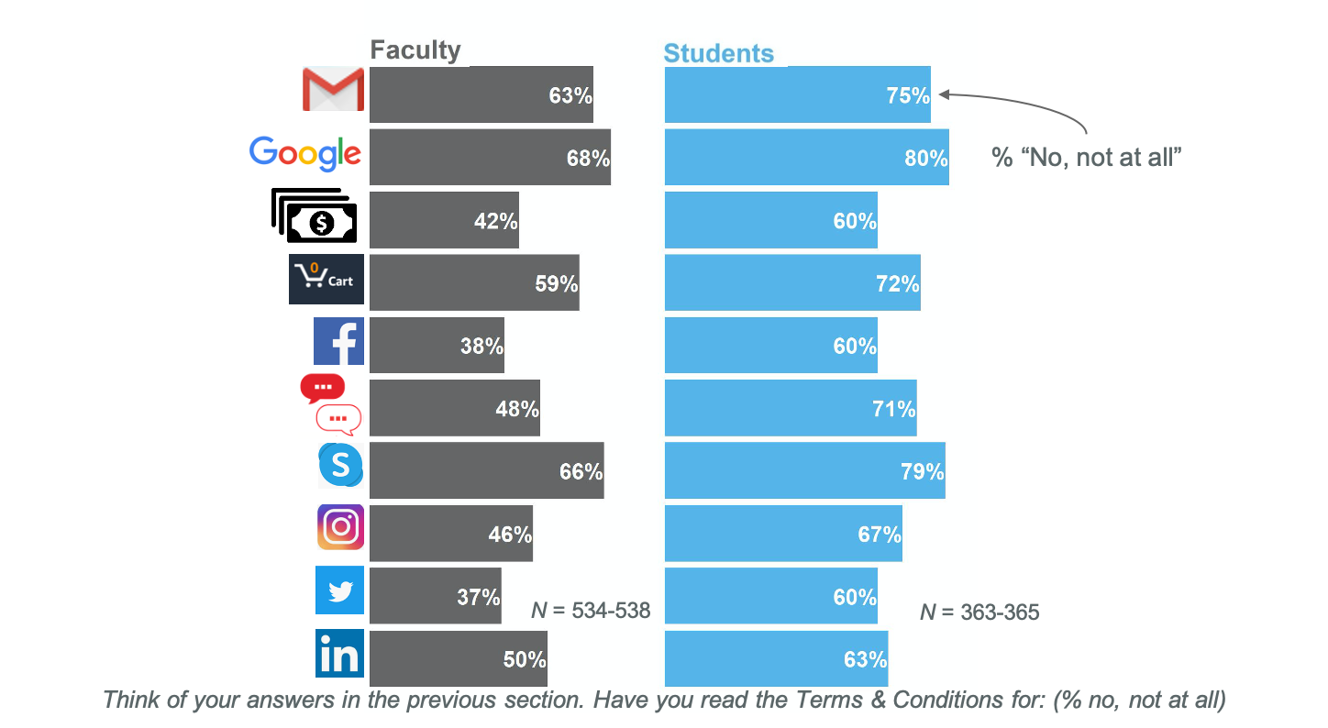
Actions to protect privacy online
A majority of students or faculty do not read the Terms & Conditions

Slide 29
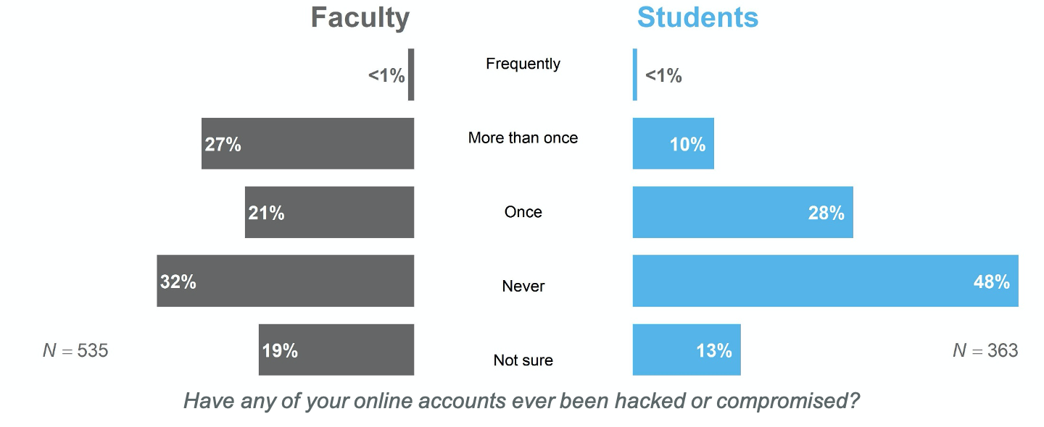
Actions to protect privacy online
A higher percentage of faculty (48%) reported having their online accounts hacked or compromised than students (38%).

Slide 30
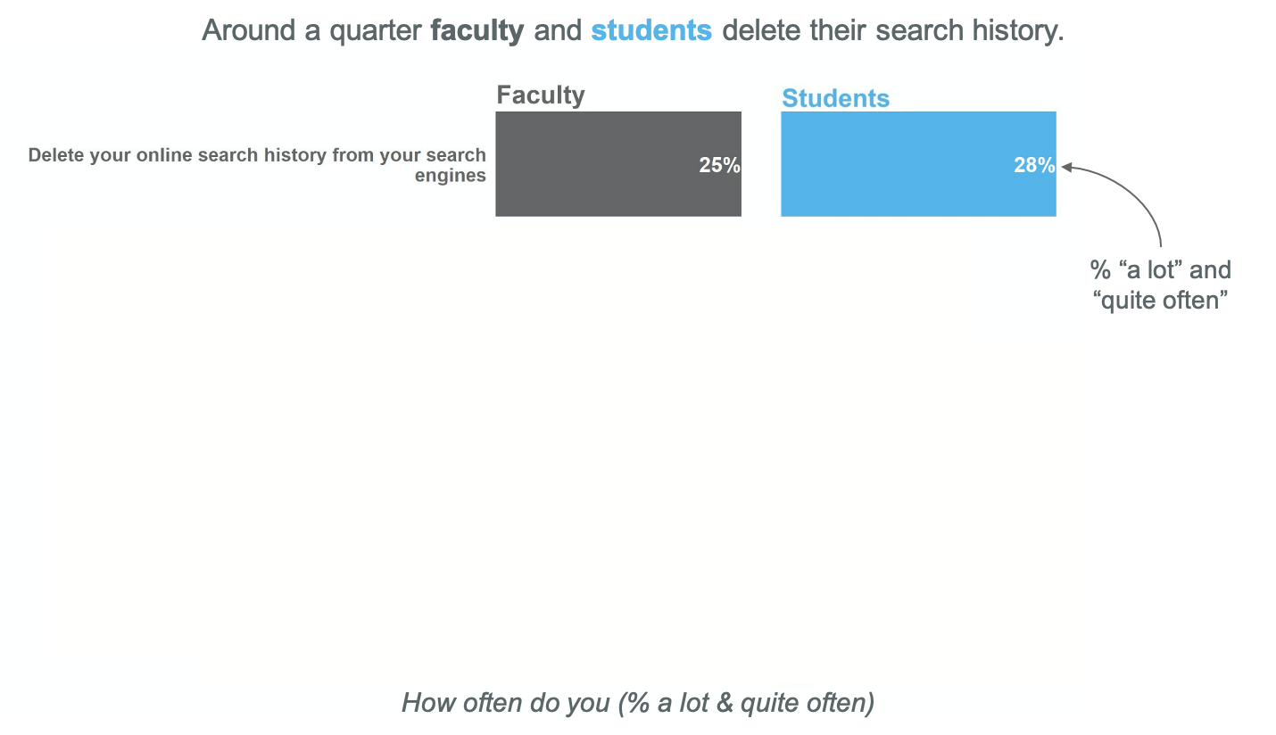
Actions to protect privacy online
Notes:
Not at all % for:
Encrypt calls: 82 faculty, 81 students
Encrypt texts: 78% faculty, 75% students
Encrypt email: 74 faculty, 71 students

Slide 31
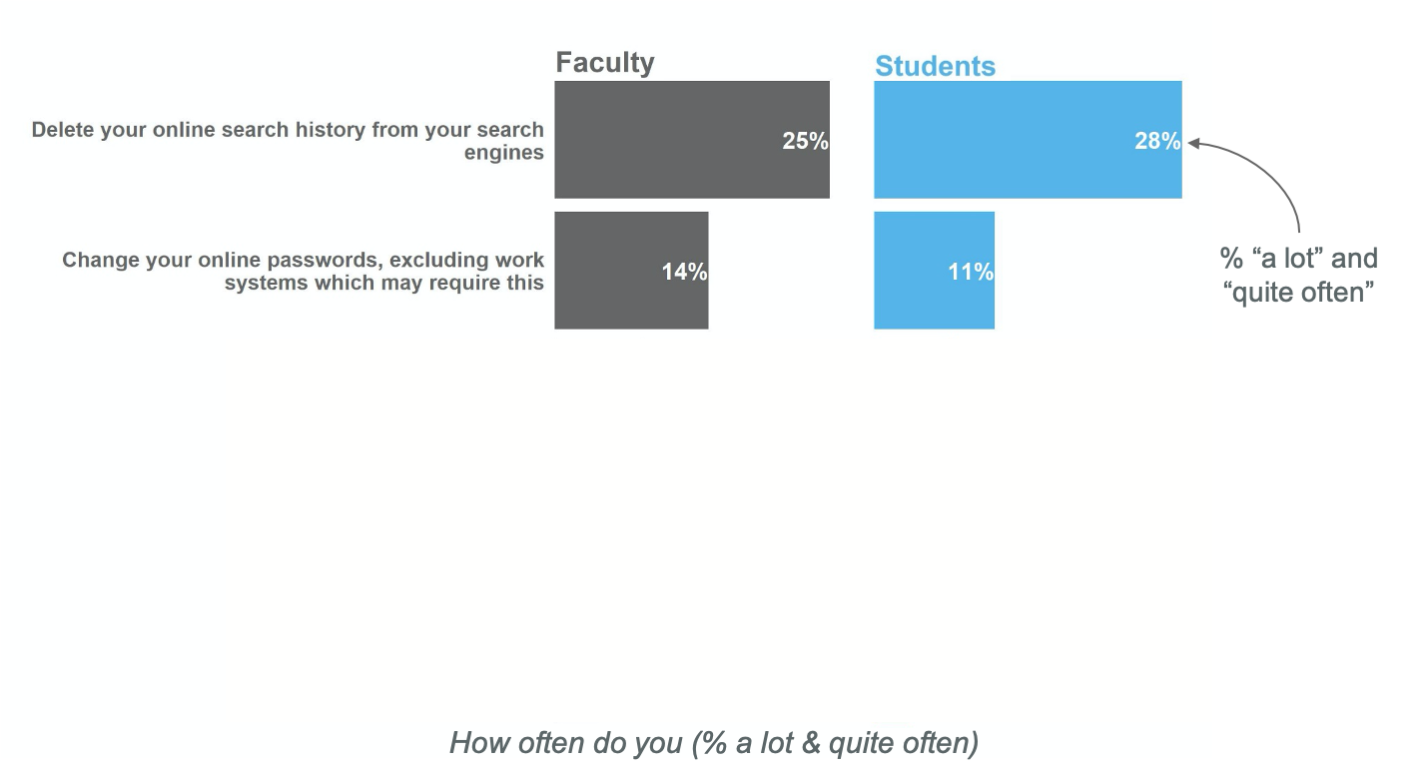
Actions to protect privacy online
Around a quarter faculty and students delete their search history.
Notes:
Not at all % for:
Encrypt calls: 82 faculty, 81 students
Encrypt texts: 78% faculty, 75% students
Encrypt email: 74 faculty, 71 students

Slide 32
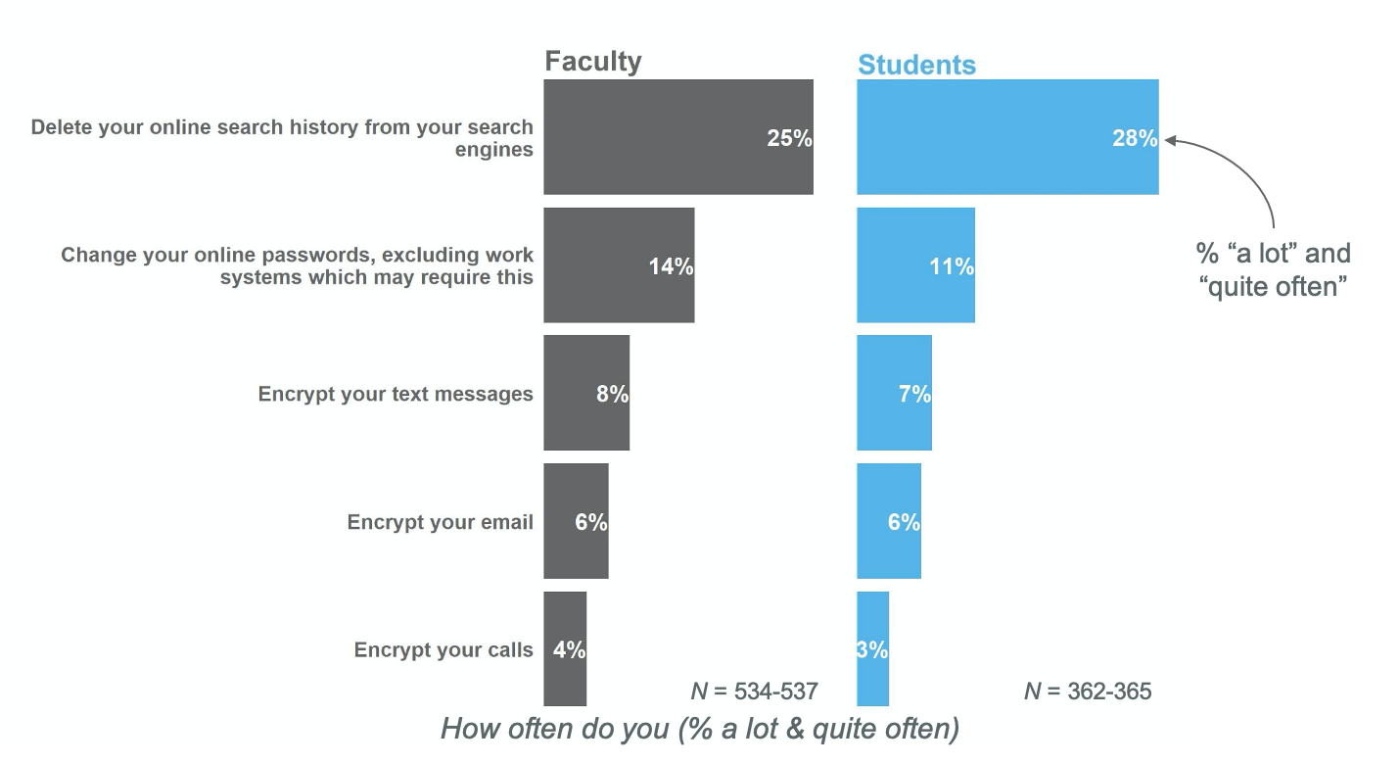
Actions to protect privacy online
Around a quarter faculty and students delete their search history.
Notes:
Not at all % for:
Encrypt calls: 82 faculty, 81 students
Encrypt texts: 78% faculty, 75% students
Encrypt email: 74 faculty, 71 students

Slide 33
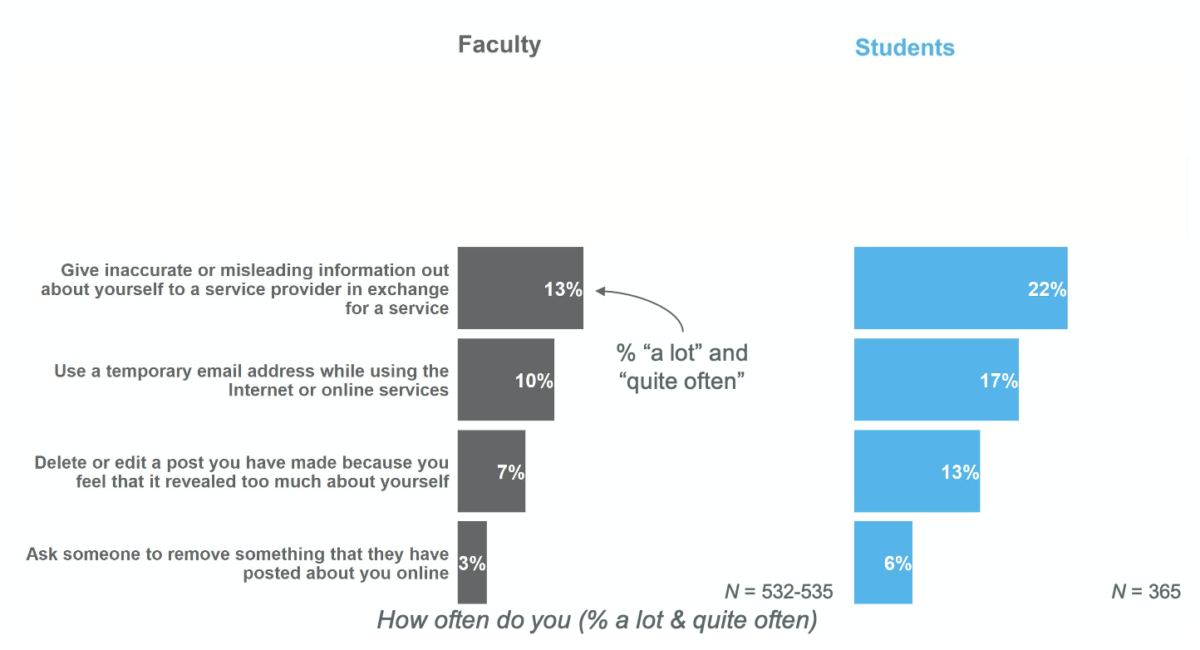
Actions to protect privacy online
Students more often provide inaccurate information to use an online service than faculty.

Slide 34
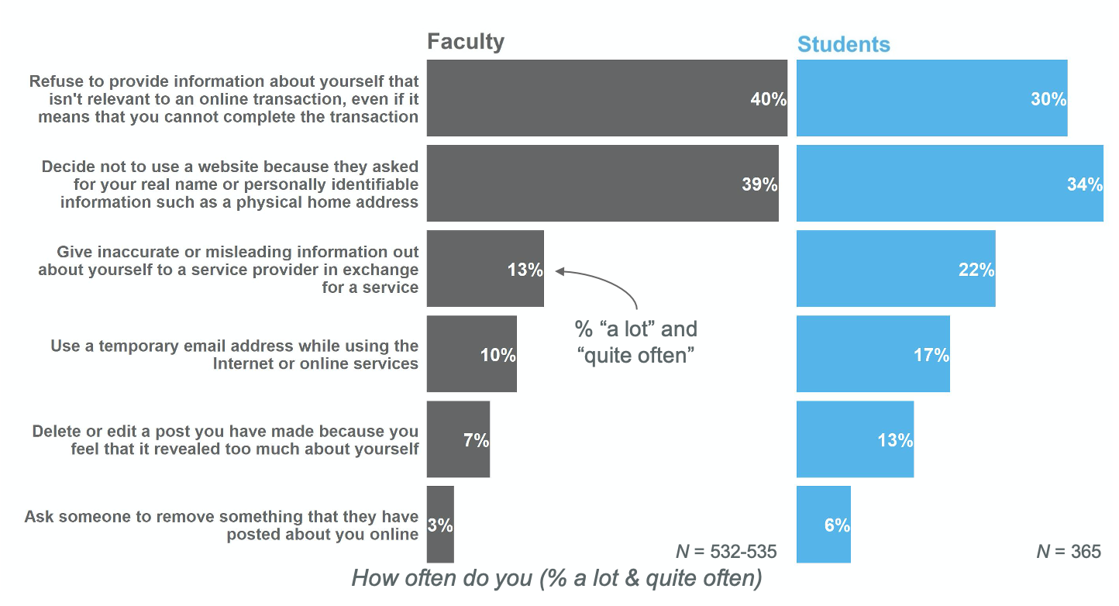
Actions to protect privacy online
Students more often provide inaccurate information to use an online service than faculty.

Slide 35
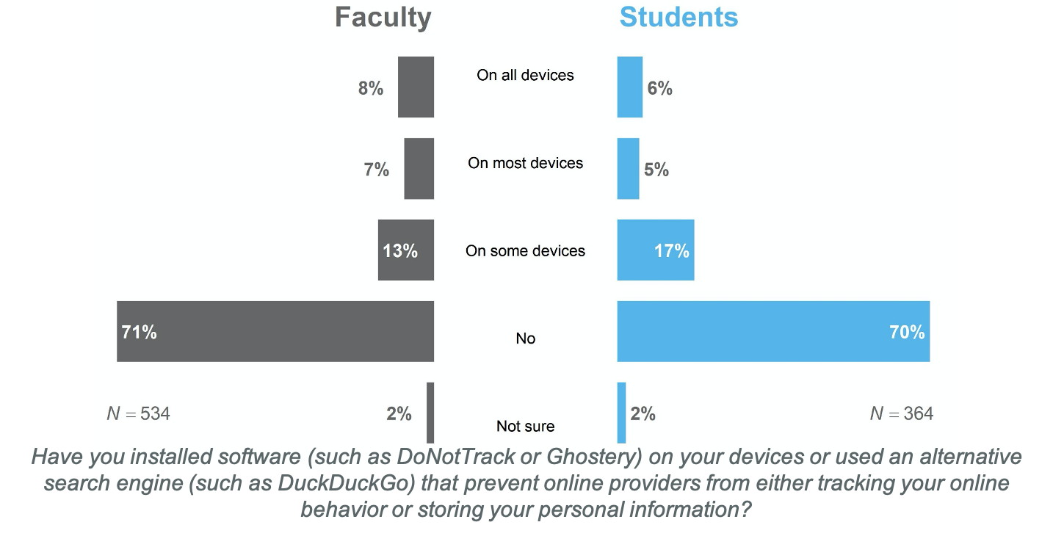
Actions to protect privacy online
Neither faculty nor students have installed software or used alternative search engines to prevent personal data storage and tracking.

Slide 36
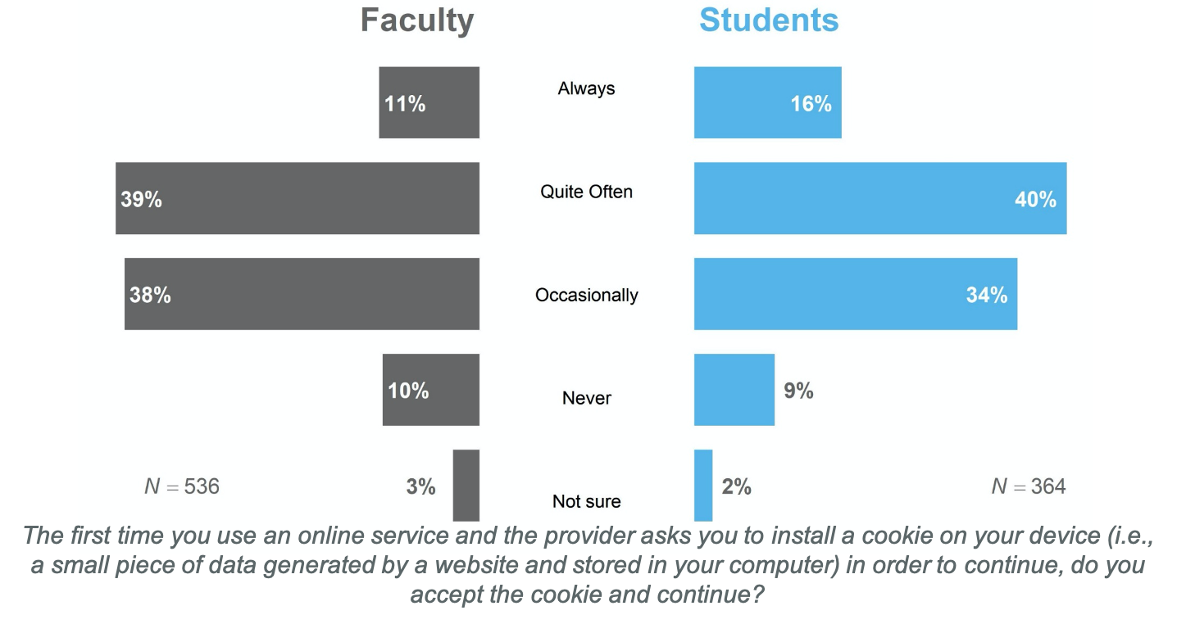
Actions to protect privacy online
About half of faculty and students regularly accept cookies.

Slide 37
Student comments
I use private browsing windows with an adblocker and noscript so that even when sites put cookies on my computer, they are erased when I close the window. I also use a VPN in an effort to keep my browsing a little more anonymous, and I try to read Terms of Service and Privacy Policies...
I think privacy and anonymity are fantasies and should be treated as such. anything posted on the internet can be traced with enough effort, tools, and know how. No one should ever post anything online they wouldn’t announce out loud in a crowded room. for me, worrying about privacy is a waste of time.
Notes:
Contrasting student comments on the efficacy beliefs they have about their actions
These represent endpoints of the spectrum

Slide 38
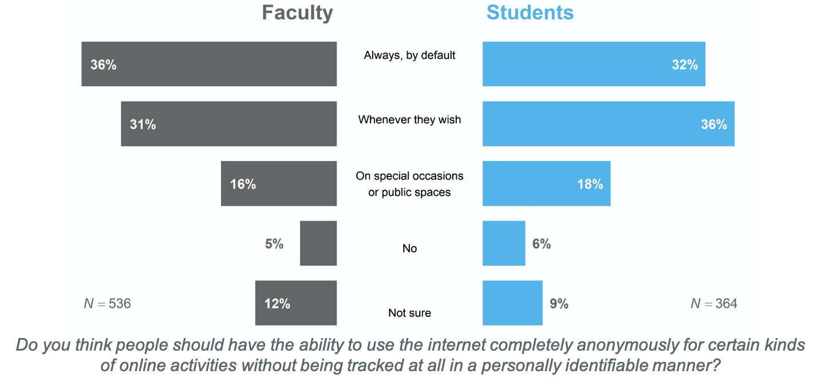
Actions to protect privacy online
About a third of faculty and students believe that people should always be able to use the internet anonymously for certain activities.

Slide 39
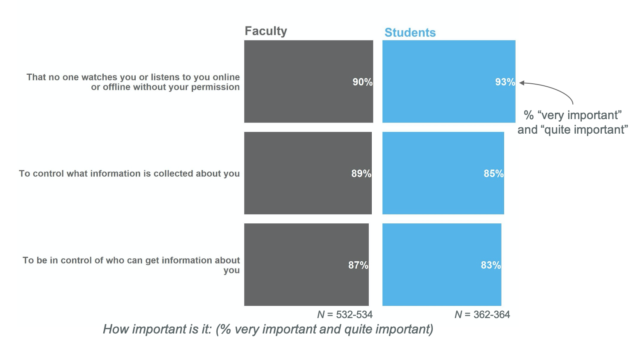
Actions to protect privacy online
Over 85% of faculty and students believe it is important to control who and what is collected about you online.

Slide 40
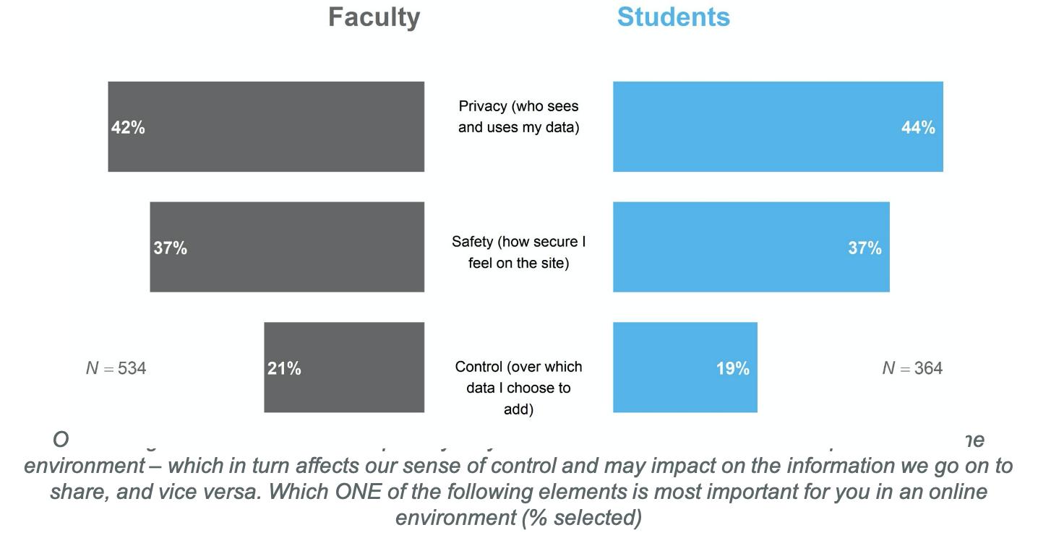
Actions to protect privacy online
Privacy is most important factor for both faculty and students in online environments.
Notes:
What are our expectations of privacy when it comes to things like use of webcams, forced to show where you live and your surroundings…what unconscious biases are arising by both students and faculty that could influence their learning experiences?
Increasing privacy-related vulnerabilities when the lines are more and more blurred between work and home life
For our current learning context, we needed different ways to keep track of students while learning remotely than we did when learning in a traditional face-to-face setting
This is particularly important when we think about things like contact tracing
Student application development and the inclusion of things such as “geo fencing” around UMD campus

Slide 41
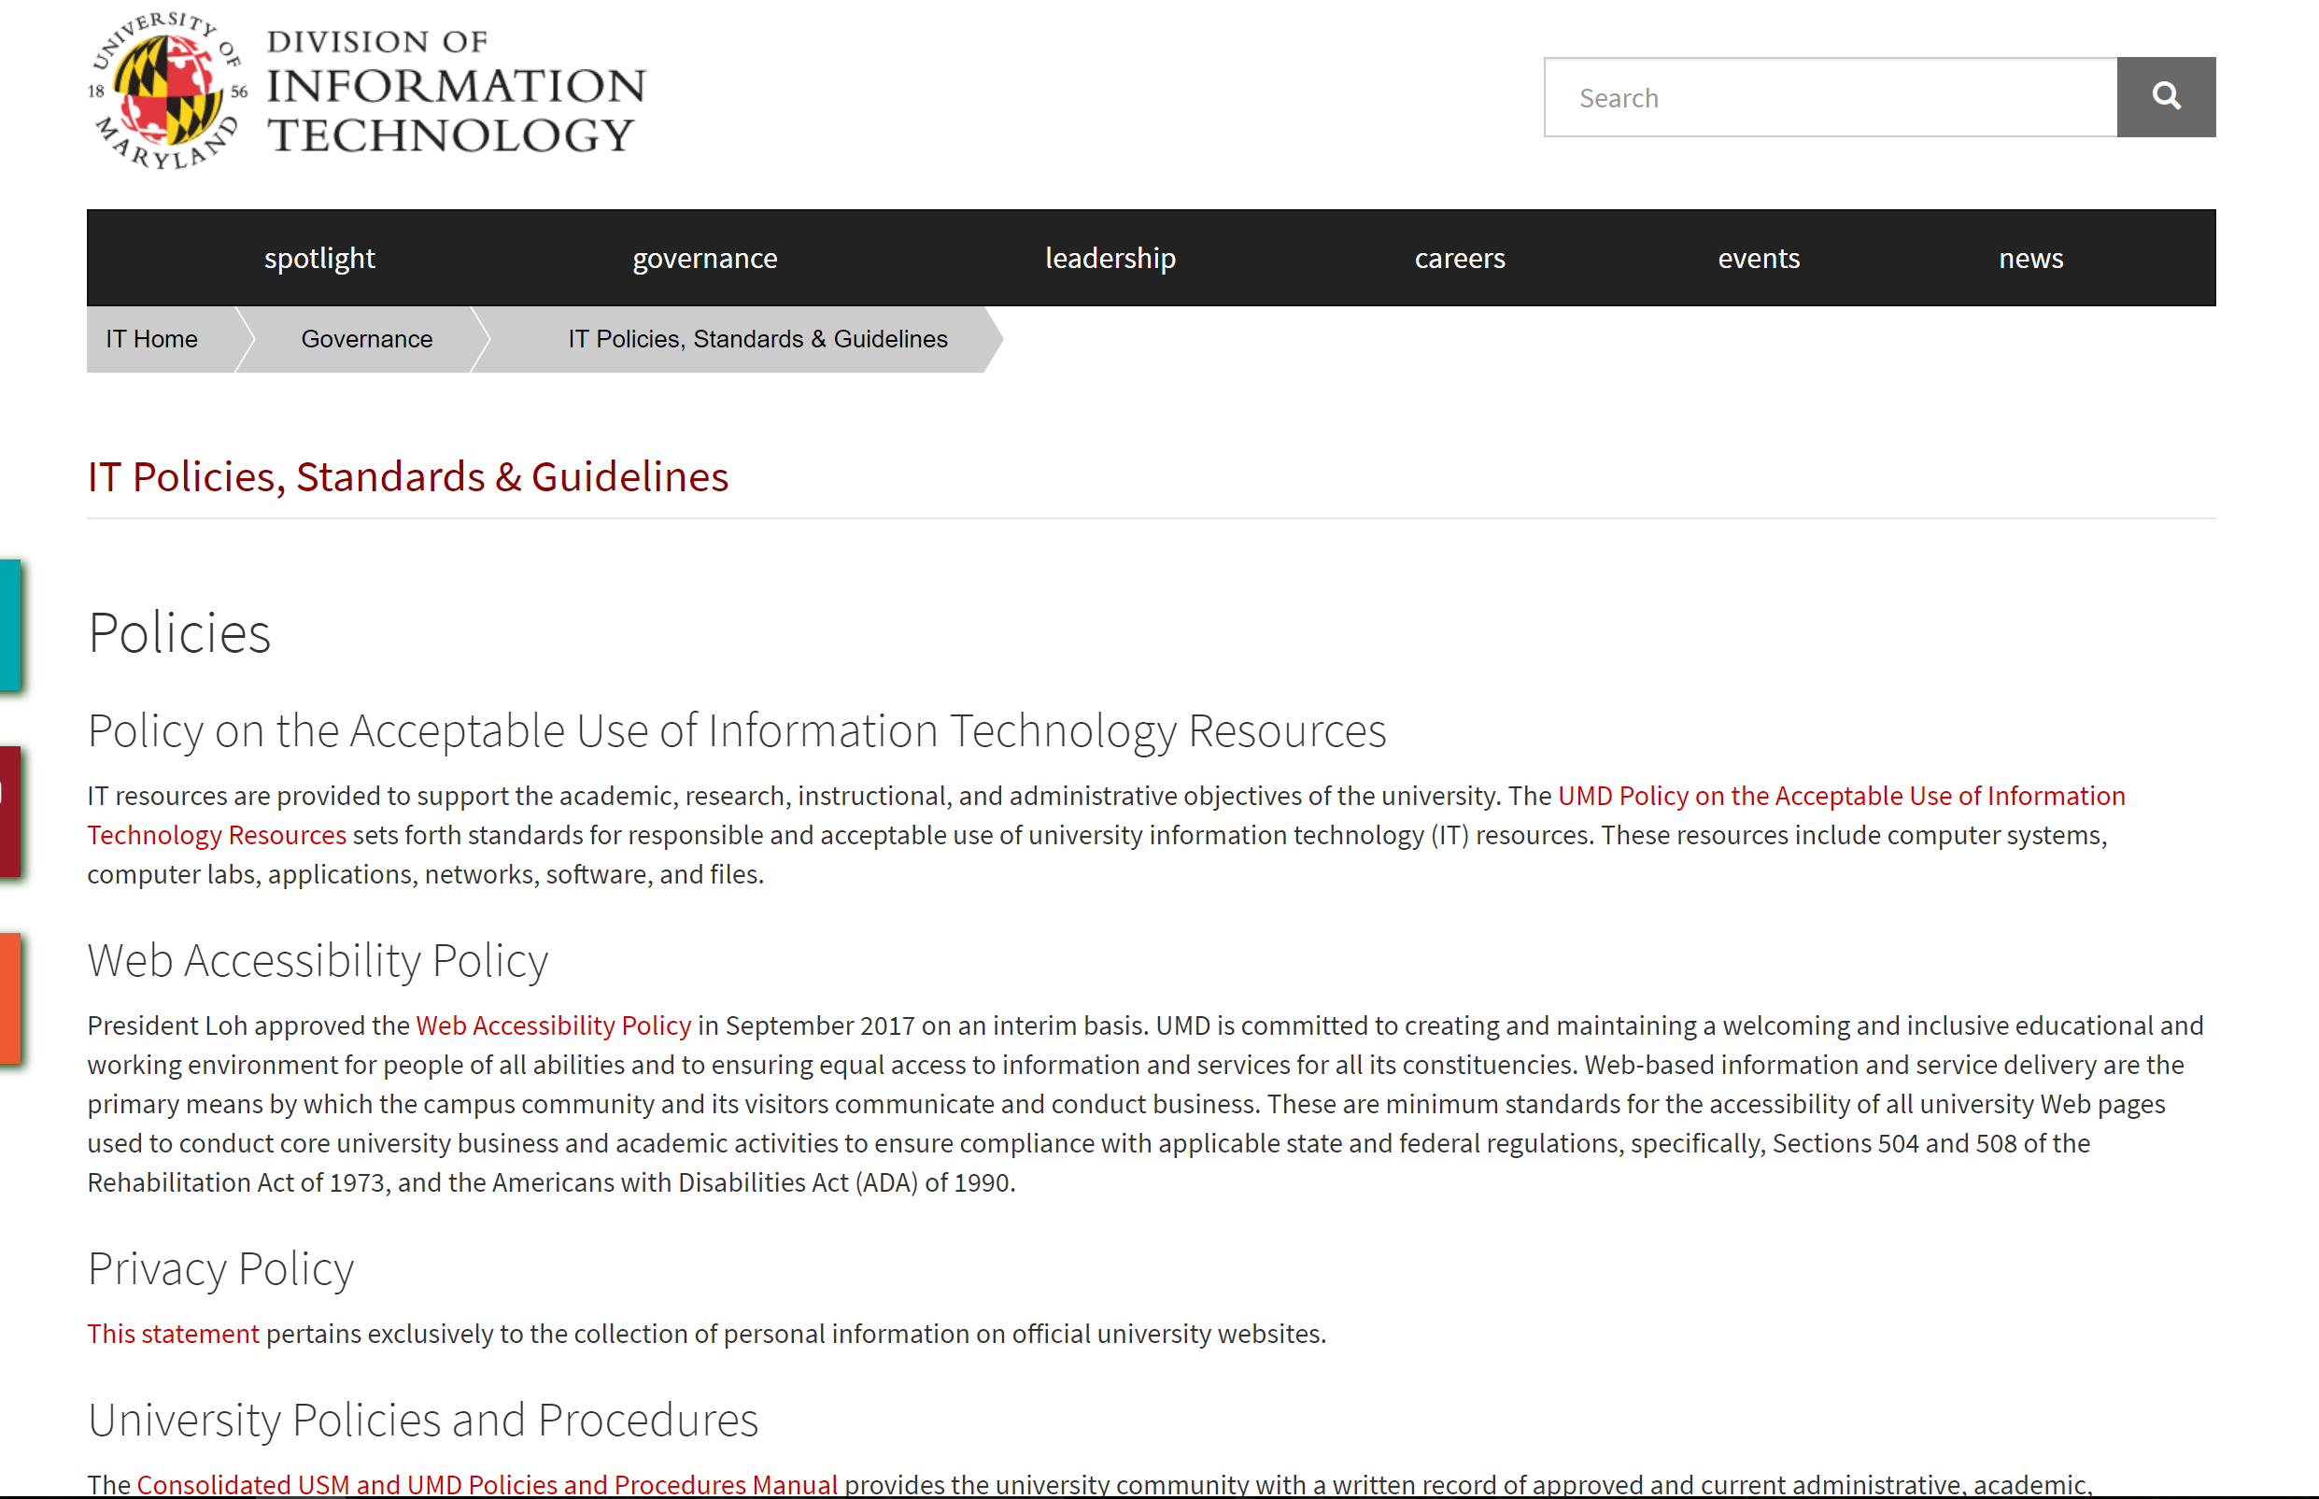
Data at UMD
How informed are you about the University of Maryland’s policies covering privacy, security, and web accessibility? Click here to view the policies

Slide 42
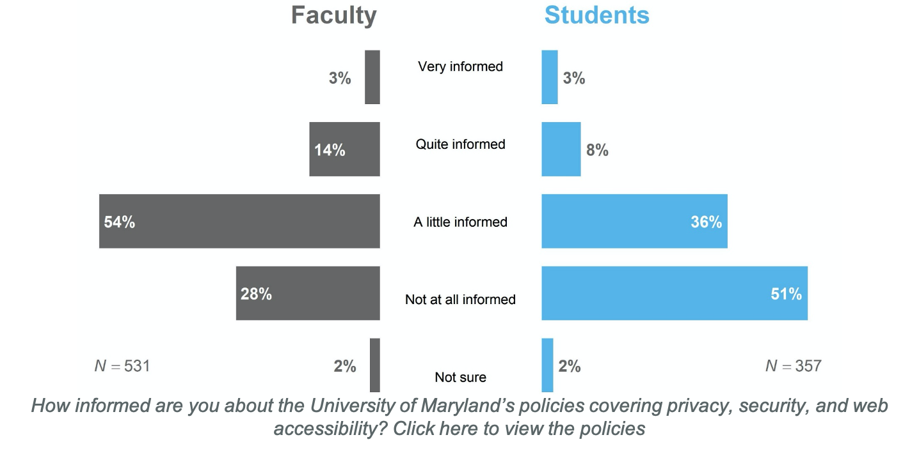
Data at UMD
Neither faculty nor students feel well informed about UMD’s data policies.

Slide 43
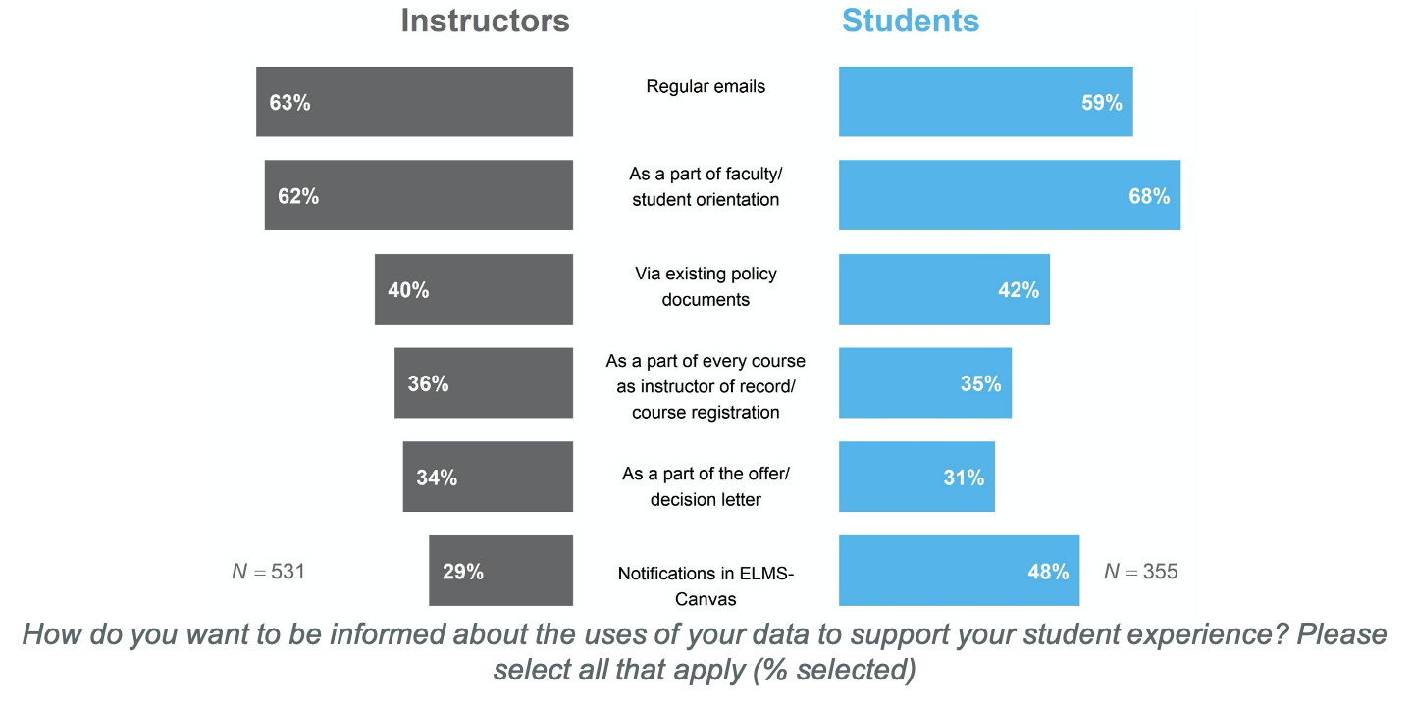
Data at UMD
Faculty and students want to be informed about UMD’s data policies early (i.e., at orientation) and often (i.e., regularly via ELMS-Canvas or email).

Slide 44
Student comments
We could have an online training for these topics in conjunction to the alcohol and sexual harassment trainings all incoming freshmen have to complete.
I believe being educated enough to understand the increasing information that will hopefully be provided to users of the many different platforms. If we don't understand what certain aspects mean, the information is useless. A freshman class or online class provided to all students for free would be a great accessible vehicle for this.
Notes:
Left: 2 student comments calling for UMD-sponsored education on the topic (there were more)
Right: student opinion on UMD data storage

Slide 45
Faculty comments
I am certainly unhappy about the University's choice to go with "G Suite for Education" to save money at the expense of privacy. When has DIT provided information sessions about what this means regarding privacy when folks are logged in to their academic GMAIL accounts?
I'm generally concerned about the use of enterprise Google services, specifically Google Drive being recommended for storing data and records related to research and teaching. I am also concerned about the move from Lynda.com to LinkedIn Learning as LinkedIn has a some specious claims regarding privacy and tracking.
Notes:
11 faculty members (20%) of comments mentioned google services and/or duo

Slide 46
Faculty comments
Like all terms of usage, UMD's policies are unreadable because they are written to satisfy lawyers. Please endeavor to add an Executive Summary or something like that which will enable the regular user to understand the University's policies.
Privacy should be a default because we don't have time to review conditions every time we want to access a service. The reason no one reads those policy documents is that they are long, technical, complicate ON PURPOSE. Default privacy, don't collect data unless we have specifically agreed to should be a given.
The amount of online policies is mind-boggling. There were over 20 different policies listed on the page that is linked in the first subsection of section 4 of this survey. And, like many other policies, they are written in such language and in such length that no one has the time to read these policies. Language and usability matters.
Notes:
There were several faculty comments on the unreadability of the current policies we linked to

Slide 47


Main findings
Neither geographic location nor instructional context greatly influences students’ perceptions of online privacy
Students have more lenient privacy attitudes and stronger privacy actions than faculty (consistent with other research, e.g., Miltgen & Peyrat-Guillard, 2013)
Notes:
US and UK responses generally similar in magnitude. Exceptions to US and UK similarities: UK students more likely to delete an account if provider tracked and shared data. So neither factor greatly affects the privacy calculus students perform
Why faculty and students different: faculty more financially independent (i.e., more choice), faculty have had more accounts hacked (i.e., experience), how online interactions viewed (human vs. computer entity)
So the general privacy paradox is probably true for older adults, but different for younger adults.

Slide 48


Implications
Communicate about privacy policy early and often
Create a privacy program that incorporates easy-to-find and understandable language
Co-develop best practices with stakeholders
Ensure vendor agreements meet privacy program standards
Educate, inform, and prepare students for digital environments
Notes:
The privacy program needs to go beyond regulatory and compliance requirements
Ohio State has a Chief Privacy officer that reports to the Chief security officer (Enterprise security) and Chief compliance officer for the office of university compliance and integrity
Co-development is important since opting out may not be an option, due to infrastructure, a vendor, or federal and state mandated reporting

Slide 49
Discussion
How do we engage in discussions around privacy that allow for the co-development of best practices among our stakeholders (faculty, students, and staff)?
In a perfect world, how might we promote privacy practices that are accessible (e.g., incorporate easy-to-find and understandable language)?
Given the need to respond quickly to changing realities, how do we ensure our vendor agreements reasonably meet privacy policy standards?
How can we better educate, inform, and prepare both students and faculty of the privacy-related implications of learning within digital environments?
Now that we are within a remote learning/teaching environment, what new privacy-related concerns need to be (re)considered?

Slide 50
Megan Masters, PhD | Alia Lancaster, PhD | Martyn Clark, PhD
acadtechfeedback@umd.edu

